Slide 1
Geography 2153 – Fall 2013
Environment, Economy and Society
“Science” in Environmental Decision Making
Jamie Baxter

Slide 2
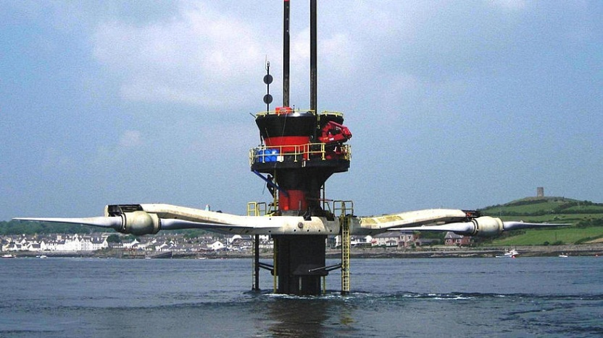
Outline
Science and the environment
Values and politics
Environmental Worldviews
Environmental Movements
"SeaGen“ tidal electric generator in Northern Ireland – installed 2008; generates 1.2 MW (wind turbines in Ontario average 2MW)

Slide 3
Science
What is science?
Identify key aspects of science that differentiate it from other forms of enquiry – e.g., every day or journalistic enquiry
See slide (password provided in lecture after discussion)

Slide 4
Scientific terminology
Hypothesis
An explanation that is based on testable observations and experiments and that can be accepted until such experiments prove otherwise
Experiment
An orderly procedure for verifying, refuting, or establishing the validity of an hypothesis and cause-effect relationships

Slide 5
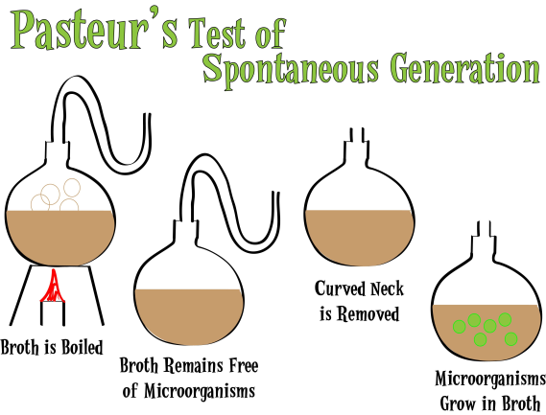
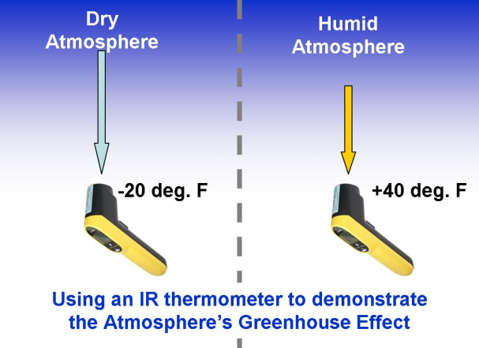
Types of Experiments
Manipulative
researcher has control over the variables in the experiment
Natural
observations of naturally occurring phenomena and looking for correlations
Is one preferred over the other as the basis for environmental decision-making?
What about for studying human populations?
Pasteur – master manipulator!
Natural experiment that supports the greenhouse effect hypothesis
Notes:
Much environmental research is not manipulative.

Slide 6
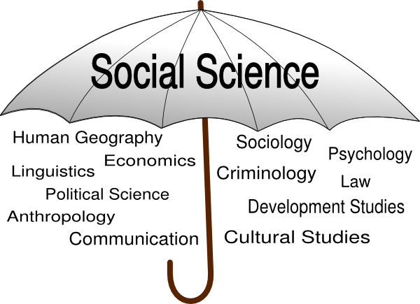
Science
What is social science?
Identify key aspects of social science that differentiate it from other forms of enquiry – e.g., every day or journalistic enquiry or science

Slide 7
Logic in “Science”
Theory
Empirical
Generalizations
Hypotheses
INDUCTION
DEDUCTION
Observations
Notes:
Observe swans, every one is white, hypothesize that all swans are white, observe more swans…so what does it mean when you find a black swan?

Slide 8
Social Science
Quantitative/Statistical
Research on the social world that tries to mimic the natural sciences
Uses numbers and statistics in the collection and analysis of data.
Qualitative/Interpretive
Uses mainly words and other non-numeric symbols in the collection and analysis of data.
Notes:
Both are legitimate and rigorous, but for different reasons…ones that are beyond the scope of this course.

Slide 9
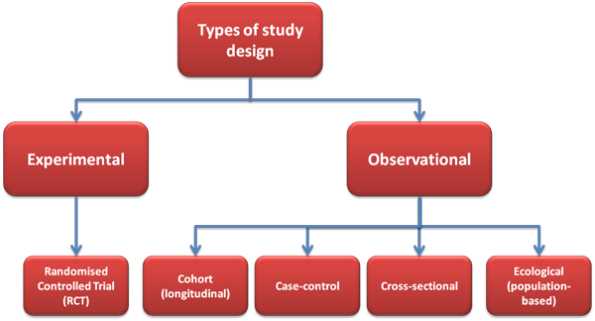
Studying Humans using Observational Designs for studying impacts on human health
Observational studies account for the fact that it is often unethical or impractical to manipulate humans and their environment
Epidemiologists and others use these designs to get the best estimates of environmental impacts on human health
Each design has inherent design weaknesses
The tools for studying human health impacts from environmental exposures (e.g., pollution, chemical contamination) are different from traditional laboratory science

Slide 10
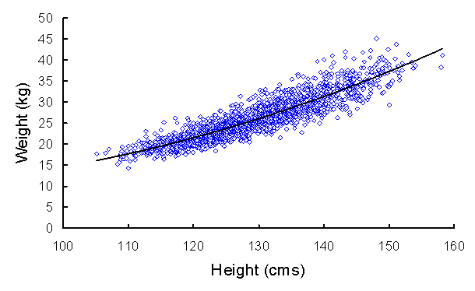
Science and Uncertainty
Probability
The quantitative foundation of most science and much of social science
Correlation
Degree to which two phenomena are associated
Due to their close correlation, height can be used instead of weight in dosing medications when weigh scales not available. Most correlations in research are not nearly this strong!
Notes:
Does correlation mean causation – i.e. that a causes b?

Slide 11
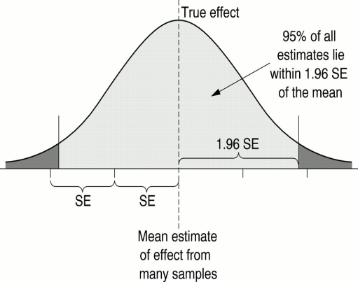
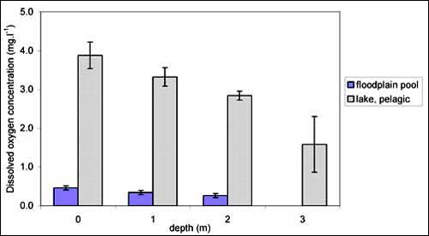
Science and Uncertainty
Standard Error
All measurement has error!
A statistical measure of variation between samples
Scientific conclusions are usually based on assumption of 95% accuracy (this is an oversimplification, but ample for our purposes)
When you see data, watch for error bars! If they don’t overlap likely statistically significant relationship

Slide 12
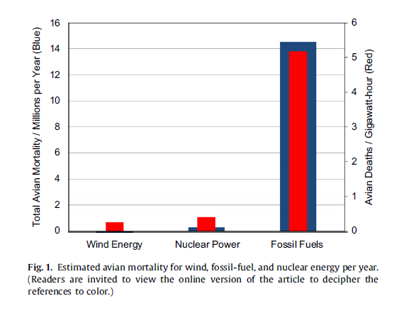
Science and Uncertainty
Assumptions
Science must simplify to make the world comprehensible
Scientists may disagree on the appropriate assumptions
Sovacool, B. (2009) Contextualizing avian mortality… Energy Policy, 37: 2241-48
But Willis et al (2010) disagree because the data are uncorrected for searcher efficiency and scavenger losses, should be between 0.65 and 1.46 for wind

Slide 13
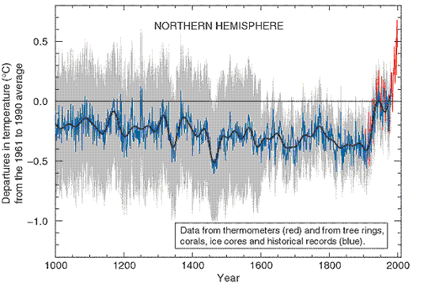
Science and Uncertainty
Measurement
All scientific measurements are approximations of the “real” world
Historic climate record has large error bars because it is a reconstruction using proxy measures like tree rings and ice cores
Source: Intergovernmental Panel on Climate Change 2001

Slide 14
Misunderstandings/Misuses of Science
Language of Certainty
Scientists shy away from saying they have proof
Theory
is a good thing
Lay language: “…it’s just a theory…”
Scientists aspire to develop (unfalsifiable) theory
News media are prone to use all-or-nothing language but scientists tend to use probabilistic language

Slide 15
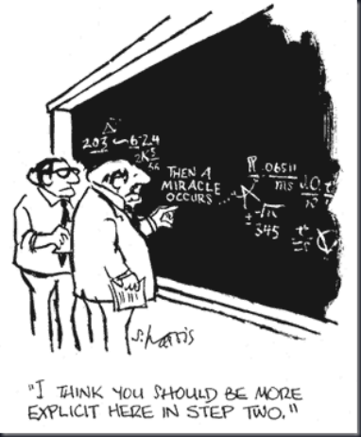
Misunderstandings/Misuses of Science
Science is not value-free
Scientists have biases (human values)
Choice of topic
Choice of method
Choice of research design and data collection methods
Actual data collection
Analysis of data
Interpretation of data
Conclusions
But objectivity is a goal
Pseudoscience
Research that is presented as science but lacks clear adherence to the scientific principles or otherwise lacks rigour and
may be guided too much by human values (working backwards from desired endpoints)
Thinking critically helps overcome bad decision-making

Slide 16
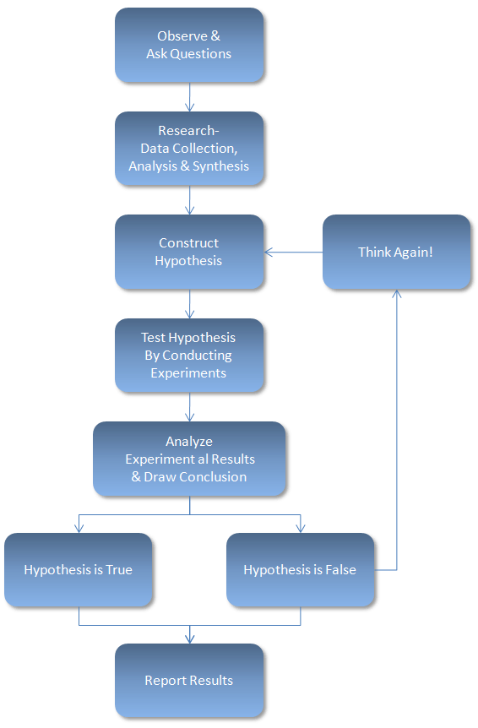
Misunderstandings/Misuses of Science
Science has to use the scientific method
This may not fully account for accidental discoveries (e.g., radiation)
Ecologists and geographers may not use this strict logic, but focus more on e.g. inductive/interpretive understanding
Scientific method

Slide 17
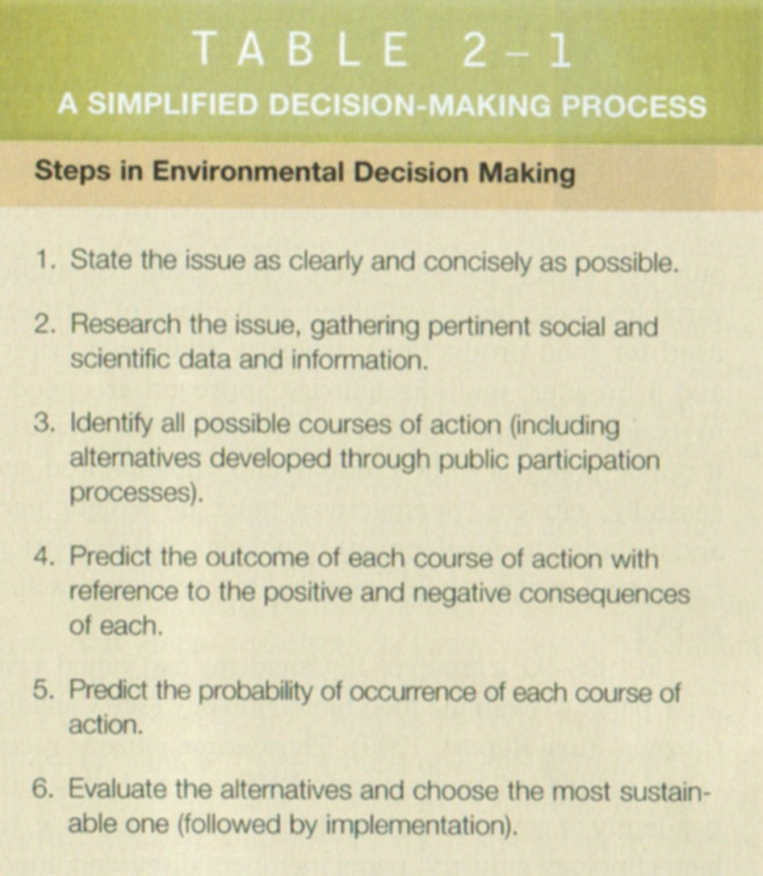
Misunderstandings/Misuses of Science
All problems can be resolved with science
Environmental problems are too complex to be solved by science alone
Most problems require invoking worldviews/values because there can never be enough science
Scientific method

Slide 18
Environmental Decision-making
There tends to be a tension in terms of policy change
Precautionary principle
Paralysis by analysis
Notes:
We “need more evidence” is a discourse often used to maintain the status quo. Which side of the diagram does this idea align with?

Slide 19
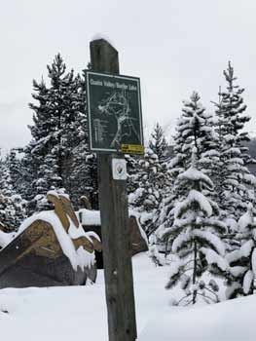
Expansionist Worldview
Wise management
Product of the enlightenment
Faith in science/technology to prevent/solve problems
Nature is a resource to be use
Nature is resilient
Conservation consonant with society values
Conservation is congruent with simultaneous use of the resource for human consumption
Hikers, dozers and bikers…It is legal (encouraged?) to draw resources from Kananaskis Country Alberta – forestry, gas, grazing, oil – this is one of the main outdoor recreational areas for Calgarians

Slide 20
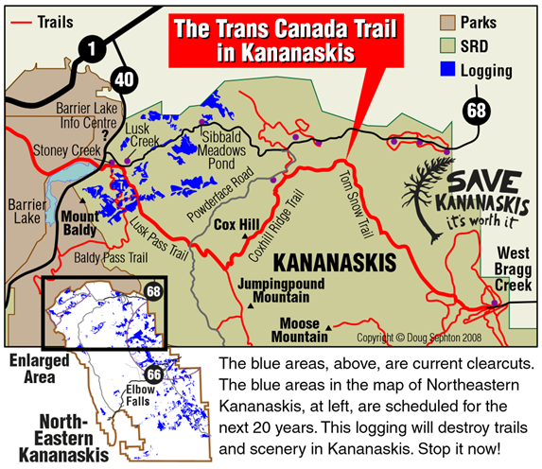
Ecological Worldview
Preservation or “righteous management” is a driving principle
Preservation is contrary to dominant human values
Nature has intrinsic value (not just use value – aka utility)
Biotic system must be protected
Ecosystem tightly linked and impacted by human use
Constrain human use according to limits of ecosystem (e.g., EF analysis)
Kananaskis is also a “battleground” for differences between expansionist and ecological worldviews.

Slide 21
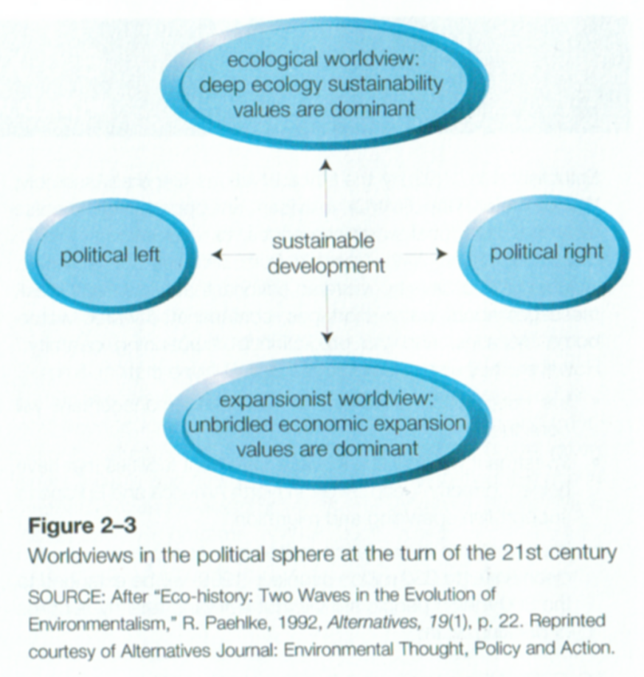
Politics and Worldviews
Politics in recent decades influenced as much by environmental worldviews as by traditional left-right political worldviews
Notes:
Blue greens

Slide 22
Politics and Worldviews
These to tend to refer mainly to social and economic policies
Left
market inadequate
government intervention to ensure human welfare
discourage free trade e.g., labour rights, environmental degradation
Right
unconstrained markets
minimal government intervention leads to human welfare
free trade/globalization

Slide 23
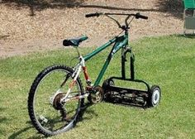
Politics and Worldviews Coalitions
eco-entrepreneurs
coalition: right & environmentalism
environmentally friendly/sound products/practices
profit motive
growth
coalition: labour (left - social equity) & capital (right - business)
increased growth - create/maintain jobs
labour still oppose free trade - cheaper labour south
equity often has priority over environment
eco-entrepreneurs
growth

Slide 24
Politics and Worldviews Coalitions
progressive (red) greens
coalition: left, social equity & environmentalism
united justice and threats to health
share costs and benefits more equitably
sharing benefits - i.e., jobs - most controversial
not motivated by profit so suspicious of corporate motives
progressive (red) greens

Slide 25
Environmental Worldviews in Geog2153
To which environmental worldview do you subscribe?
Text a letter to 37607 (you may have to text Geog2153 first to connect)
Expansionist/growth
Ecological
Progressive “red” green
Eco-entrepreneur
Not sure
Or
Respond at this link
Instructor:
activate the poll now
poll results here

Slide 26
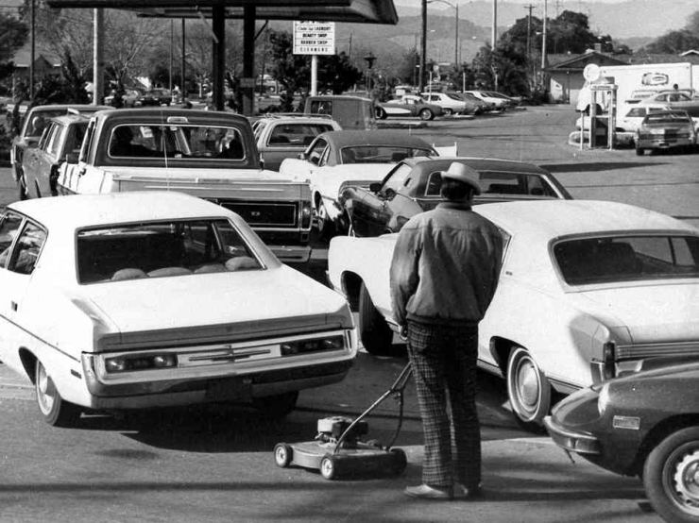
(Abridged) History of Modern Environmentalism
First Wave (1968-76)
Alienation from mainstream consumerism– “tune in turn on and drop out”
Anti-technology
Standards for emissions used as main policy solution – aka “end-of-pipe”
Building awareness of variety and depth of problems
Prominent issues: pollution, energy crisis, offshore oil drilling, nuclear power, overpopulation, resource depletion, urban neighbourhood preservation
Gas lines were common in the energy crises of the 1970s which underscored the political and economic aspects of global resource distribution

Slide 27
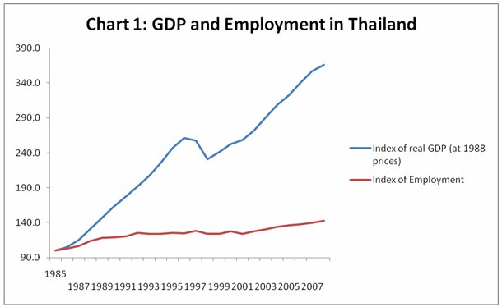
(Abridged) History of Modern Environmentalism
Second Wave (1985 - onward)
free trade agreements - e.g. U.S.-Canada Free Trade Agreement {FTA}, NAFTA, European Economic Community {EEC}
↑ pressure growth: create jobs
↑ pressure environment: e.g., lax environmental regulations developing countries
jobless growth
economic growth (e.g. ↑ GNP) without proportionate ↑ jobs
increased productivity - e.g., automation
Jobless growth puts a spotlight on inequities, and pressure on governments to stimulate job creation - which can in turn put pressure on loosening environmental regulations

Slide 28
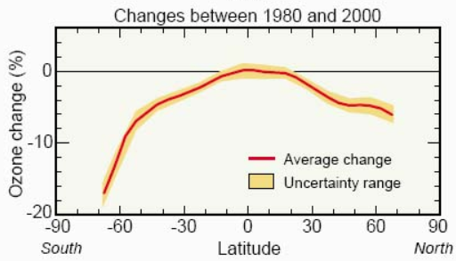
(Abridged) History of Modern Environmentalism
Second Wave (1985 - onward)
Re-emergence of preservationism
Increasing global concerns
Globalization – economies of countries worldwide more tightly linked
Environmental concerns go mainstream
Professionalization and influence of environmental organizations (e.g., Sierra club, Greenpeace)
Split between compromisers and deeper environmentalists
“Multiple tools” approach to policy change
Prominent issues: climate change, ozone depletion, old- growth forests, hazardous wastes – carcinogens, tanker spills, resource depletion, urban planning, auto use, indoor air
“Ozone hole” - Protective stratospheric ozone has declined most at the poles, particularly the south pole – greater radiation can result in dramatic changes to ecosystems – e.g., loss of plankton

Slide 29
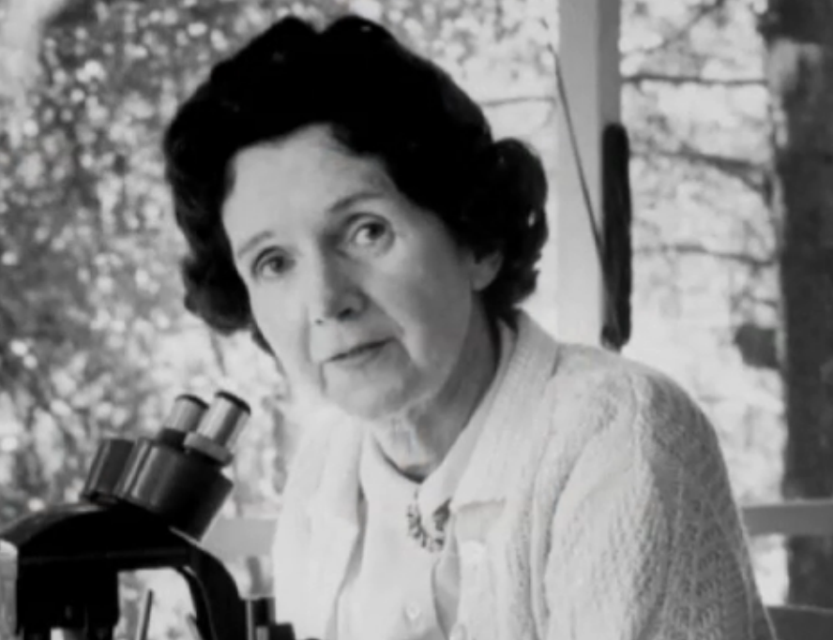
Science, Worldviews, and Environmentalism Rachel Carson and Pesticide Use Reduction
Rachel Carson considered architect of the modern environmental movement
Instrumental in banning of DDT (North America) and reduction of use of other pesticides worldwide
View 00:00–02:00 and 26:40-28:20
More on pesticides/DDT view this shorter PBS video.

Slide 30
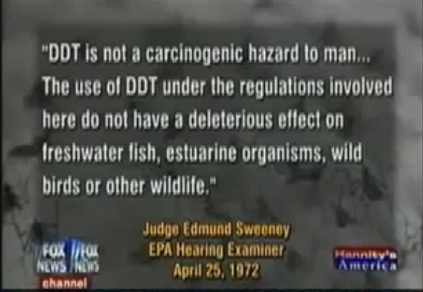
Science, Worldviews, and Environmentalism Rachel Carson and Pesticide Use Reduction
Indeed the World Health Organization, Sierra Club and others cautiously endorse DDT for indoor use in areas of high malaria risk
Comment on this using some of the terminology from this lecture
Recent politically-infused backlash against Carson and Silent Spring

Slide 31
Review
Which of the following best describes a characteristic of science
Text a letter to 37607 (you may have to text Geog2153 first to connect)
It is value-free
Scientists tend to use the language of “proof” rather than the pseudoscientific language of probability
Scientists aspire to develop theory
Errors in measurement can be reduce to zero if scientists are vigilant
Or
Respond at this link
No peeking back up the notes…
Instructor:
activate the poll now
poll results here
Notes:
chalmers

