Slide 1
Geography 2153 – Fall 2013
Environment, Economy and Society
Earth’s Life Support Systems and Human Population Growth (Ch 3 and 4)
Jamie Baxter

Slide 2
Outline
Nature’s building blocks
Ecosystems
Human impacts
Human population, environment and development

Slide 3
Nature’s Building Blocks
Matter
2 chemical forms: i) elements; ii) compounds
the Earth is a “closed system” for matter, which is of both “high quality” and “low quality”
- low quality matter: little potential use as a resource; it is either dispersed or diluted (in oceans or atmospheres) or too far underground
- high quality matter: usually concentrated and organized; found at or near the Earth's surface (such as coal) and has high resource potential
organic inorganic
Aluminum ore = lower quality
Aluminum can = high quality
Notes:
Link these concepts back to our definition of “resource”.

Slide 4
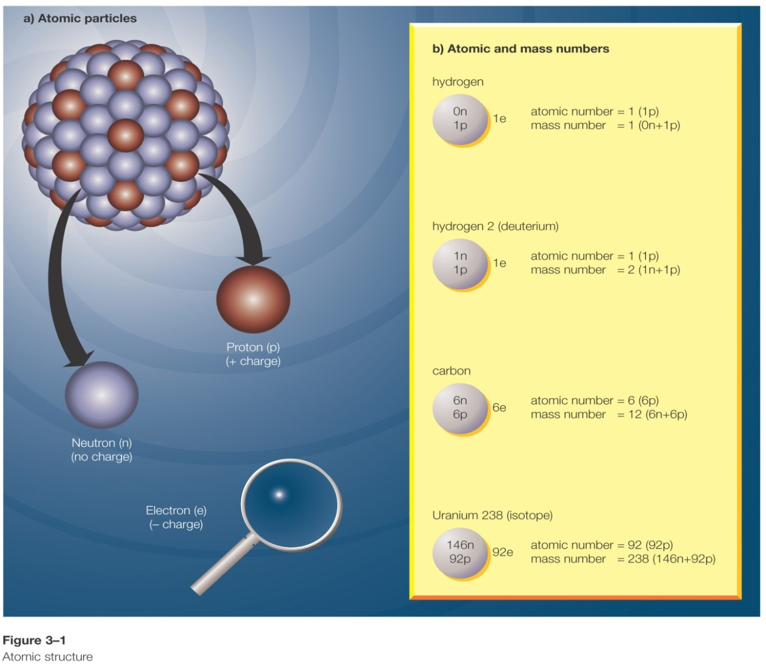
Nature’s Building Blocks
Atoms
Ions
Protons
Neutrons
Electrons

Slide 5
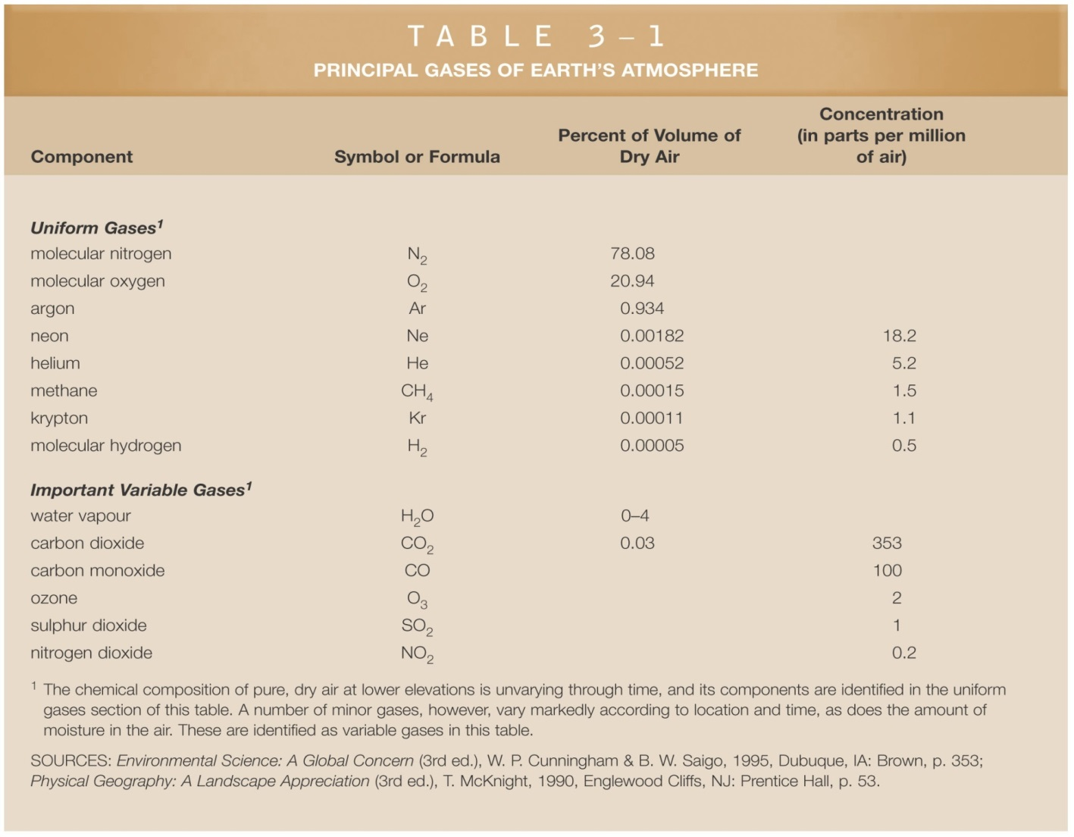
Earth’s Gases
In terms of environmental change, it is the variable gases that tend to be most important – i.e. “variable” over time and space

Slide 6
Nature’s Building Blocks
Energy
2 forms: i) kinetic (e.g., wind); ii) potential (e.g., coal)
Energy, the ability or capacity to do work, is of two qualities:
- high quality energy: high velocity wind or coal, natural gas energy
- low quality energy: dispersed and of lesser value for work (ocean energy)
Notes:
Is all coal/natural gas a “resource” by virtue of being high quality?
Is the quality of the energy the only think that is important?

Slide 7
Nature’s Building Blocks
Physical and chemical changes
Law of conservation of matter (mass)
- matter may change form, but it can neither be created nor destroyed (e.g., products of incomplete combustion from incineration)
First law of thermodynamics
- energy may be changed or moved from place to place, but during physical or chemical change it can neither be created nor destroyed
Two chemicals may combine to produce precipitate, but the weight unchanged
“No physics teachers were harmed in the making of this film”
Notes:
How does the first law of thermodynamics – aka the principle of the conservation of energy – mean for our course?

Slide 8
Nature’s Building Blocks
Second law of thermodynamics
each change in energy, results in degradation to less useful forms
incandescent light bulb: 90% of the energy is dispersed heat (low quality energy) ; only 10% is used for light (high quality energy
Entropy:
measure of disorder
high quality energy has low entropy and low quality energy has high entropy
increases over time – moving slowly towards a low-energy (high disorder) system
90% energy is lost as heat
30% energy is lost as heat
Notes:
Sure, these are oversimplifications, but good enough for our purposes.
How does this relate to burning biomass (wood) or fossil fuels?

Slide 9
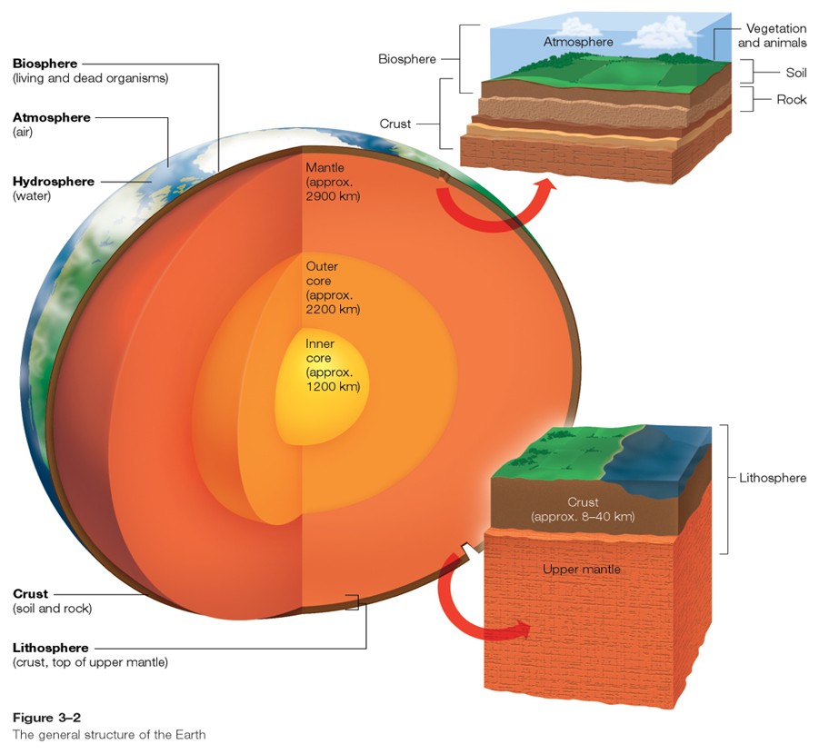
Earth’s Major Components
Atmosphere
troposphere
stratosphere
ozone layer
Biosphere
Hydrosphere
Lithosphere

Slide 10
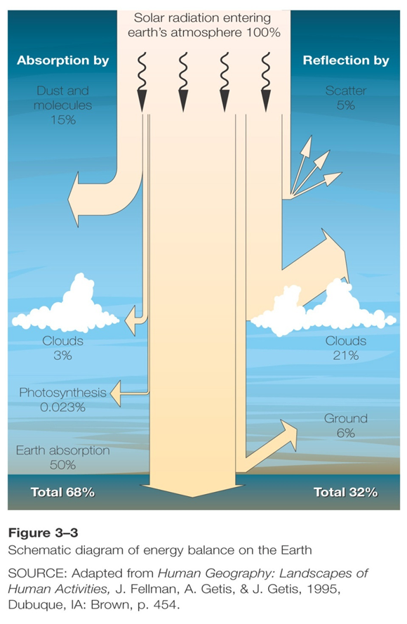
Earth’s Major Components
Energy Balance
Understanding the energy balance provides the foundation for understanding environmental problems like climate change
Processes – absorption, reflection
Notes:
What global environmental issue(s) relate directly to the energy balance?

Slide 11
Review
Which best describes the law of the conservation of matter
Text a Geog2153 to 37607 to initiate a session if you have not done so already
all matter must be conserved to maintain biodiversity
energy may be changed but it can neither be created nor destroyed
matter may change form, but it can neither be created nor destroyed
matter is created from the powerful energy of the sun, so it needs to be conserved in ecosystems
Or
Respond at this link
No peeking back up the notes…
poll results here

Slide 12
Ecology
study of interactions of living (biotic) organisms with one another and with their nonliving (abiotic) environment of matter and energy
Levels of organization:
biome – the collection of ecosystem environments
ecosystem – grasslands, wetlands (multiple communities)
community – alpine meadow (multiple species)
population – group of individuals of the same species
organism – a single member of a species
Increasing organization

Slide 13
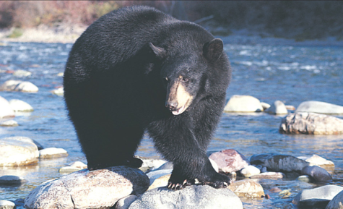
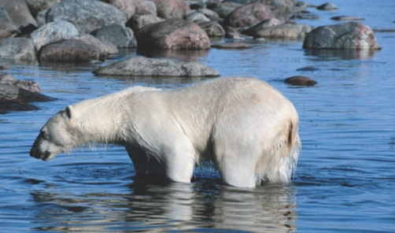
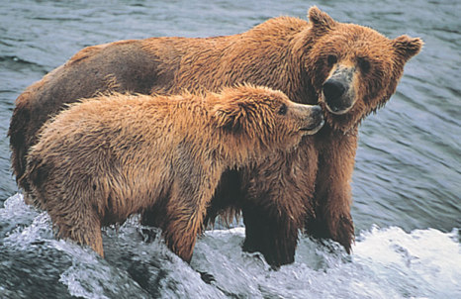
Biodiversity
3 classifications of biodiversity:
species biodiversity
the number of different species and their relative abundance
ecological diversity
the variety of biological communities that interact with one another and with their non-living environments
human cultural
variety of human cultures that represent our adaptability in the face of changing conditions
In North America, 4 species in genus “ursus” is enough diversity? Does science tell us?

Slide 14
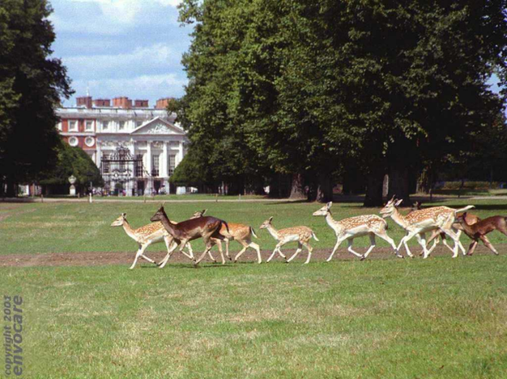
Components and Structure of Ecosystems
Interspecific competition
Competitive exclusion principle
Law of tolerance (e.g., temp.)
Limiting factor principle (e.g., food)
Threshold effect (re: sepcies extinction)
Indicator species (e.g., lichens sensitive to heavy metals) and keystone species (e.g., beaver)
Deer on campus: Humans cause the competitive exclusion principle to take effect more than any other species
Notes:
All of these are defined in your textbook
Together they describe the vulnerability of ecosystems to shocks – e.g., if humans competitively exclude keystone species there can be devastating effects on an ecosystem

Slide 15
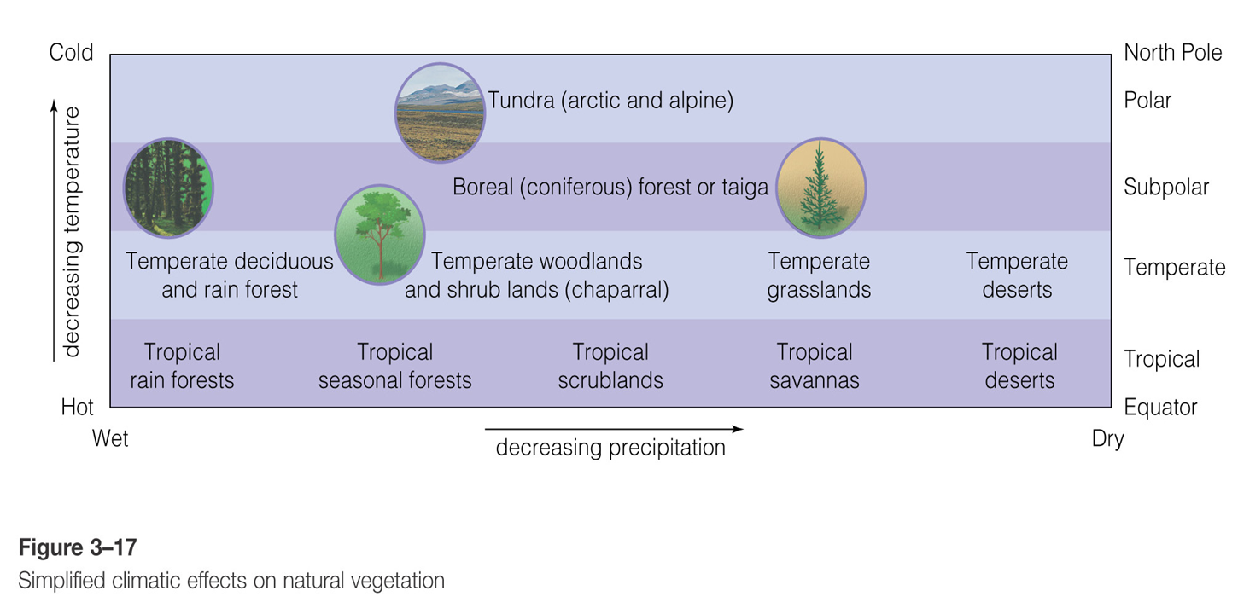
Limiting Factors
Temperature and precipitation

Slide 16
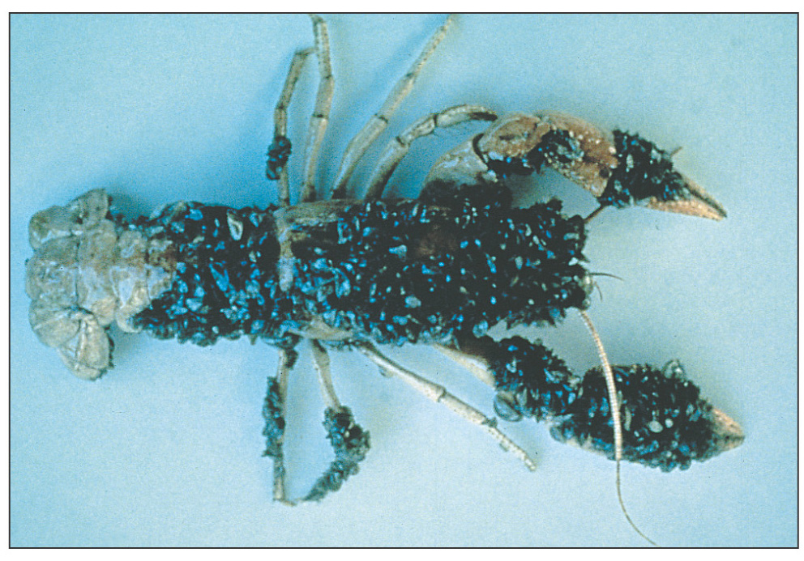
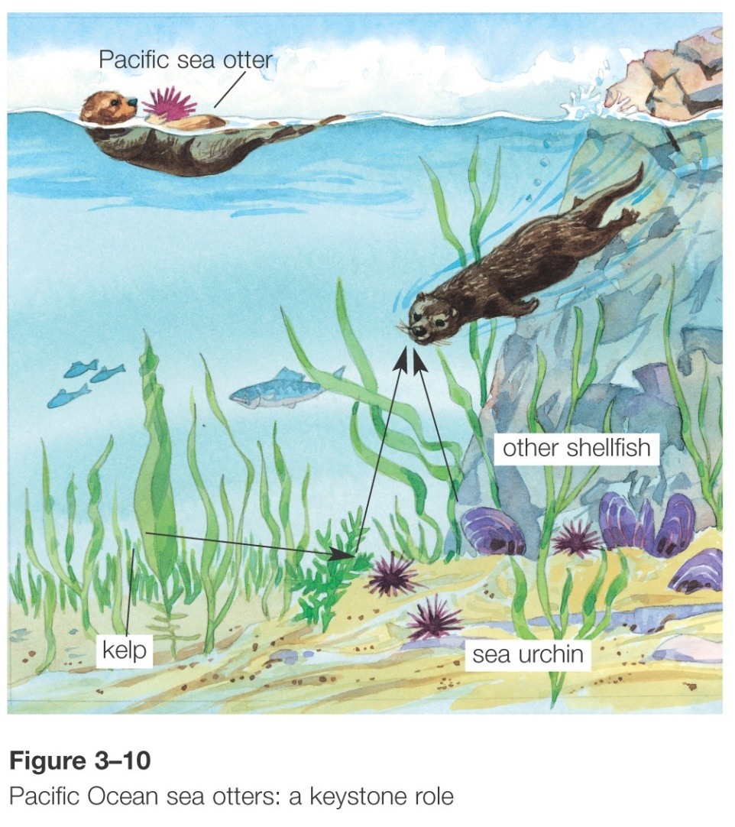
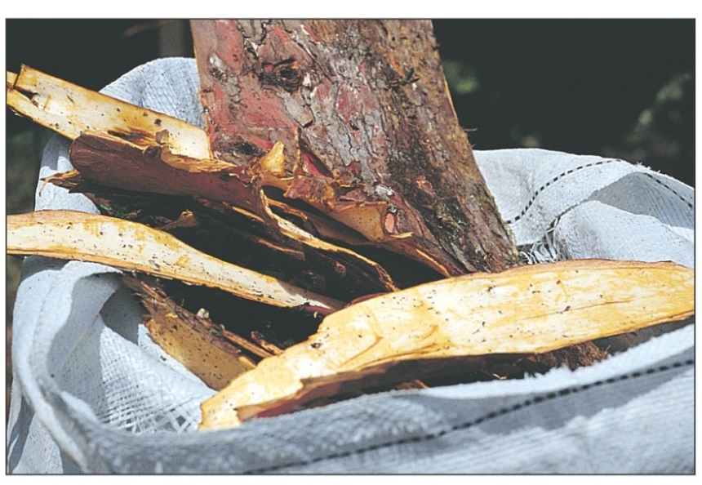
Exotic species: zebra muscles on crayfish
Keystone species: otters prevent sea urchins from destroying kelp roots
Medicinal species: pacific yew bark for cancer treatment

Slide 17
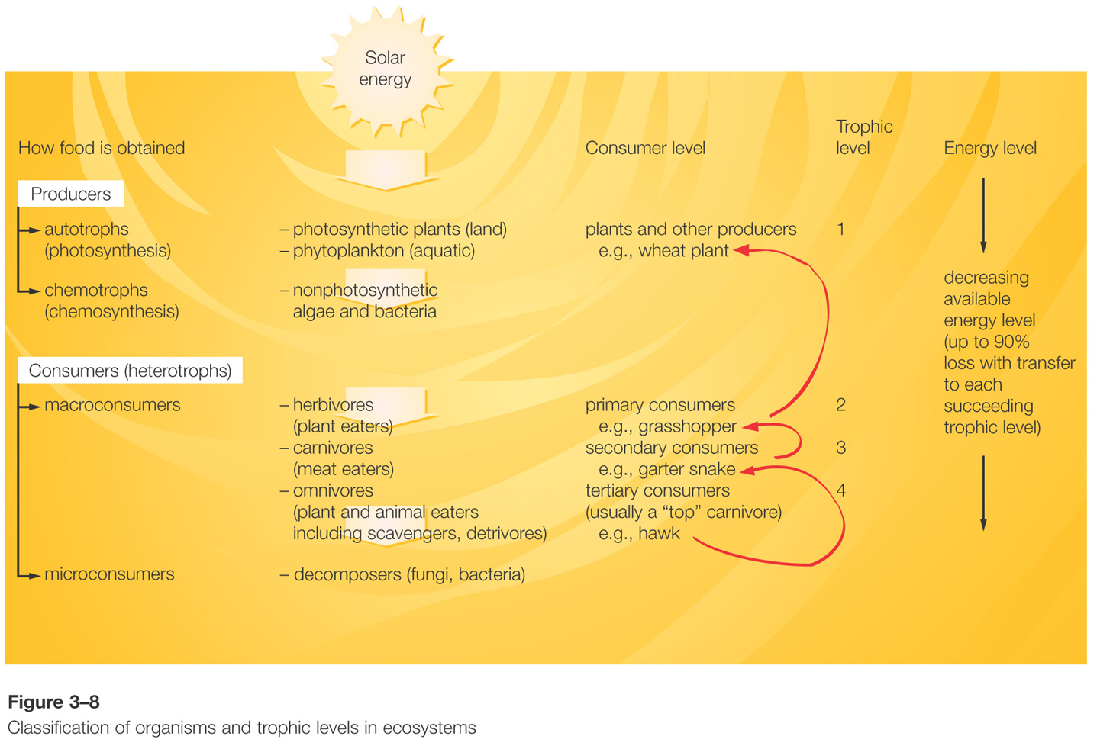
Ecosystems
Though much energy is available from the sun
Energy is lost at each successive trophic level

Slide 18
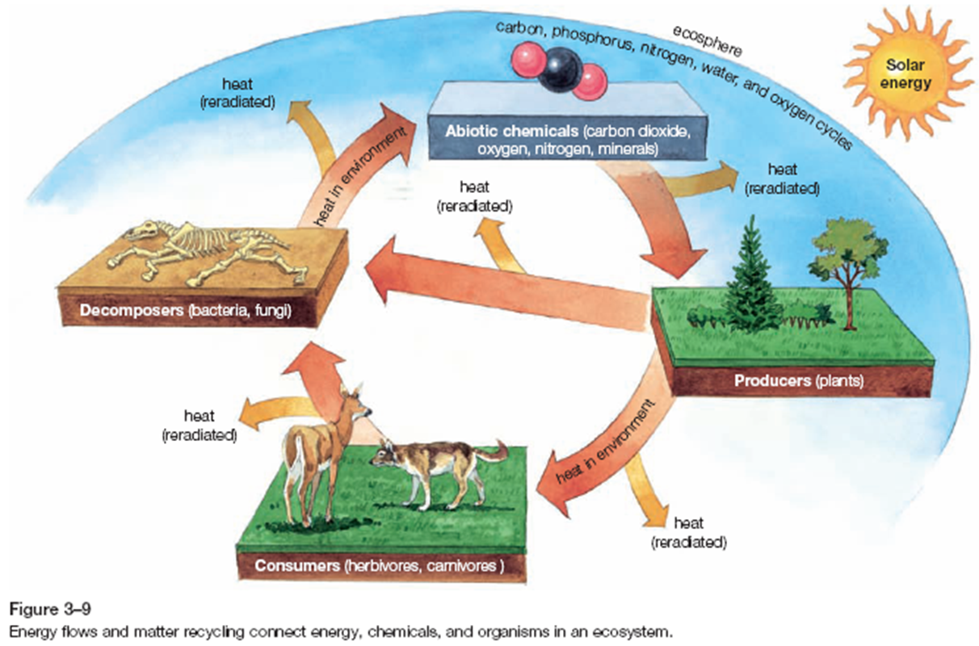
Energy Flows in Ecosystems
Notes:
Again…lots of energy lost as heat

Slide 19
Matter Cycling in Ecosystems
Nutrient cycles
- biogeochemical cycles; the means by which nutrient elements and their compounds cycle continuously through the atmosphere, hydrosphere, lithosphere, and biosphere
5 main nutrient cycles (driven by solar energy and gravity)
carbon cycle
nitrogen cycle
phosphorous cycle
hydrologic cycle
oxygen cycle
(think about how humans impact/interrupt each cycle)

Slide 20
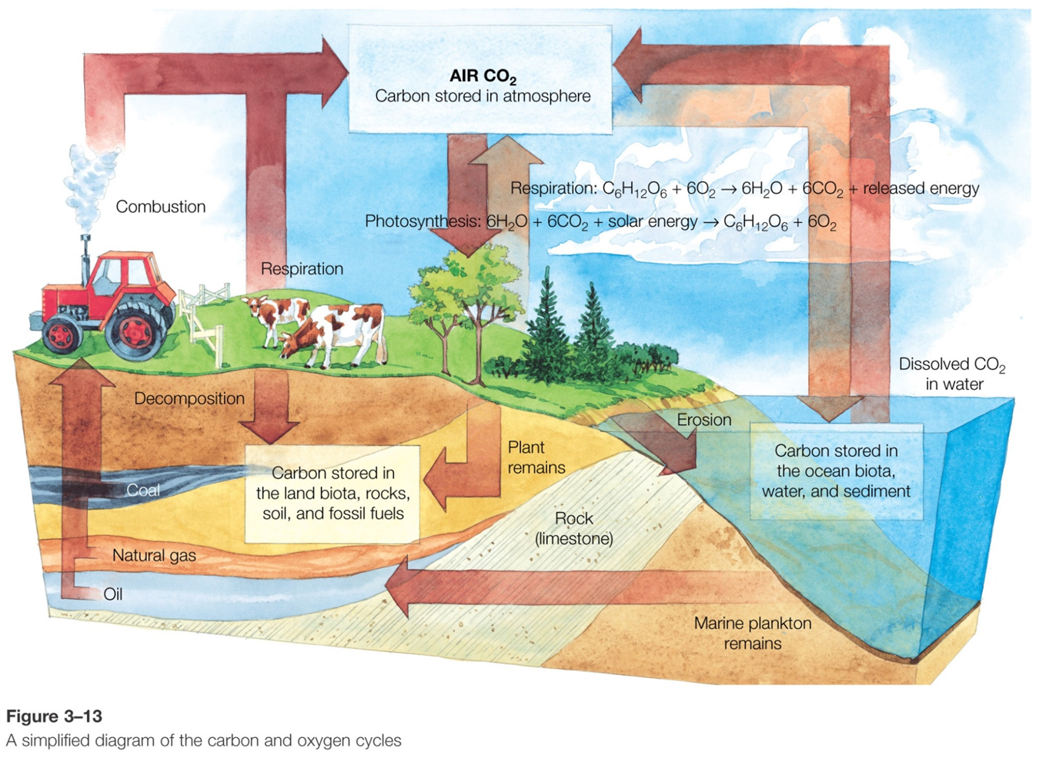
Notes:
How do humans interrupt this cycle?

Slide 21
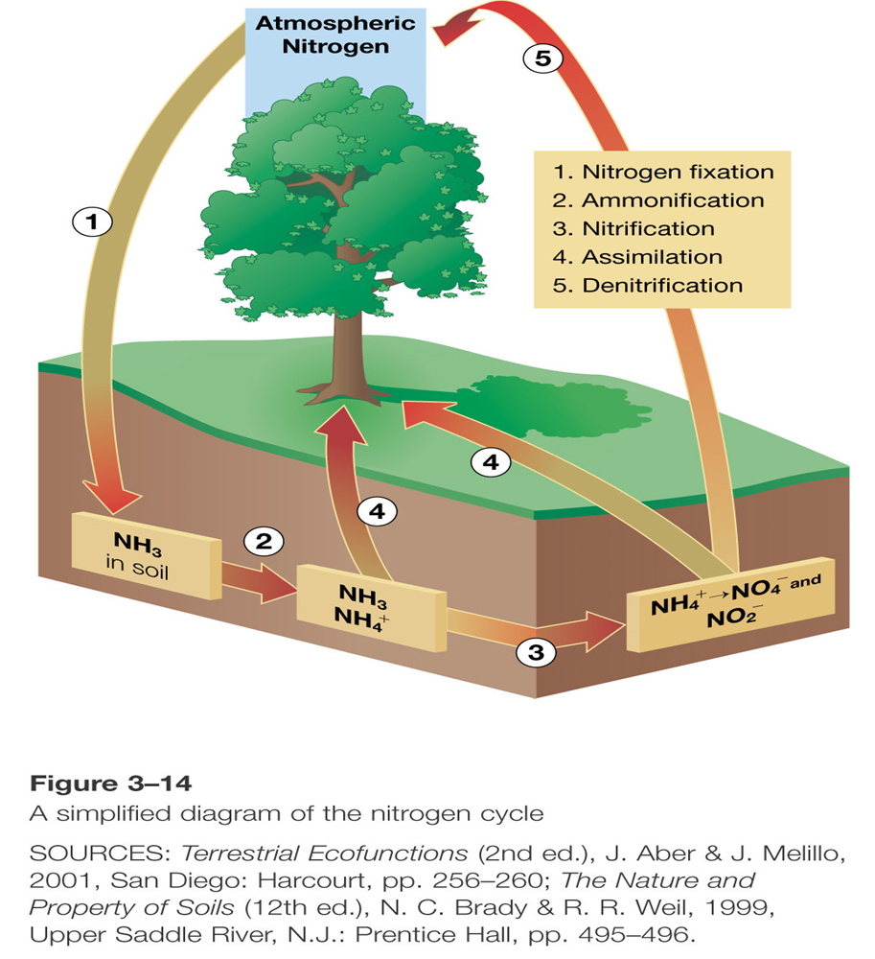
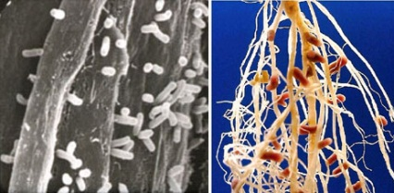
Nitrogen is stored in plants so when it is burned (including fossil fuels) nitrogen releases can lead to (nitric) acid rain
Rhizobia – bacteria are symbiotic with plants like clover and “fix” N₂ from atmosphere into the soil to covert it to ammonia (NH₃)
Nitrogen in fertilizer can leach into aquatic ecosystems (see hydrologic cycle) and (over)stimulate plant growth which can lead to eutrophication
Notes:
How do humans interrupt this cycle?

Slide 22
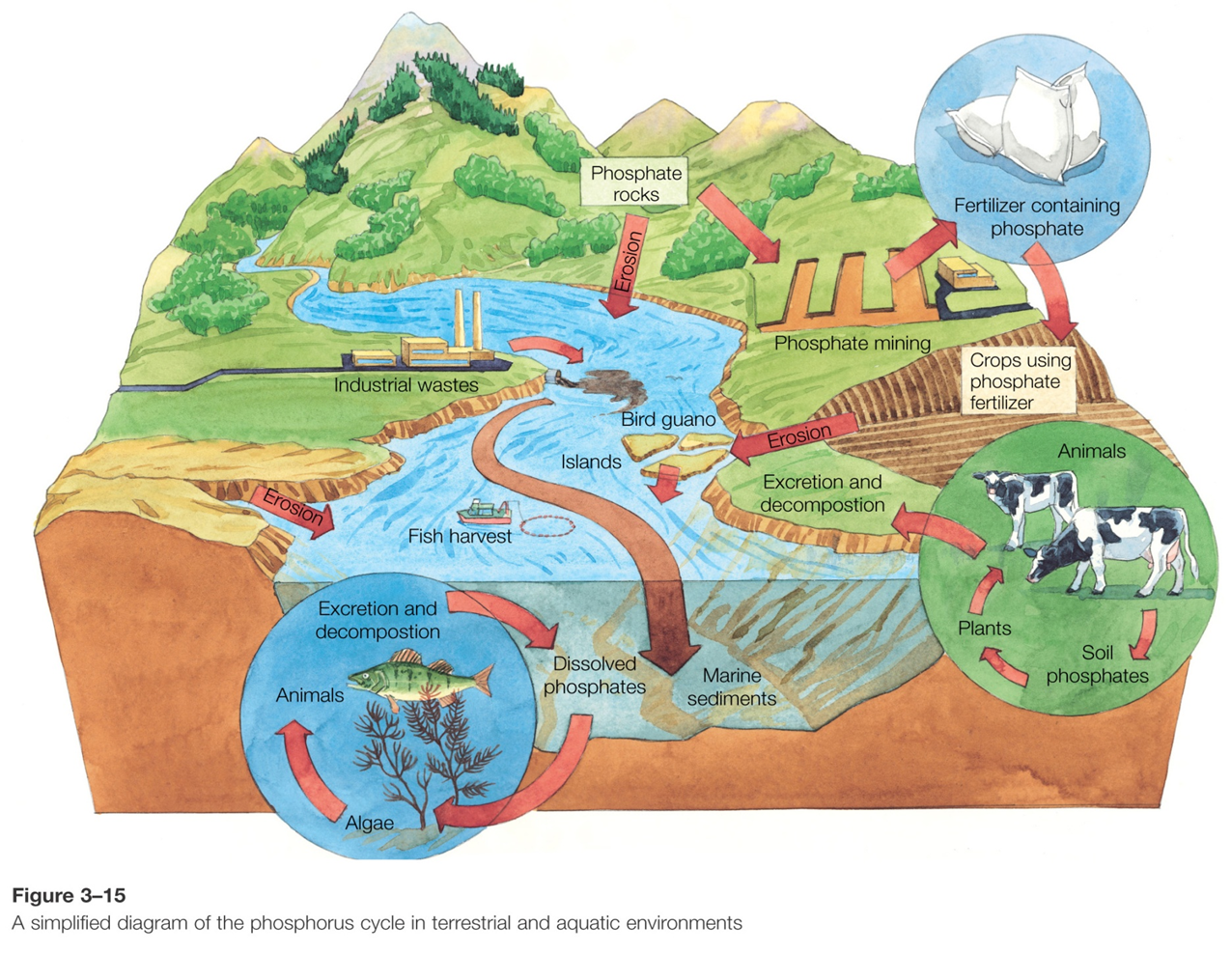
Because phosphorus is not present in the atmosphere, it is often a limiting nutrient in various ecosystems…that said it can over accumulate…
Phosphorus in fertilizer can leach into aquatic ecosystems (see hydrologic cycle) and (over)stimulate plant growth which can lead to eutrophication
Notes:
How do humans interrupt this cycle?

Slide 23
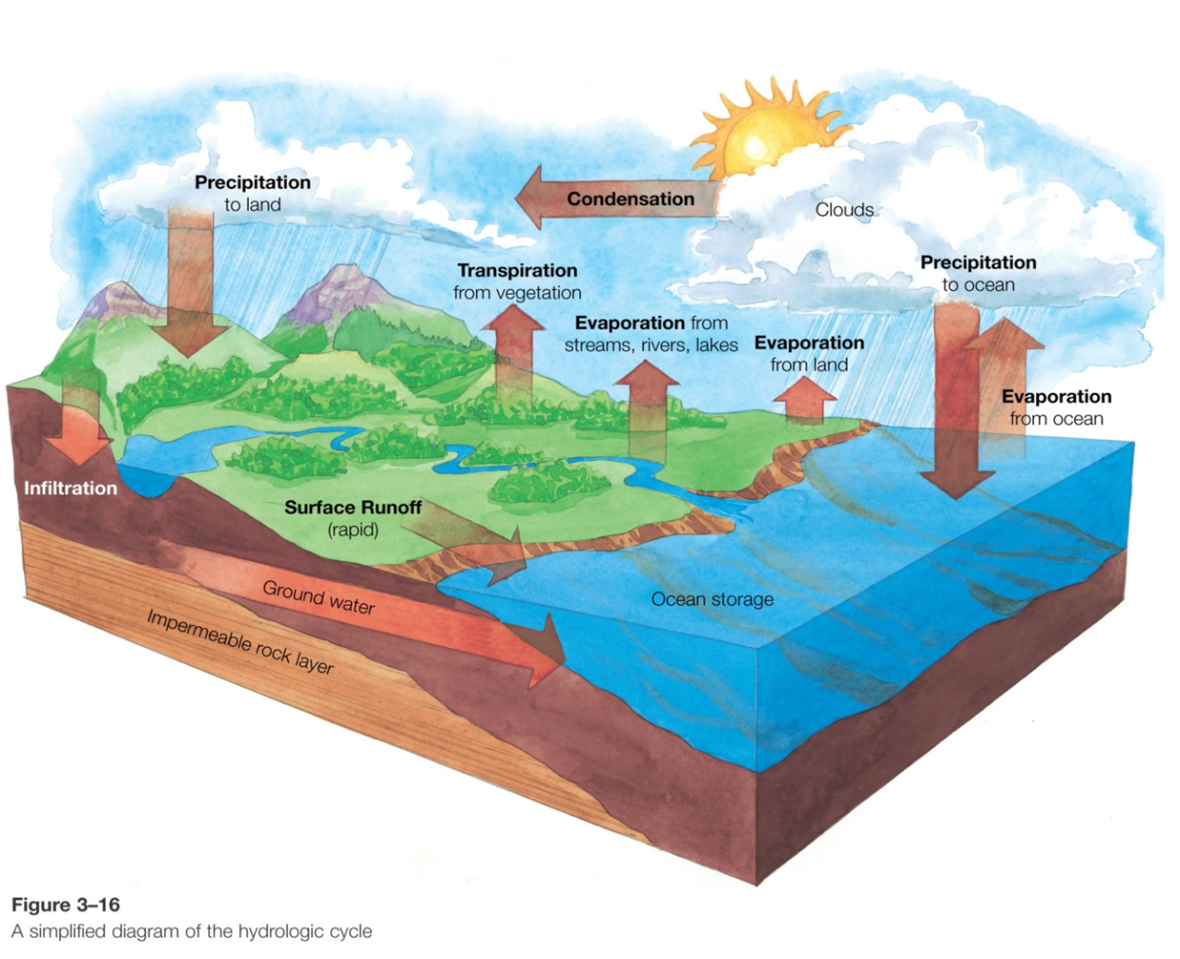
Built up areas (paving) accelerate surface runoff and erosion
Notes:
How do humans interrupt this cycle?

Slide 24
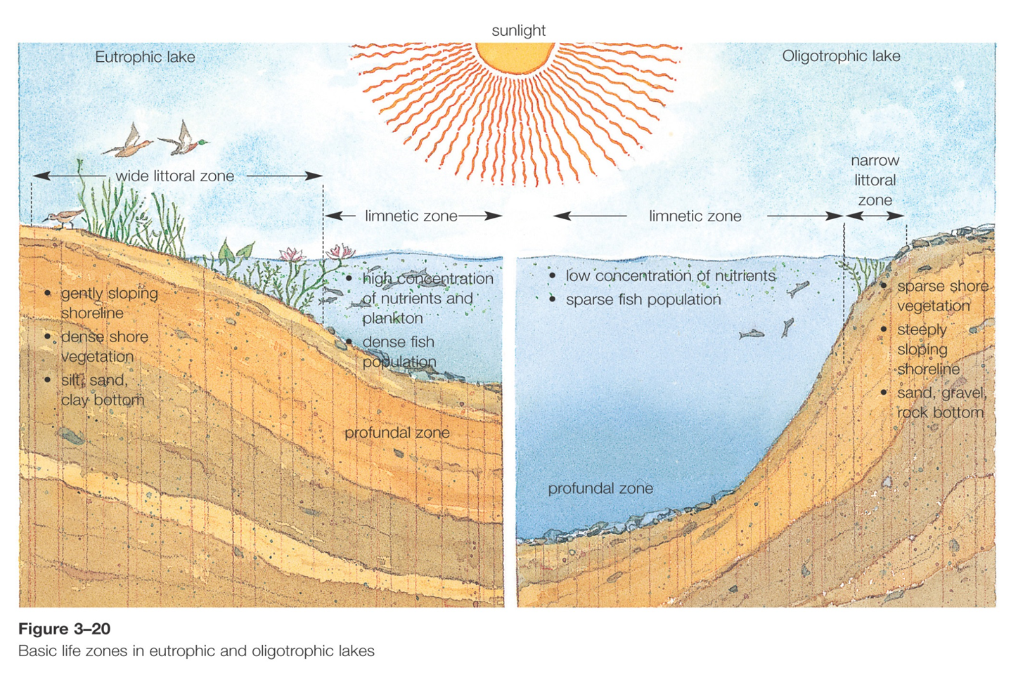
Marine Ecosystems
Natural eutrophication is slow (good), human eutrophication is rapid (bad)

Slide 25
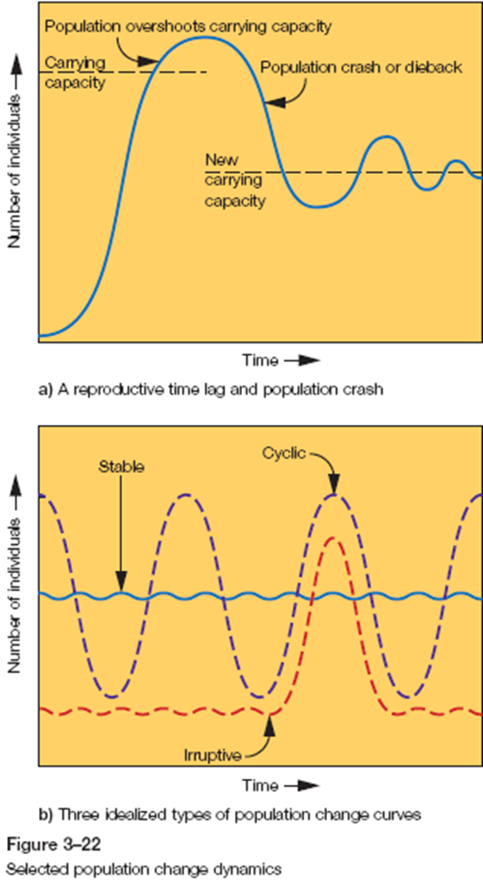
Constancy of Change
The only “constancy” in nature is change - a “non-changing system” is likely a dead system!
Population dynamics
biotic potential: the maximum rate at which a population can increase (exponential under ideal conditions)
environmental resistance: limits set by the environment that prevent populations from increasing indefinitely at an exponential rate

Slide 26
Review
Up to 90% of energy is lost when transferred from one trophic level to another e.g., from producers to primary consumers
Text a code to 37607 (text Geog2153 first if your session is not yet open today)
True
False
Or
Respond at this link
No peeking back up the notes…
poll results here

Slide 27
Review
A limiting factor is a biotic component that prevents the growth of a population even when all other abiotic factors are at or near optimum range.
Text a code to 37607 (text Geog2153 first if your session is not yet open today)
True
False
Or
Respond at this link
No peeking back up the notes…
poll results here
Notes:
Can it be a non-biotic component instead?

Slide 28
Human Impacts on Ecosystems Summary Ch 3
Principle of connectedness:
humans as part of ecosystems
Features of living systems:
interdependence, diversity, resilience, adaptability, unpredictability, limits
Working with nature
Examples of human impacts

Slide 29
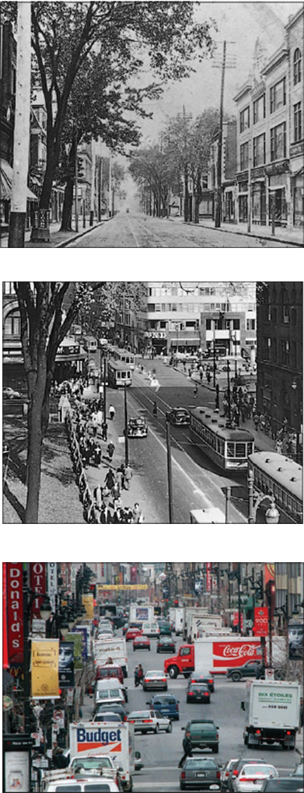
Human population, environment and development (Ch 4)
Population growth and environmental pressures:
Paul Erlich:
Impact = Population + Affluence + Technology
an increase in the total number of people or an increase in individual impact on the environment results in increased total human impact
advances in technology have increased individual and total human impact (and potential for impact)
Impact of affluence on Rue Ste. Catherine Montréal
Notes:
Is this the only role for technology?

Slide 30
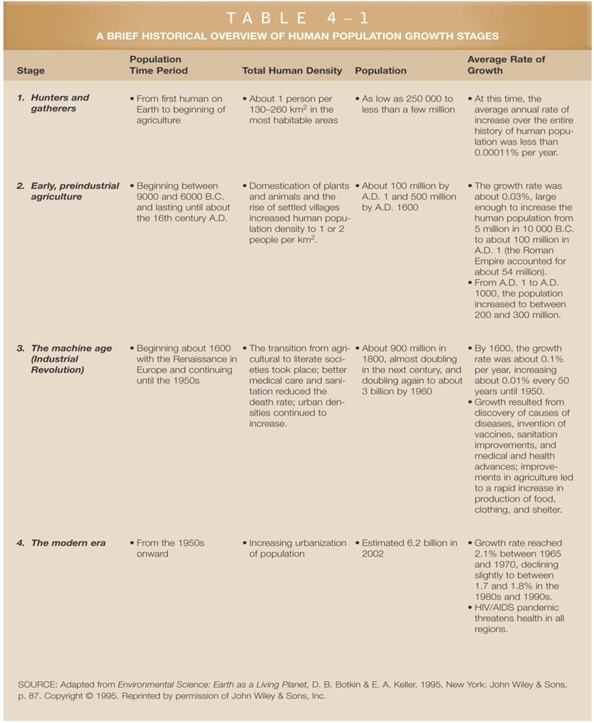
Human Demography and Population Dynamics
Demography
the scientific study of the characteristics and changes in the size and structure of human populations
Historical growth stages of human population
Hunter/gatherer
Pre-industrial agriculture
Industrial revolution
Modern era (unprecedented population growth)

Slide 31
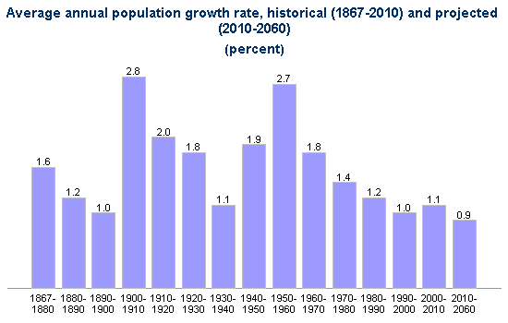
Human Demography and Population Dynamics
Basic population dynamic calculations
Crude growth rate (N) or natural increase = crude birth rate – crude death rate e.g. Can 2010 = 11.3 - 7.3 = 4.0
Can 2008 = 11.1 - 7.2 = 3.9
(Annual or other time period) growth rate = (∆ N / N ) x 100 e.g., 2008-2010 = (0.1/4.0) x 100 = 2.5%
Infant Mortality Rate = deaths of infants < 1 yr of age / 1000 live births
Notes:
Crude because it ignores the age and sex composition of the population

Slide 32
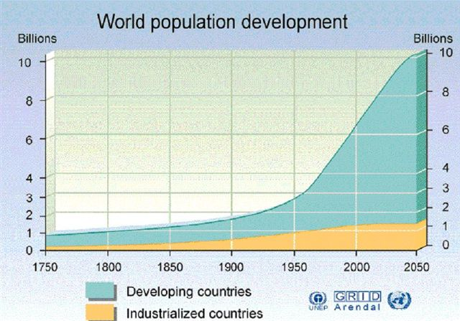
Human Demography and Population Dynamics

Slide 33
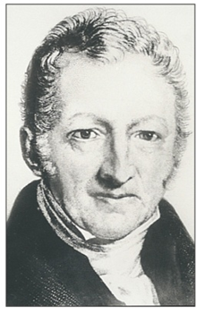
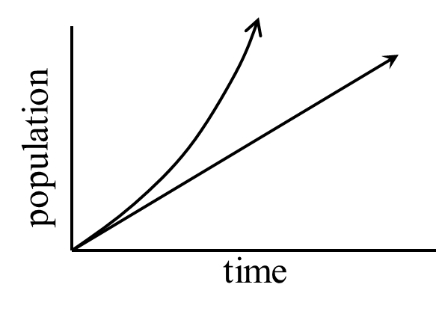
Human Demography and Population Dynamics
Thomas Malthus
Exponential growth: growth takes place at a constant rate per time 2, 4, 8, 16, 32, 64, 128….
vs.
arithmetic growth: 2, 4, 6, 8, 10, 12, 14, 16
“since it is precisely the poor who are the surplus, nothing should be done for them except to make their dying of starvation as easy as possible and to convince them that it cannot be helped…”
Notes:
Had not accounted for the power of fossil fuels to create efficiencies in food production and distribution among other things

Slide 34
“since it is precisely the poor who are the surplus, nothing should be done for them except to make their dying of starvation as easy as possible and to convince them that it cannot be helped…”
Marx despised the ideas of Malthus, asserting that it is capitalism that is the cause of overpopulation, not some simple biological imperative. Excess people = cheap labour…but people can change that…
Malthus 1766-1834
Marx 1818-1883

Slide 35
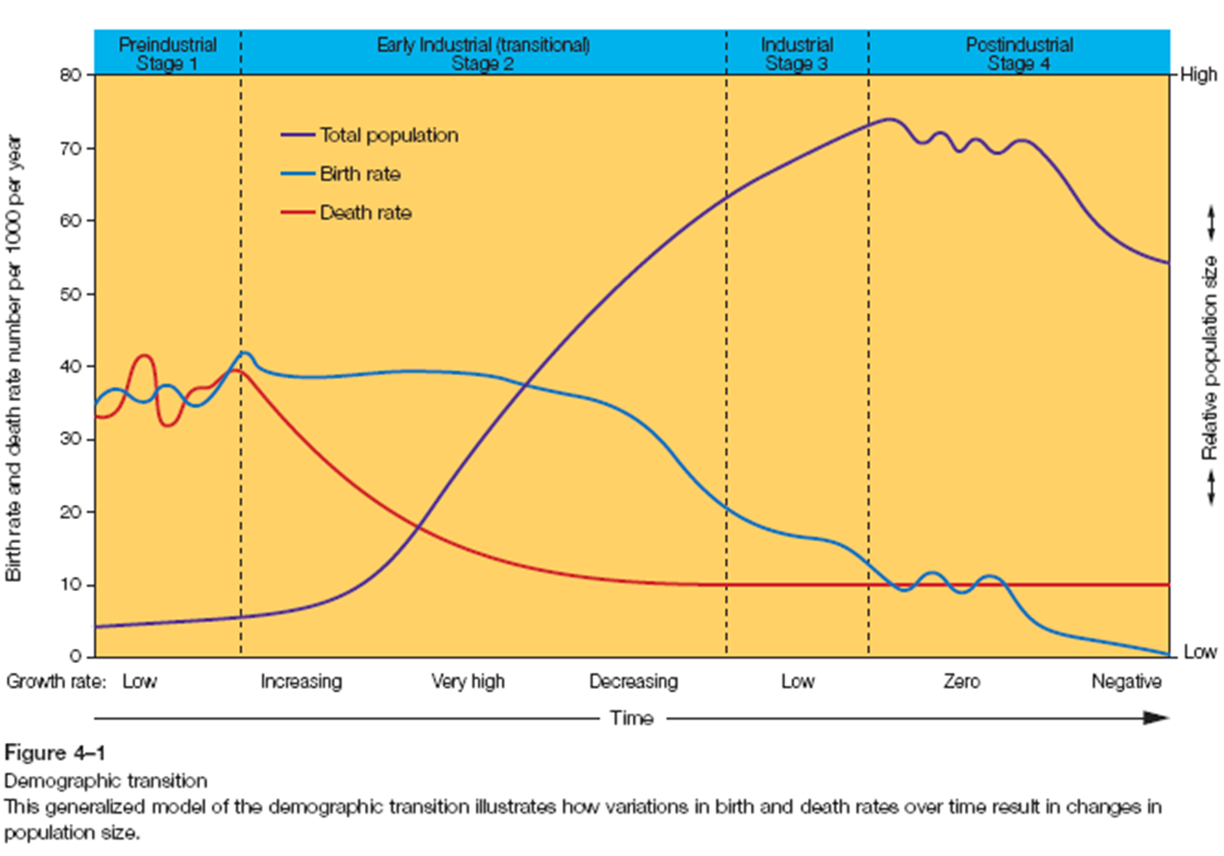
Demographic Transition Model
Many countries in the developing world moving through these stages much more rapidly than did places like Canada

Slide 36
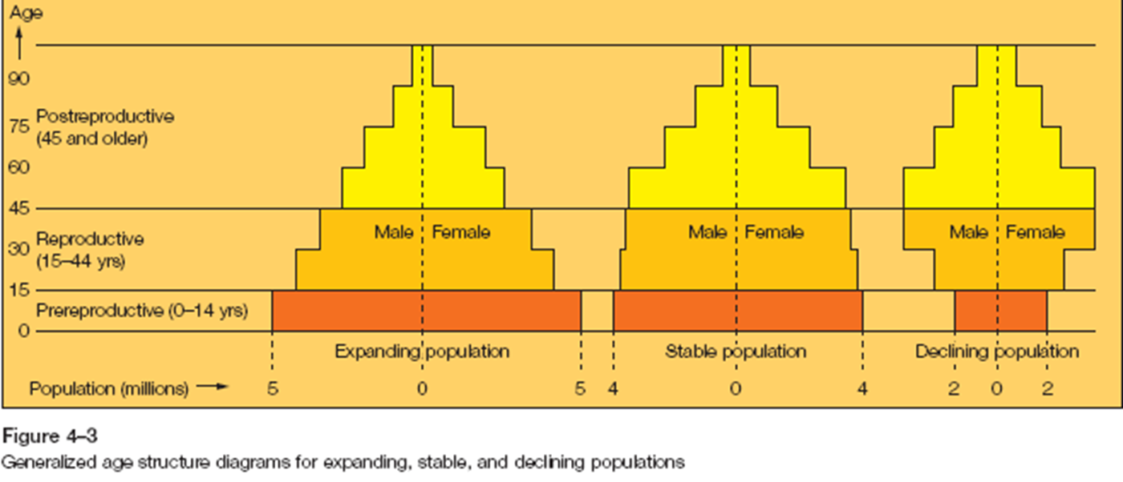
Generalized Age Structure Diagrams - aka Population Pyramids
Notes:
Expanding populations generally the only ones with the triangular shape – so not always called “pyramids” anymore.
Age and gender structure important for reproduction – wide base represents many future births

Slide 37
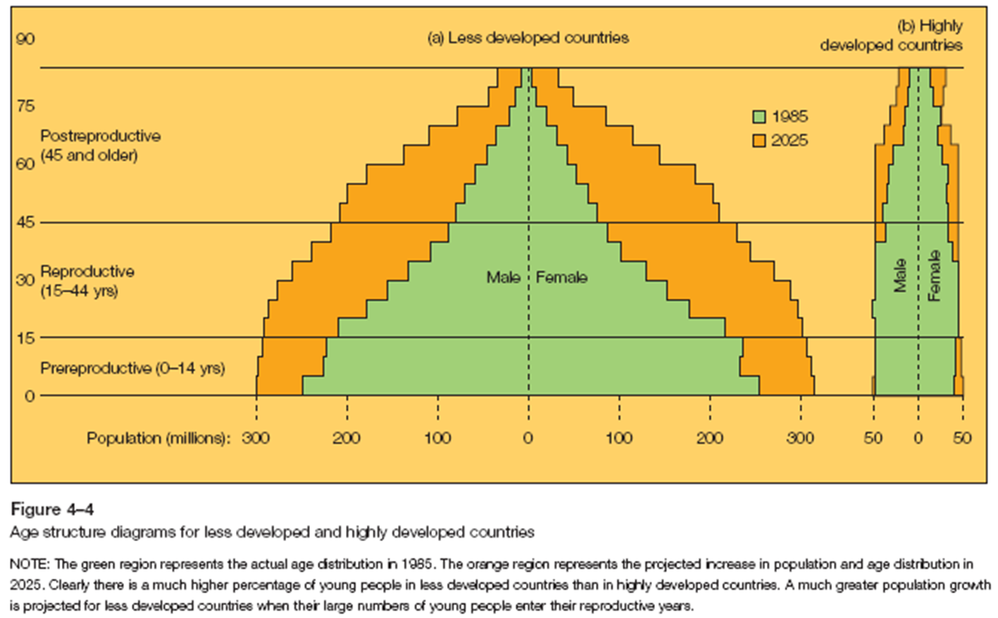
Age Structure Diagrams for Less Developed and Highly Developed Countries
Click the image to go to interactive site
Notes:
These pyramids do no account for migration – a major component of Canada’s population growth

Slide 38
Demographics of Aboriginal Peoples
Yet these data are likely gross underestimates as Aboriginal people are poorly enumerated
Notes:
Yet they are disproportionately impacted by environmental harms

Slide 39
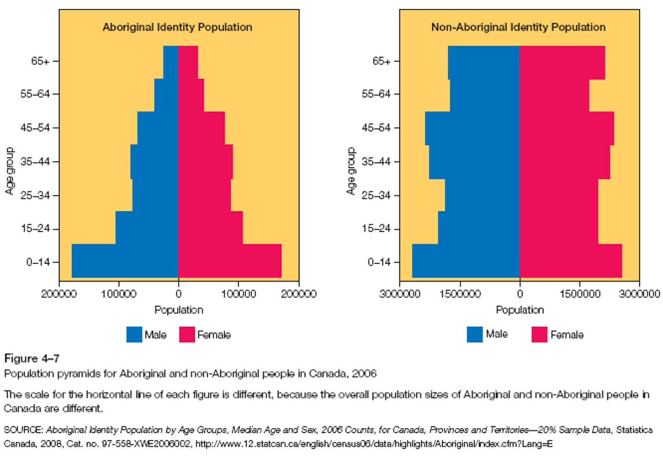
Demographics of Aboriginal Peoples

Slide 40
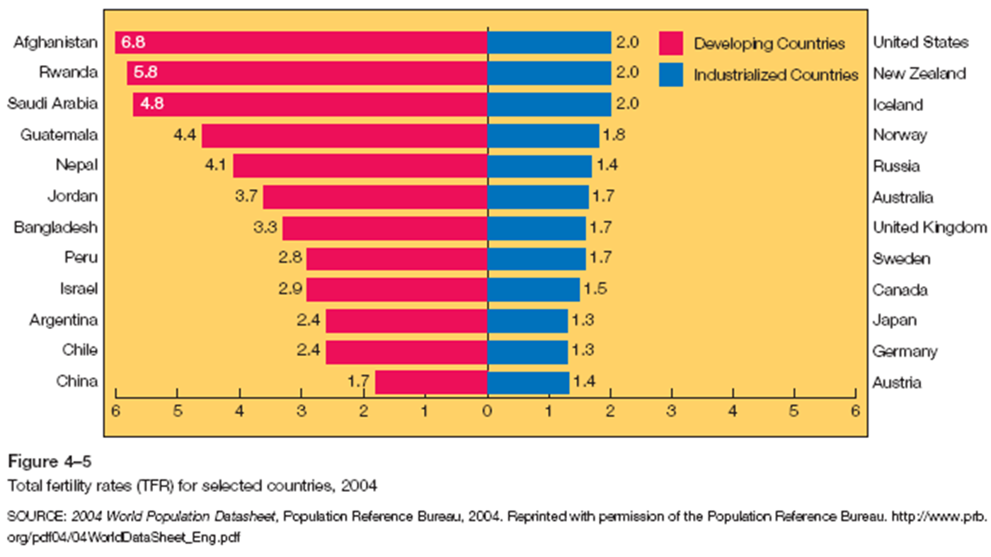
Fertility Rate
Notes:
Average number of children expected to be born to each woman of child bearing age
2.1 is considered replacement TFR – considering some female children die before reaching reproductive years

Slide 41
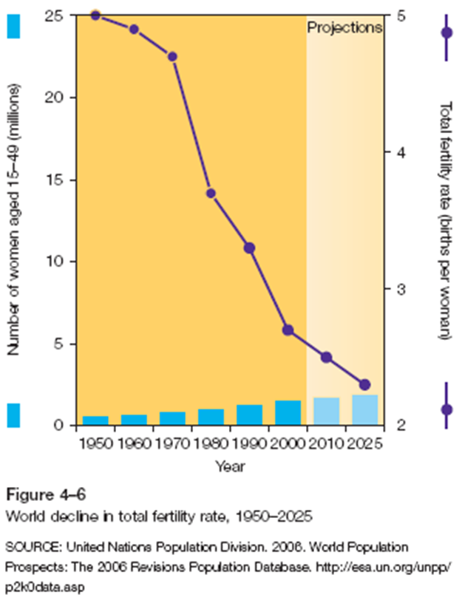
Fertility Rate
Click image for interactive website

Slide 42
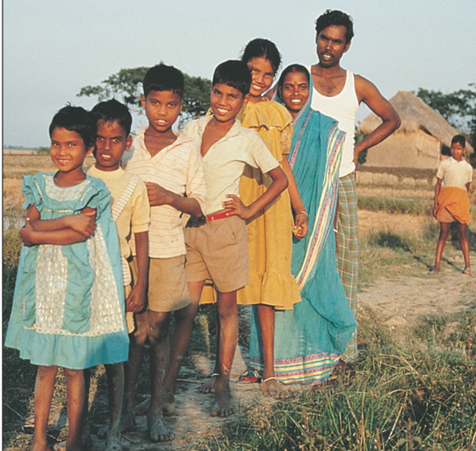
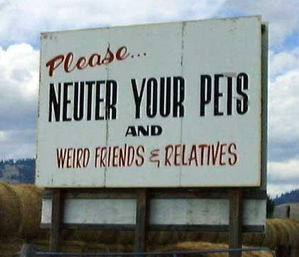
Population Control Strategies
Increasing marriage age
Migration
Cultural factors
Government financial incentives (e.g., China)
Having large families is a context-dependent yet typically rational decision
…not really…except the pets…

Slide 43
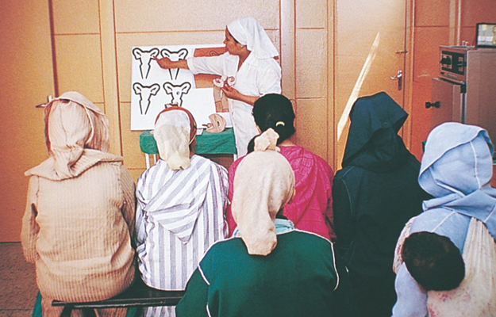
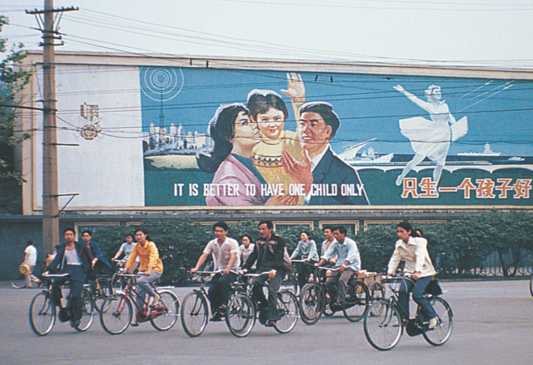
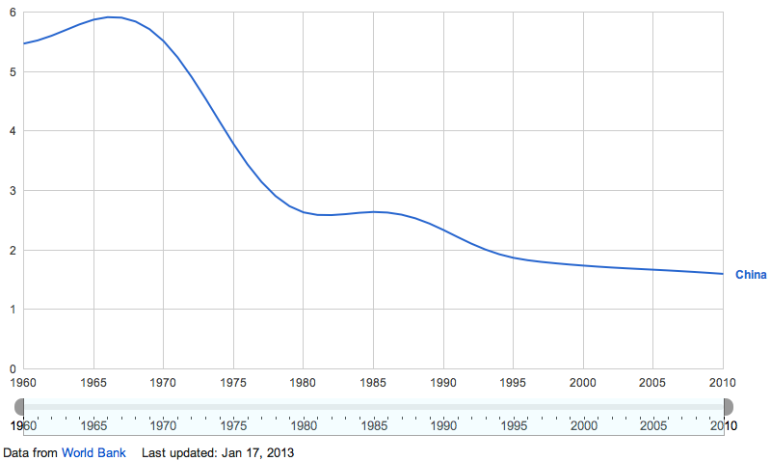
Population Control Strategies
Increasing education levels
Birth Control
National birth rate reduction programs (e.g., China)
Improved health care
Education puts some power (back) in the hands of women, but there are often substantial social and economic barriers to them invoking this knowledge to control fertility
One-child policy (1979) reduced China’s already declining fertility rate to reduce strain on resources…but with many unintended consequences
Notes:
e.g., preference for male babies (orphaned females); little emperor syndrome?; 4-2-1 problem – one child with two dependent parents at old age (and 4 grand parents), - a complex psychology of being less willing to take risks

Slide 44
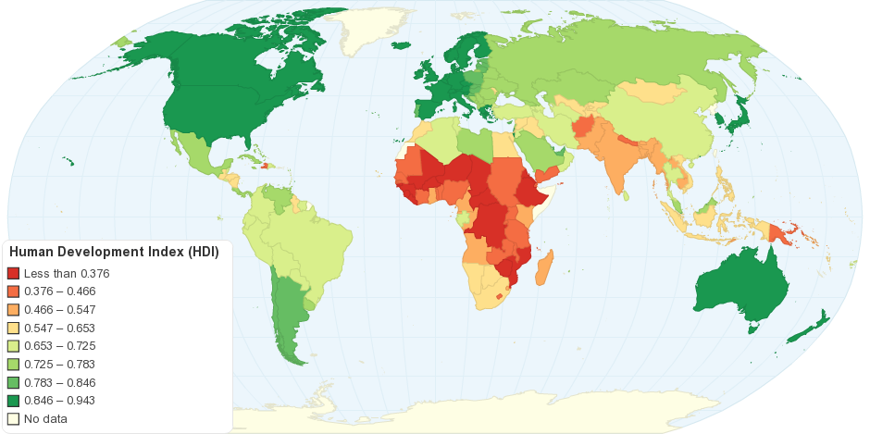
Human Development Indexes
Alternatives to GDP for measuring “progress”
Human Development Index (U.N.)
(see here for relation to ecological footprint section)
Millennium Development Goals
Genuine Progress Indicator
Canadian Index of Wellbeing
Millennium development goals

Slide 45
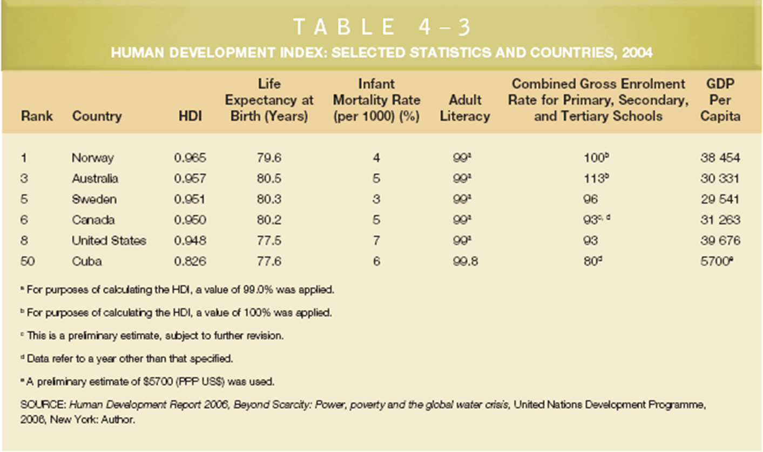
Human Development Index

Slide 46
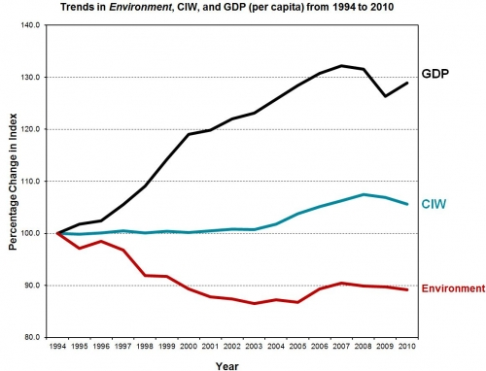
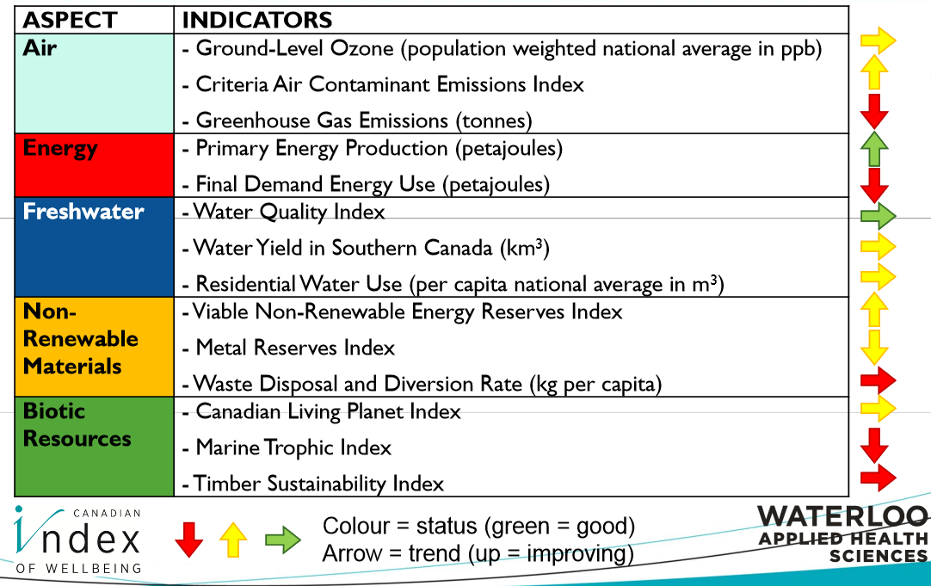
Canadian Index of Well-Being

Slide 47
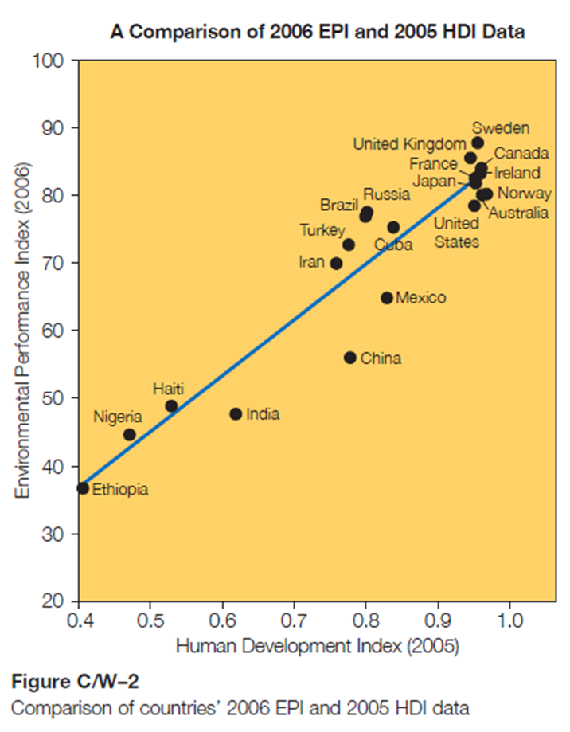
Environmental Performance and Human Development
Countries with high HDI scores in 2005 generally had high 2006 EPI scores, e.g. Sweden, Canada, United Kingdom, and United States

Slide 48
Canada’s Challenges
Population, environment, development
uneven economic, social, and environmental impacts of development across time and space
costs large-scale resource exploitation
treatment Aboriginal people and inclusion as full partners in Canada’s development – environmental repossession, economic sovereignty
First Nations businesses based on sustainability principles

