Slide 1
Geography 2153
Environment, Economy and Society
Our Changing Atmosphere
(Ch 5)
Jamie Baxter

Slide 2
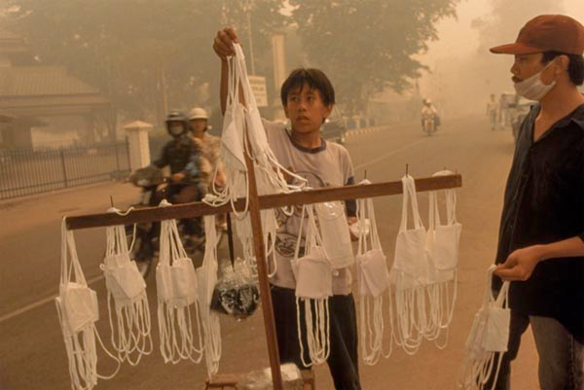
Outline
Atmospheric concerns
Climate systems
Changes, atmospheric composition
Greenhouse effect and climate change
Ozone layer
Airborne contaminants
Acidic deposition
Policy responses
Challenges to air quality sustainability
Fires to clear for palm oil plantation in Indonesia engulf Singapore and Malaysia in particulate matter laden smog

Slide 3
Human Activities that Alter Earth’s Atmosphere
Activity | Substances with Negative Atmospheric Effect
Industrial | SO₂, particulates (PM), CFCs heavy metals, reactive hydrocarbons (HCs)
Burning fossil fuels | GHGs, SO₂
Transportation | GHGs, smog, NO_{x}, So_{x}, polycyclic aromatic HCs (PAHs), carbon monoxide (CO)
Deforestation | GHGs, CO, PAH’s, PM, loss of carbon sinks
Agricultural practices | CH₄

Slide 4
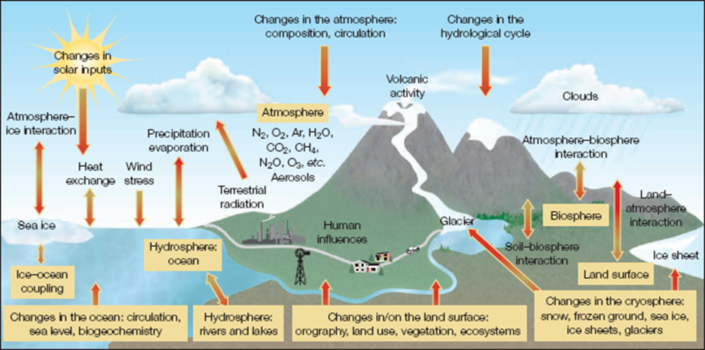
Earth’s Natural Climate System
dynamic atmosphere + circulating ocean + changing Earth surface

Slide 5
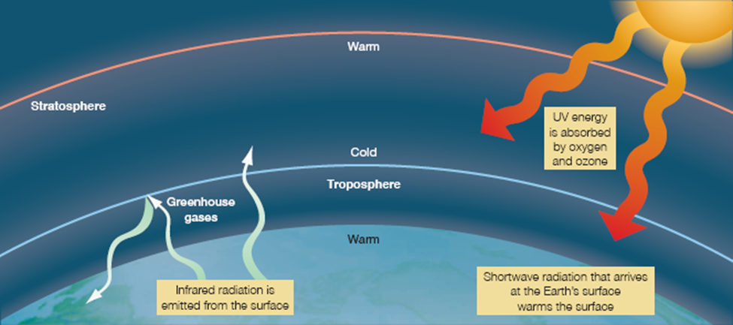
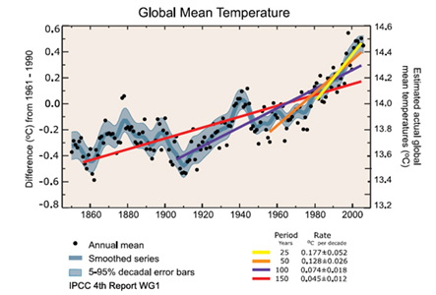
Natural Green House Gas Effect
Natural and anthropogenic process
0.6 average global surface air increase in temperature last 100 years
Accelerating in recent decades (most likely) due to anthropogenic causes
Time lag - changes now may not have effects for decades
Short wave radiation in, long wave out. 90% long wave absorbed by clouds, vapour, GHGs
Notes:
Not many…

Slide 6
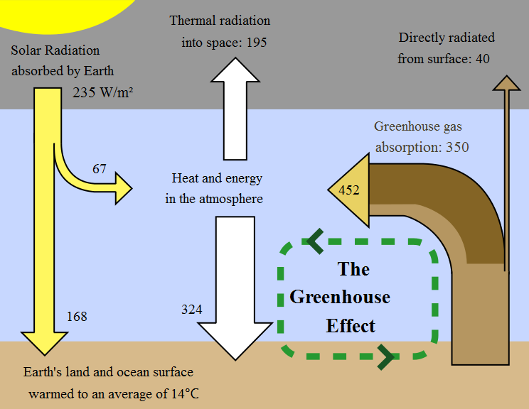
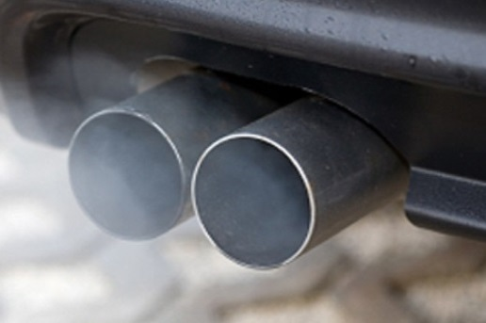
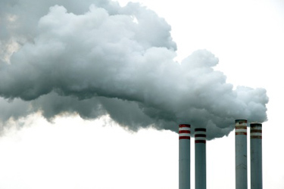
Natural/Anthropogenic Portions of the Greenhouse Effect
GHGs are both natural and anthropogenic:
carbon dioxide (CO₂) (20%)
methane (CH₄)
nitrous oxide (N₂O)
water vapour (50%)
clouds (25%)
ozone (0₃ )
Why are we so focused on CO₂ ?
Notes:
Percentages in () are approximate contribution to Greenhouse effect Source: Newscientist.com
So why are we so focused on CO₂

Slide 7
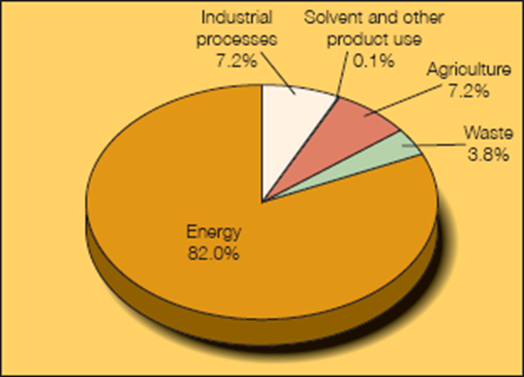
Enhanced Greenhouse Gas Effect
Concentrations of:
CO₂ increased 31 +/- 4%
CH₄ increased 151 +/- 25%
NO₂ increased 17 +/- 5%
exceed any past levels detectable in fossilized air
bubbles of ice cores over the past 420,000 years
unprecedented rate of increase in last 20,000 years
“halocarbons”: clearly human sources
Notes:
Halocarbon – carbon attached to chlorine, fluorine, bromine, iodine

Slide 8
Enhanced Greenhouse Gas Effect
Characteristics of changes in GHGs
GWP Global Warming Potential – the climate forcing potential of greenhouse gases as CO₂eq(uivalents)
changes in chlorofluorocarbons and halons: synthetic
changes in aerosols: small solid or liquid particles suspended in the air, contribute to photochemical smog, acid deposition, etc. (volcanic eruptions, aircraft emissions)
Greenhouse Gas | Formula | 100-year GWP (SAR) | 100-year GWP (AR4)
Carbon dioxide | CO2 | 1 | 1
Methane | CH4 | 21 | 25
Nitrous oxide | N2O | 310 | 298
IPCC Fourth Assessment Report (AR4) in 2007 refined IPCC Second Assessment Report (SAR) values but the latter still in much of the literature
Notes:
GWP – The Global Warming Potential (GWP) for a gas is a measure of the total energy that a gas absorbs over a particular period of time (usually 100 years), compared to carbon dioxide. The larger the GWP, the more warming the gas causes. For example, methane's 100-year GWP is 21, which means that methane will cause 21 times as much warming as an equivalent mass of carbon dioxide over a 100-year time period. But the amount released and persistence of the compound also matters!

Slide 9
Proposed Causes of Climate Change
Changes in:
solar intensity
stratospheric and tropospheric aerosol concentrations
concentrations of GHGs
ozone layer thickness
ocean - atmosphere systems (e.g., El-Niño)
Which is considered by the Intergovernmental Panel on Climate Change to likely be the most important cause of accelerated climate change in recent decades?

Slide 10
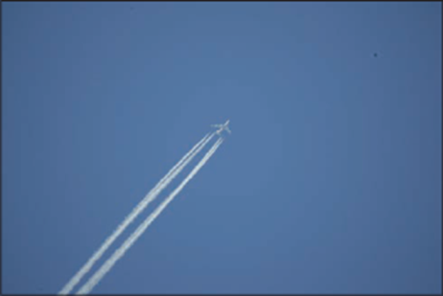
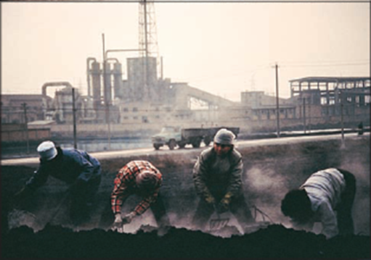
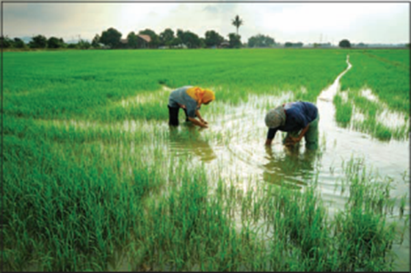
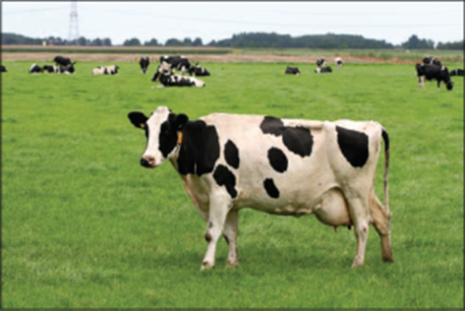
Enhanced Greenhouse Gas Effect
Characteristics of changes in GHGs
changes in human-made chlorofluorocarbons and halons (both derivative of methane)
changes in aerosols: small solid or liquid particles suspended in the air, contribute to photochemical smog, acid deposition, etc. (e.g.,volcanic eruptions, aircraft emissions)
aerosol + ghg emitters
methane emitters

Slide 11
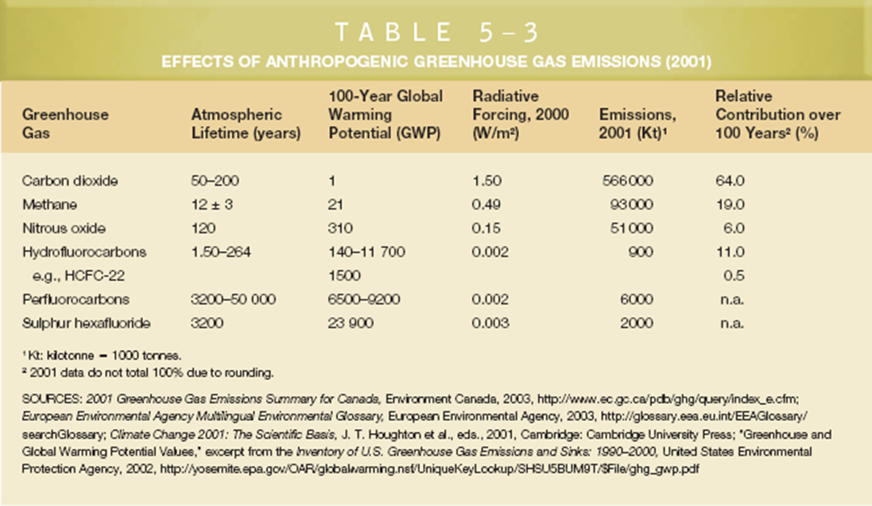
Enhanced Greenhouse Gas Effect
Notes:
Though CO2 has the lowest GWP, it is still currently the most important anthropogenic contribution to global climate change

Slide 12
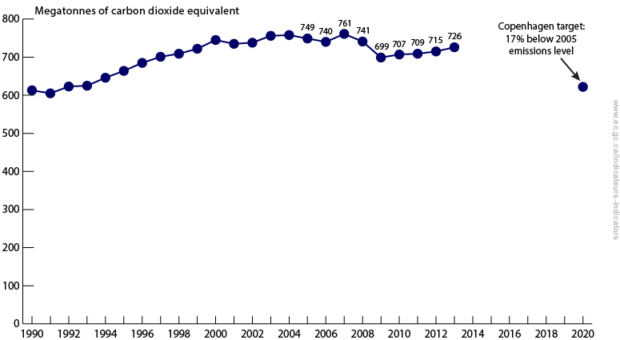
Canada’s Greenhouse Gas Emisisons
622 MT

Slide 13
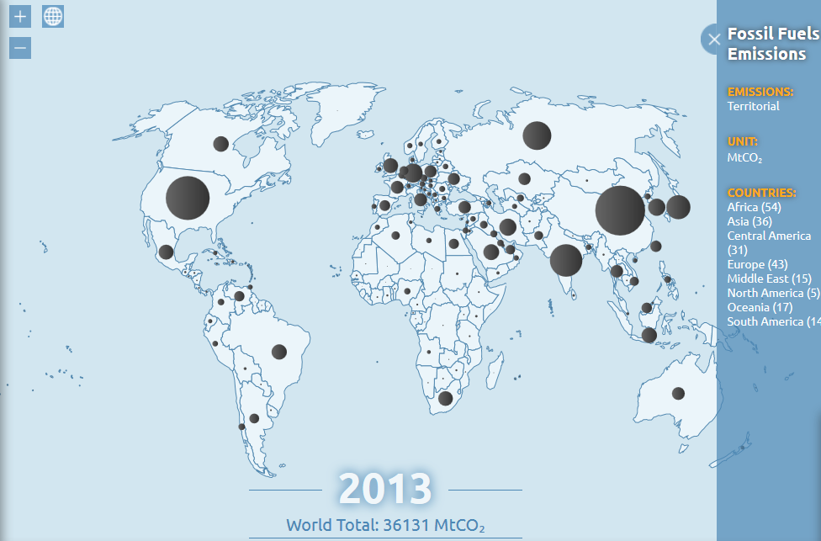
How do we compare….
Source: globalcarbonatlas.org
Notes:
Problem with absolute volumes of MTCO2 equivalent?

Slide 14
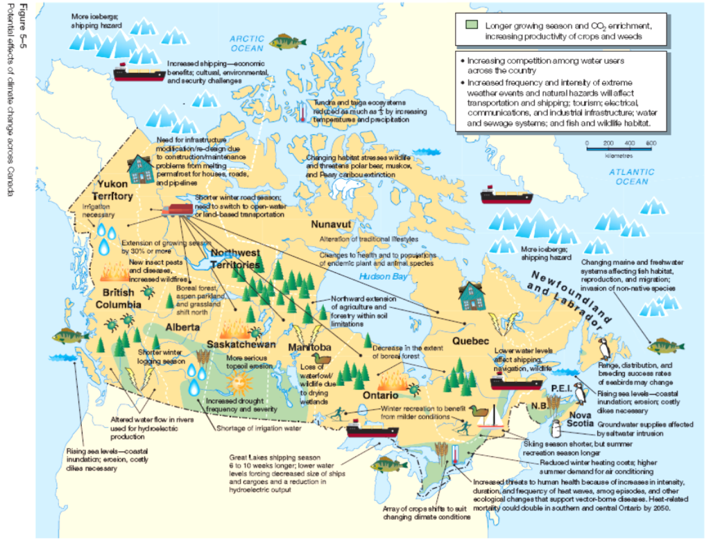

Slide 15
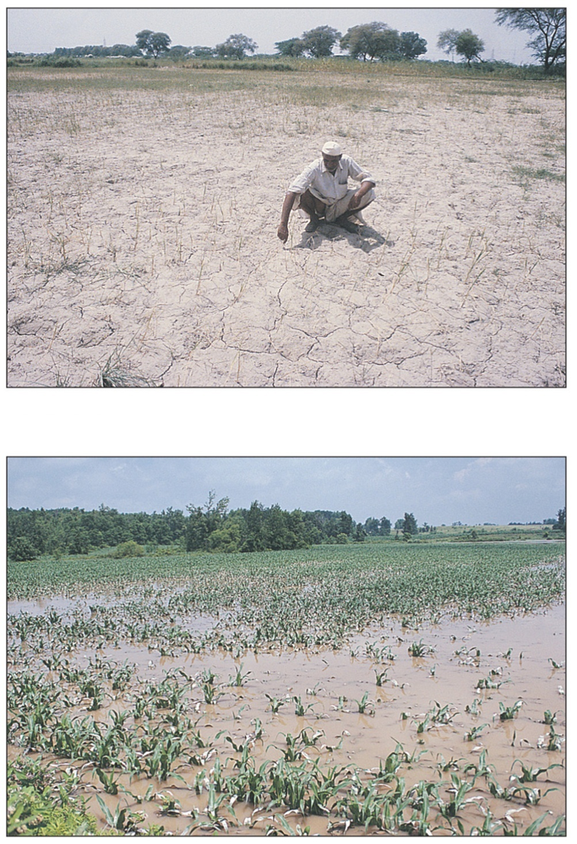
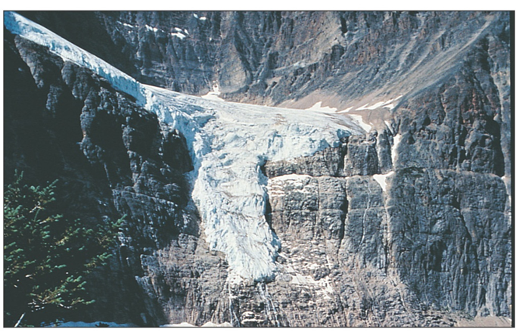
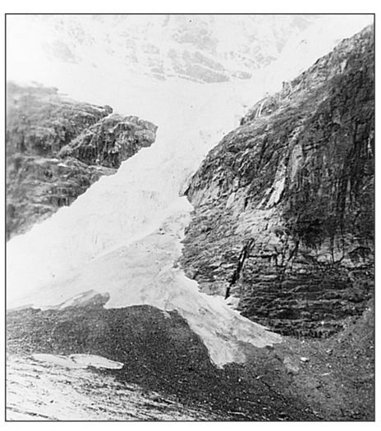
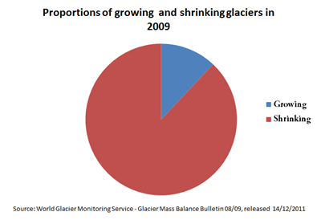
Impacts of Global Climate Change
drought and flooding
glacial retreat leads to flooding, erosion, and alters hydrological cycle

Slide 16
Exercise: “Speed Search and Summarize” (SSaS) Policy Levers for Regulating GHGs
Sort yourselves into groups of 4 – but ensure at least one member has a web-enabled device – preferably a laptop
Each group come up with 4 key “factual” bullet points and your group’s opinion on the following topic:
Cap and trade (all groups on left half of room)
Carbon tax (all groups on right half of room)
You have about 10 minutes – then we will share what you found
See slides here after the discussion.

Slide 17
Review
Which of the following is the single largest contributor to the Greenhouse Effect
Text a letter to 37607 (if needed, text Geog2153 to 37607 to open a connection)
carbon dioxide (CO₂)
methane (CH₄)
nitrous oxide (N₂O)
water vapour
clouds
Or
Respond at this link
No peeking back up the notes…
poll results here
Notes:
Why?
ipcc

Slide 18
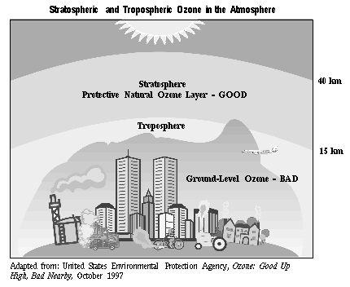
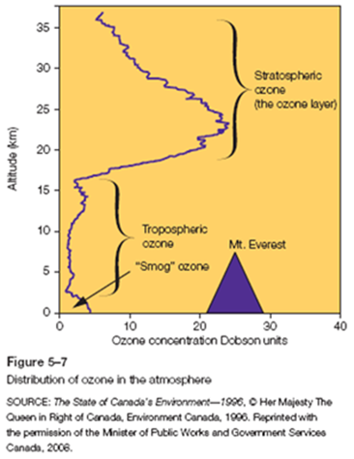
Thinning of the (Stratospheric) Ozone Layer
stratospheric ozone (not “ground level” ozone)
stratospheric: 15-40km, but maximum concentration 20-25 km above the Earth’s surface
“ozone hole”, polar vortex, polar stratospheric clouds
Notes:
Polar vortex is a persistent low pressure zone above each pole – can be responsible for long cold spells
Changes to ozone are correlated with increases in polar vortex activity

Slide 19
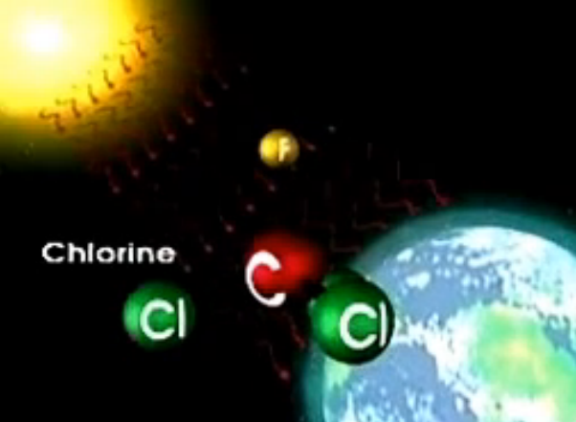
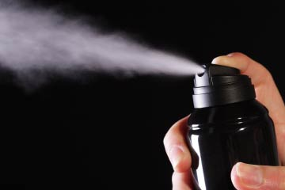
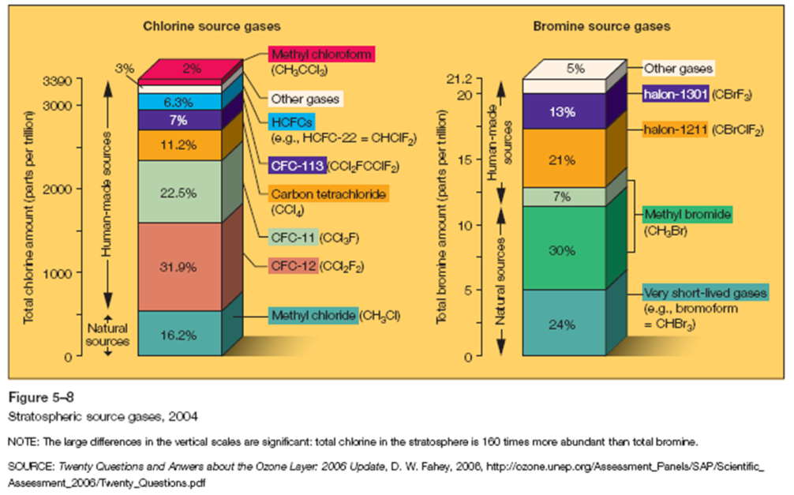
Thinning of the (Stratospheric) Ozone Layer
Ozone (O₃) depleting substances (ODS)
e.g., volcanoes, chlorofluorocarbons (CFCs)
Sunlight breaks Cl away from various forms of CFC then...
Cl + O₃ ClO + O₂
ClO + O Cl + O₂
one Cl can destroy 100,000 0₃
CFCs used to be common propellants in aerosol cans (now petroleum products are used – GHGs)
Short video on ozone and chlorofluorocarbons

Slide 20
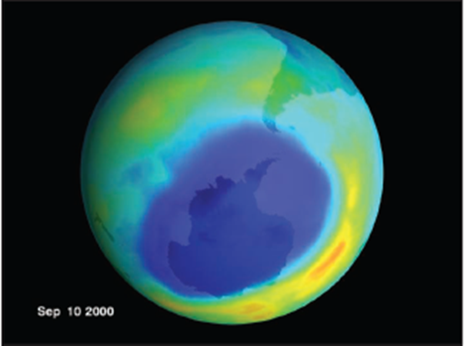
Thinning of the Ozone Layer
Spatial variations in ozone depletion
Antarctic - severe
“polar vortex” “polar stratospheric clouds”
Arctic – less severe
Tropical/Mid-Latitude – least

Slide 21
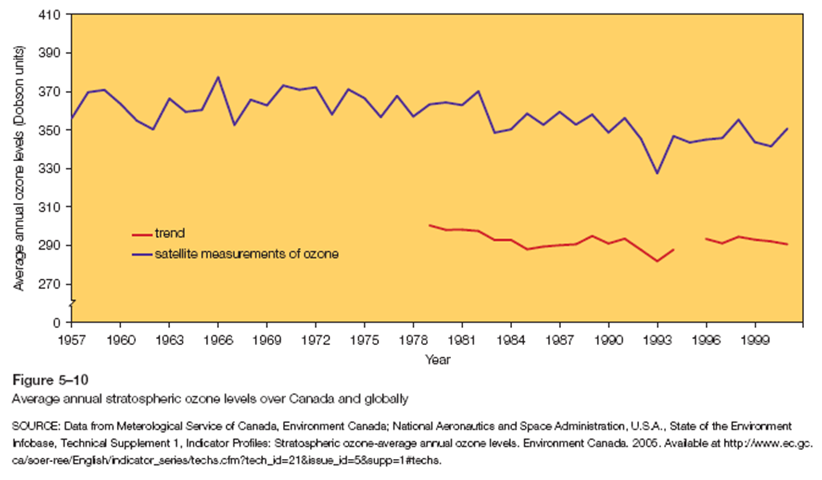
Temporal Variation in Stratospheric Ozone
Notes:
Slight trend downwards, considerable oscillation from year to year – red is Canada’s trend

Slide 22
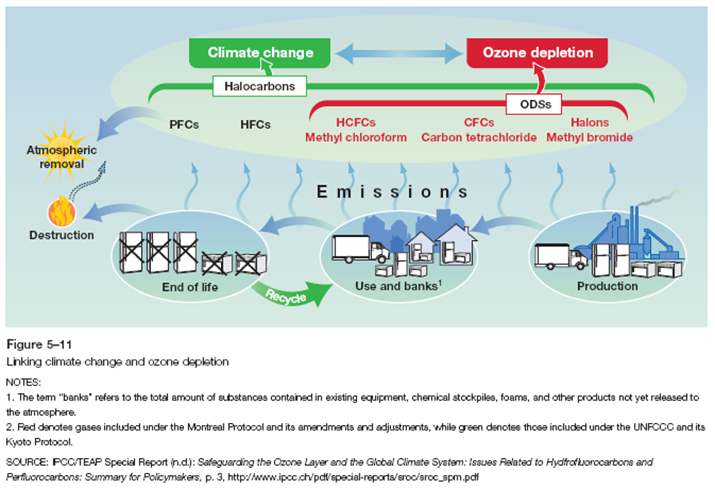
Climate Change and Ozone Depletion
A range of different policies address ODS - lower GHG “substitution” is essential
Notes:
ODSs are also GHGs – so contribute to warming through the greenhouse effect
ozone-depleting substances and greenhouse gases alter radiation processes – through O₃ changes - in the atmosphere so as to enhance both global warming and stratospheric ozone depletion. These changes result in a warming of the troposphere and a cooling of the stratosphere
Many CFCs (e.g., propellants in aerosol cans) have substitutes that do not deplete stratospheric ozone yet still have low GHG properties – i.e. hydrofluorocarbons (HFCs) – but these still have GHG properties and can be persistent in the atmosphere for over a decade or more!

Slide 23
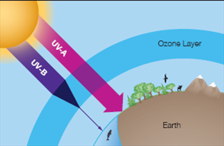
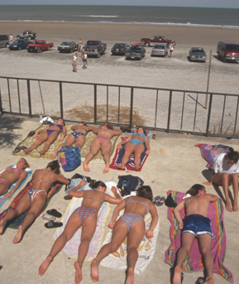
Effects of Ozone Depletion
Increased ultraviolet (UV) radiation
decreased phytoplankton production (primary producers!)
biological damage
human health threats
Canada’s UV Index
Minimizing Risks of UV Exposure
Predictive model based on: sun altitude, ozone concentration, ground altitude, the surface albedo, and cloud cover (not actual radiation)
Long wave penetrates more but short wave tends to do more damage – protect against both!
Notes:
UV-A = longwave
UV-B = shortwave

Slide 24
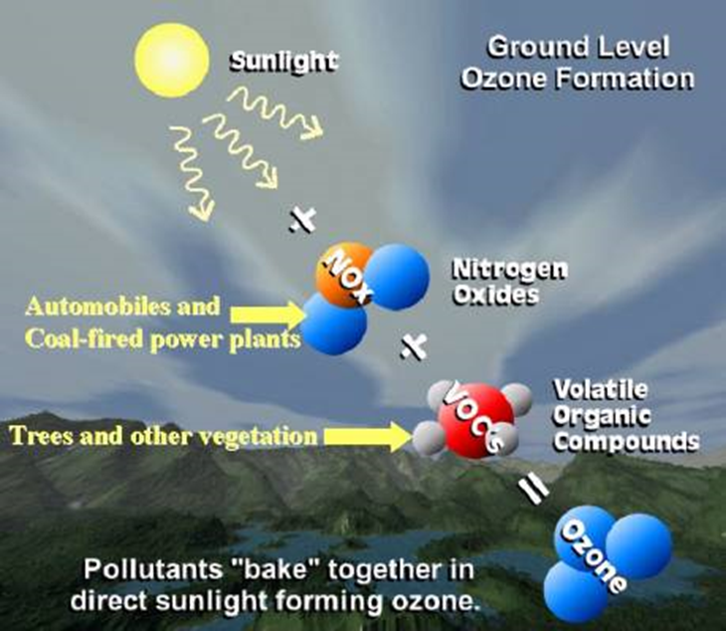
Ground-Level Ozone
Human health risk
Component of smog
Respiratory problems
VOCs – volatile organic compounds – paints, pesticides, gas vapour, glues, markers
Troposphere (approx. 15 km)
The “baking” involves chemistry way beyond the scope of this course, NOx can also combine with carbon monoxide (CO) to form O₃

Slide 25
Review
Stratospheric O3 is generally considered good while tropospheric O3 is generally considered bad?
Text a letter to 37607 (text Geog2153 to 37607 to open a connection first)
True
False
Or
Respond at this link
No peeking back up the notes…
poll results here
Notes:
Why?
ipcc

Slide 26
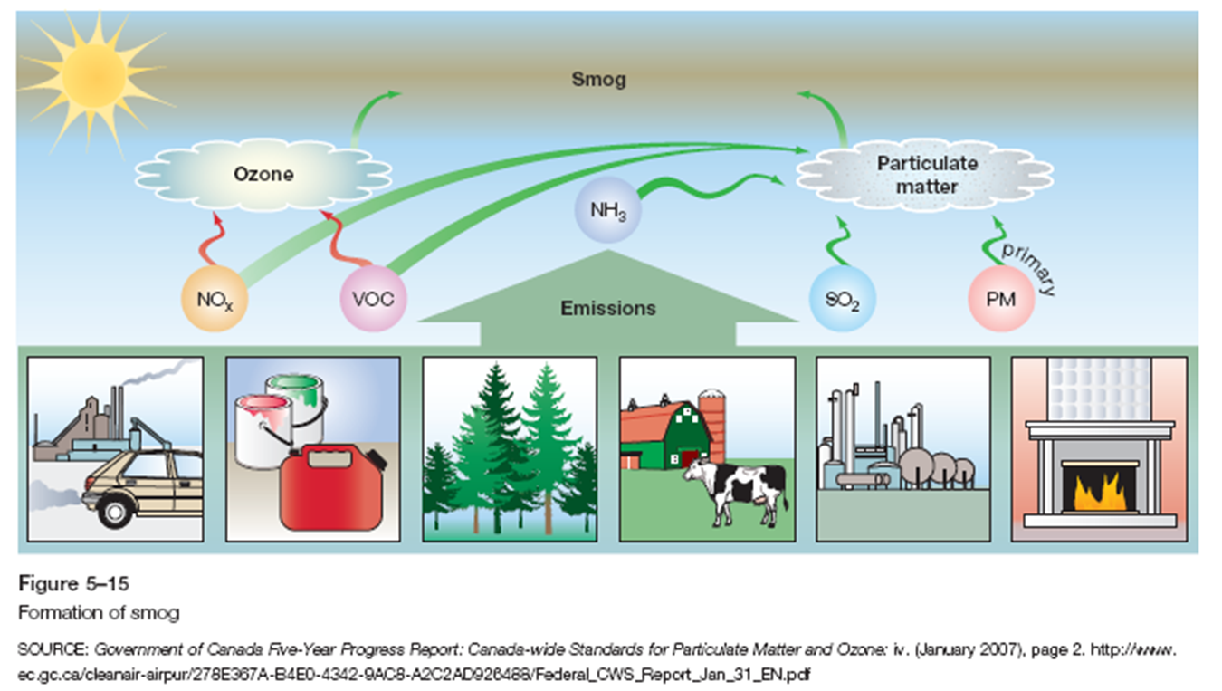
Smog
Mainly particulate matter and ground-level ozone along with their “precursors”

Slide 27
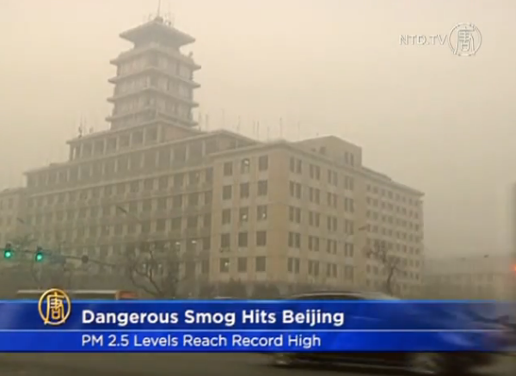
Smog and PM 2.5
Penetrates deep into the lungs
Impairs lung function
Sources (combustion): motor vehicles, power plants (coal!), residential wood burning, forest fires, agricultural burning, industrial processes

Slide 28
Responses to Atmospheric Changes
National
Canada-Wide Acid Rain Strategy for Post 2000
Climate Change Action Fund
Ozone Layer protection program
National Action Program on Climate Change
Canada Wide Standards for O₃ and PM
International
Framework Convention on Climate Change
Earth Summit
Kyoto Protocol (COP 21)
Montreal Protocol
Canada-US Air Quality Agreement

Slide 29
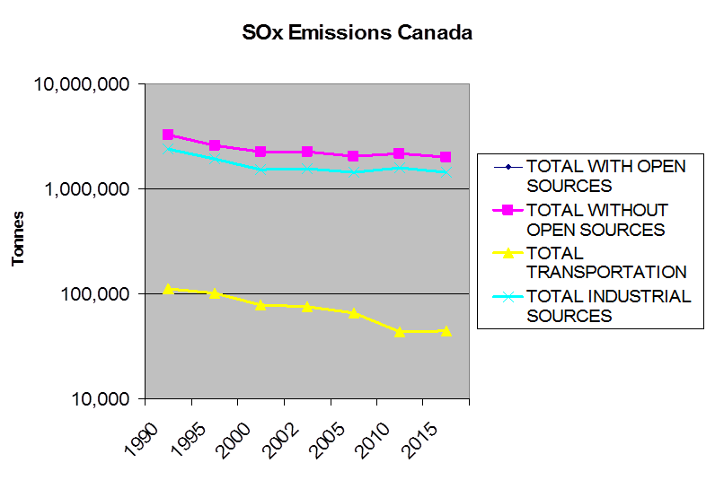
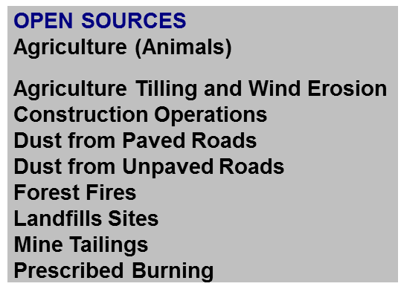
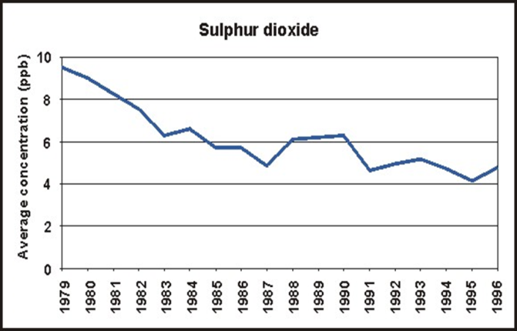
Trends in Criteria Air Contaminants over Time
Criteria air contaminants:
Sulphur Oxides (SO_{x});
Nitrogen Oxides (NO_{x});
Particulate Matter (PM);
Volatile Organic Compounds (VOC);
Carbon Monoxide (CO);
Ammonia (NH₃)
Ground level ozone (O₃)
Notes:
CACs generally have similar sources – fossil fuel burning – and have related impacts on the environment. They are precursors to important pollution processes like ozone formation.
Note these grey graphs use a logarithmic scale – so the improvements would appear MUCH more dramatic with a regular increment y-axis scale

Slide 30
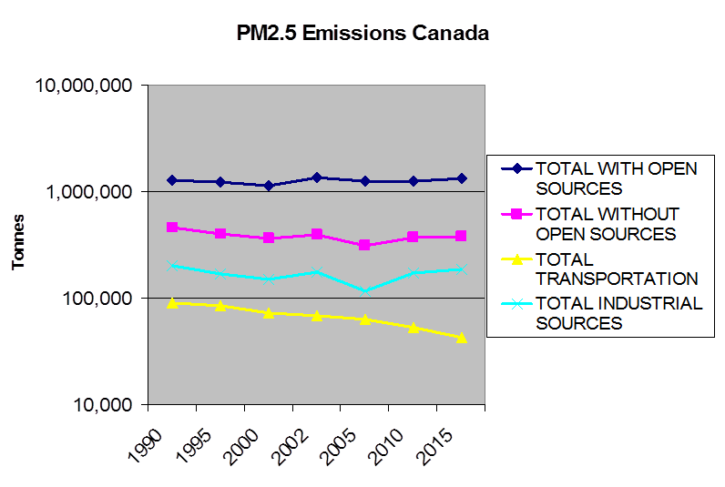
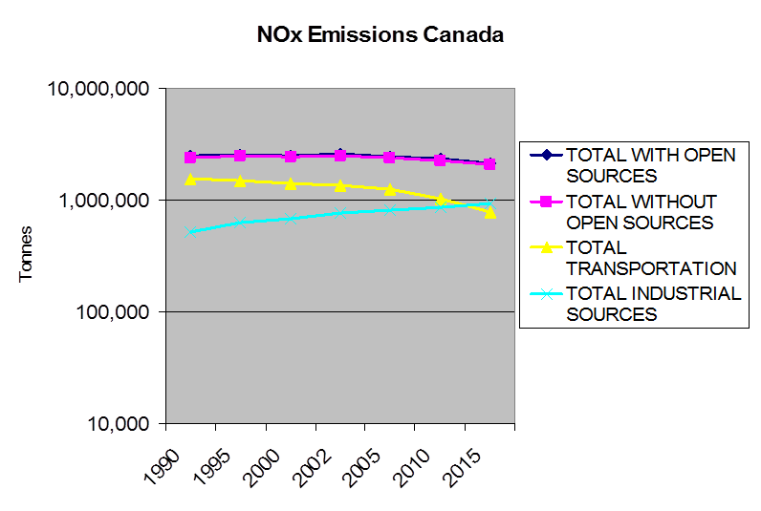
Trends in Criteria Air Contaminants over Time

Slide 31
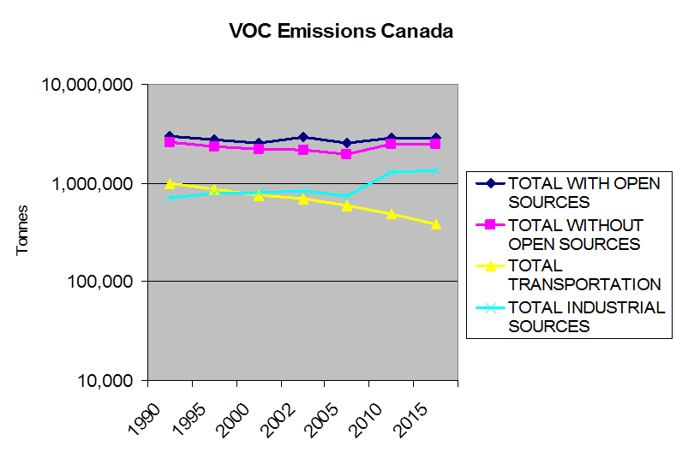
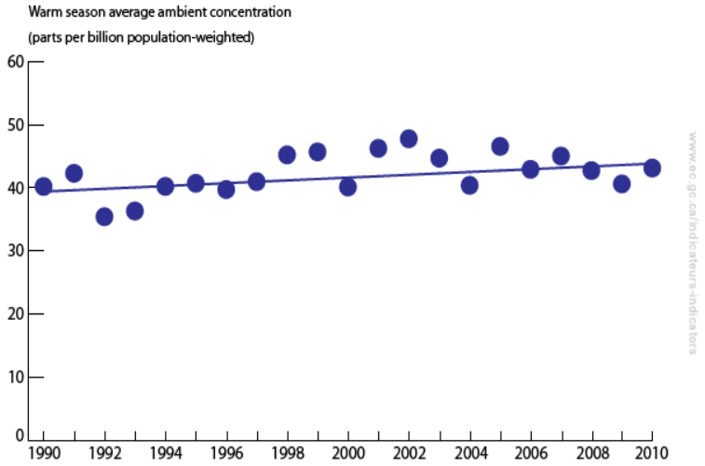
Trends in Criteria Air Contaminants over Time
Ground Level Ozone Emissions Canada

Slide 32
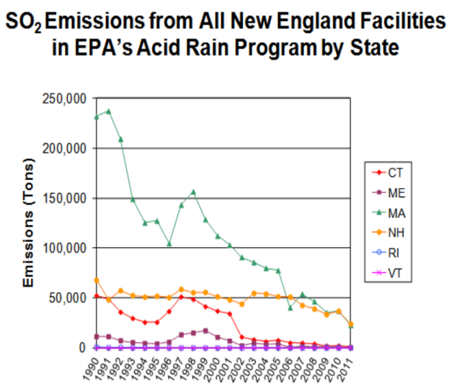
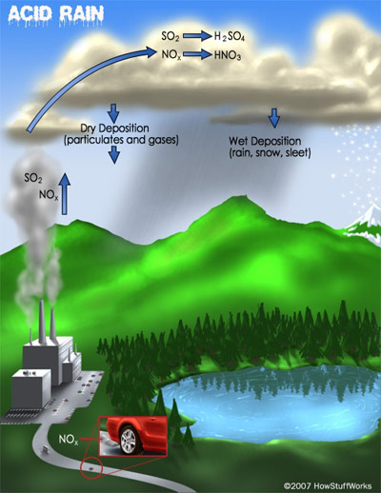
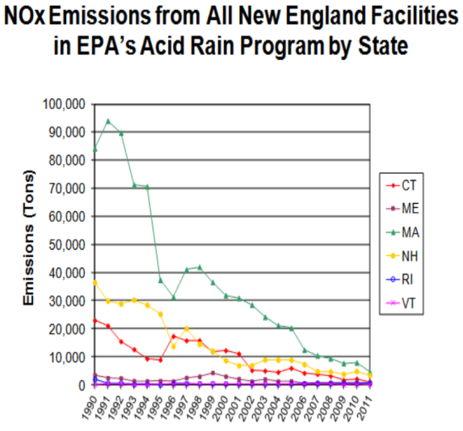
Acid Deposition
SO₂ +/or NO_{x} + H₂O vapor
H₂SO₄ or HNO_{x}
(sulfuric acid) (nitrate acids)
Sources : long range transport of air pollutants (LRTAP)
Negative impacts: acidification of water bodies, plants – e.g. sugar maples, limestone structures

Slide 33
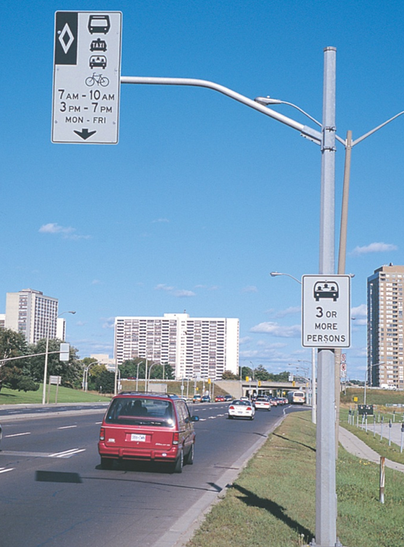
Future Challenges
Predicting Climate Change: General Circulation Models (GCMs)
Incomplete knowledge base
Canada’s reliance on fossil fuels
Canadians and cars
COP 21 – make Kyoto binding?
What do you see as the most significant challenge and why?

Slide 34
Review
Which of the following is not a criteria air contaminant?
Text a letter to 37607
Sulphur Oxides (SO_{x})
Particulate Matter (PM)
Chlorofluorocarbons (CFCs)
Carbon Monoxide (CO)
Ammonia (NH₃)
Or
Respond at this link
No peeking back up the notes…
poll results here
Notes:
ipcc

