Slide 1
Geography 2153 – Fall 2013
Environment, Economy and Society
Agroecosystems and Food
(Ch 6)
Jamie Baxter

Slide 2
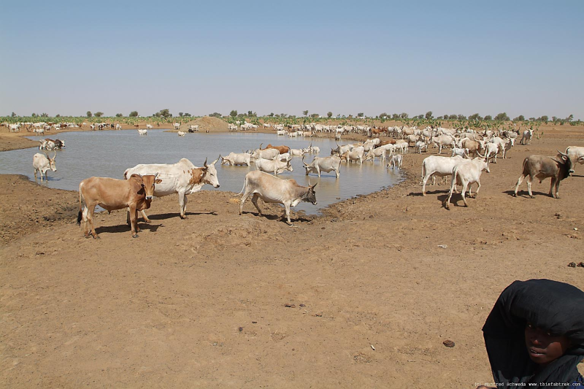
Outline
Agroecosystems and Food
Agriculture in Canada
Human activities on agricultural land
Agricultural land (mis)management
Options for change
Canada’s world EPI ranking
Sahel - desertification is one of the greatest worldwide challenges given the social and economic pressures to farm marginal lands

Slide 3
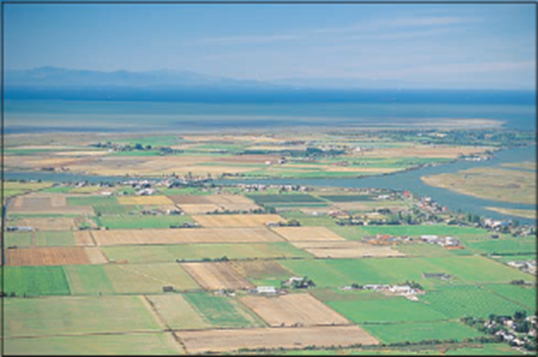
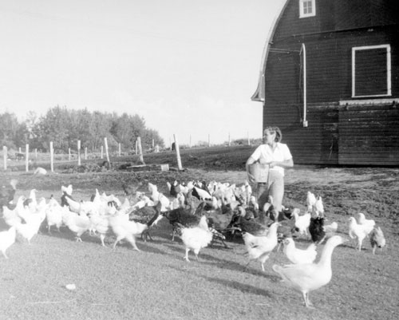
Agriculture in Canada
Agroecosystems
communities of living organisms, together with the physical resources that sustain them (e.g. biotic and abiotic elements of soils and drainage systems) that are managed for the purpose of producing agricultural products

Slide 4
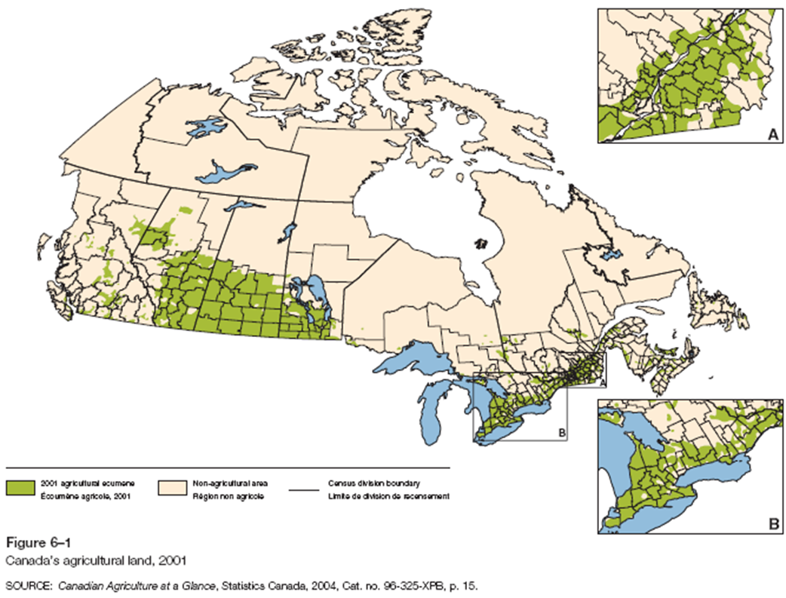
Agricultural Lands in Canada
Canada Land Inventory (CLI)
Classes 1 – 3 (dependable agricultural land base)
497,727 km² (5% of total land base)
Saskatchewan:190, 105 km² (39% C1-3)
Alberta:106, 462 km² (22% C1-3)
Ontario:76, 537 km² (15% C1-3)

Slide 5
Agricultural Lands in Canada

Slide 6
Changing Nature of Canadian Agriculture
Economic | Environmental | Social
- 6.6% of Canada’s product export | - Soil degradation | - Disappearance of family farm
- Technological efficiency | - Loss of species diversity | - Loss of habitat
- Monocultures | - Fossil fuel, agro- chemical use | - Long term effects of agro-chemicals; land stewardship
- Crop specialization, globalization | - Soil, water, air contamination | - Growing consumer demand for alternative farming practices

Slide 7
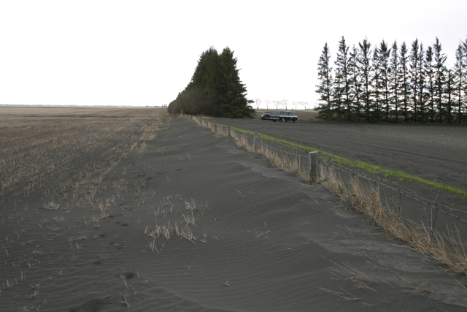
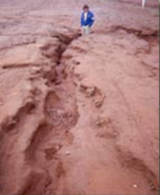
Human Activities on Agricultural Lands
Effects on soil resources
Organic matter
Wind erosion; water erosion; tillage erosion
36% of cultivated land on the Prairies is subject to high risk of wind erosion
80% of cultivated lands in Maritimes high risk of water erosion
Wind erosion on prairie soils
Water erosion PEI
Notes:
On what sorts of landscape is tillage erosion generally a concern?

Slide 8
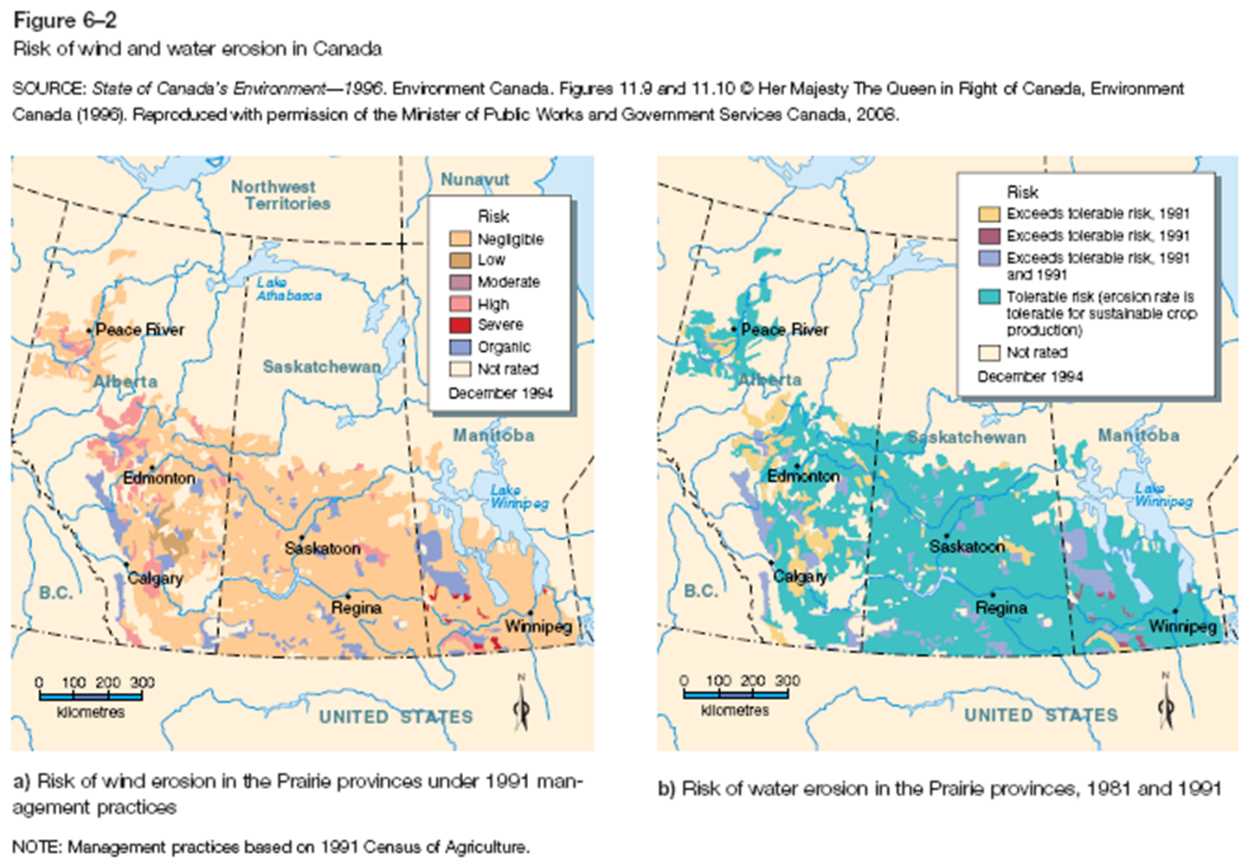
Human Activities on Agricultural Lands

Slide 9
Human Activities on Agricultural Lands

Slide 10
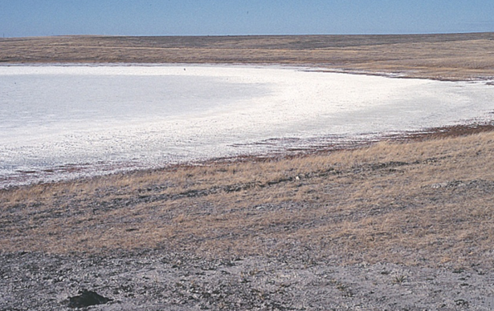
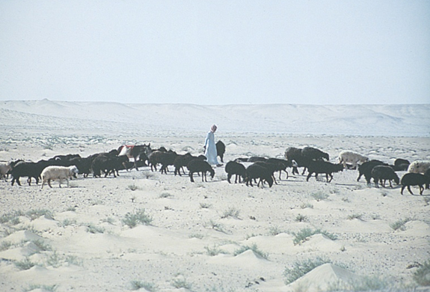
Human Activities on Agricultural Lands
Effects on soil resources
Salinization: excess of salts in soils
Chemical contamination: herbicides, insecticides
Desertification: degradation of dry land to the point where it is difficult to restore productivity
Salinization can be sped up by human land management practices
Desertification is relatively low risk in Canada, but a serious problem worldwide
Notes:
How does irrigation impact salinization?

Slide 11
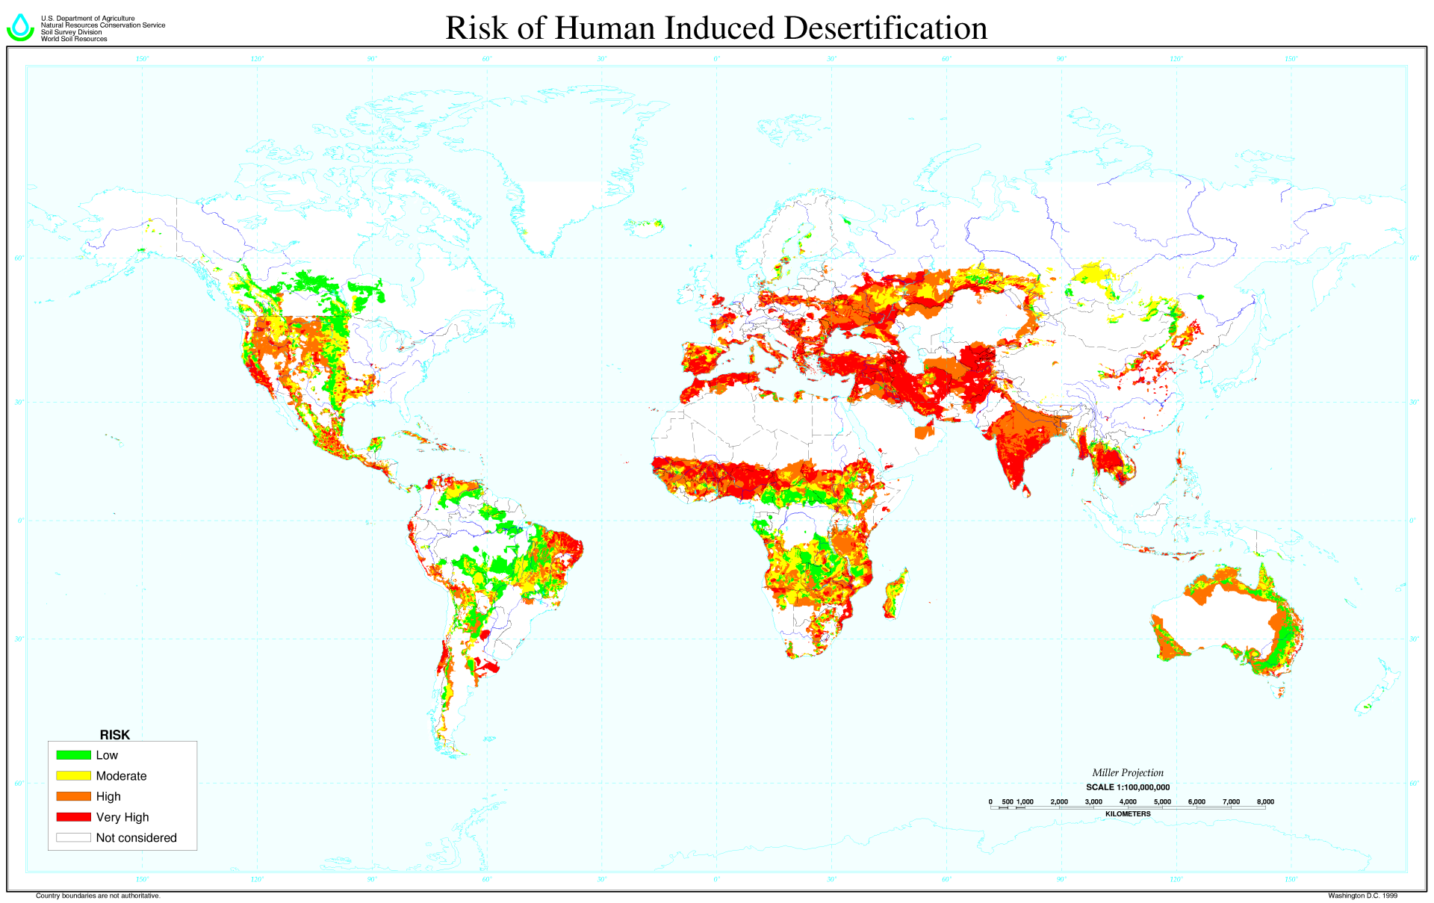

Slide 12
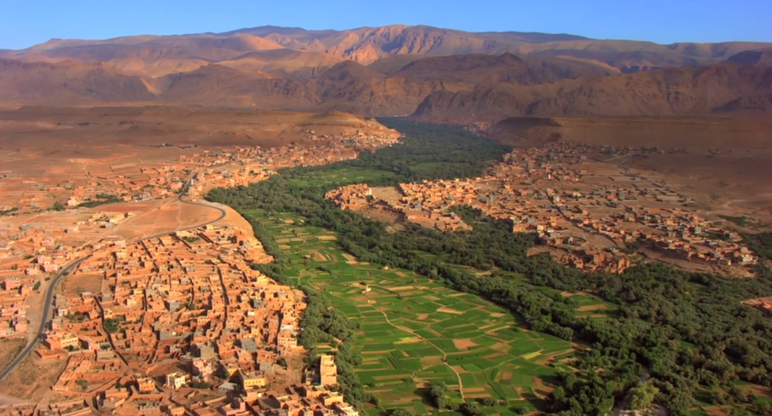
Agricultural Land (Mis)Management
Desertification
Watch this video and
What is desertification?
Identify some myths about desertification
Identify land management practices that could be used to prevent and perhaps reverse this process

Slide 13
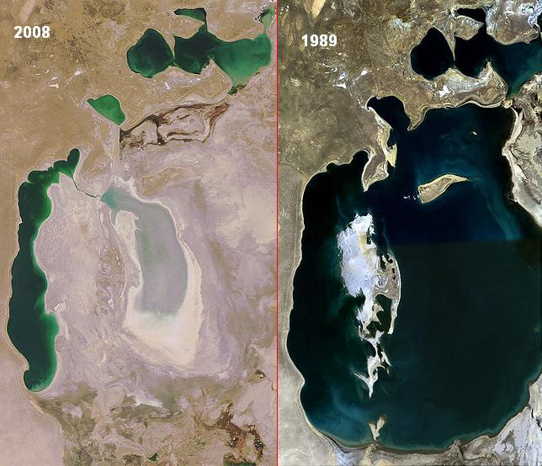
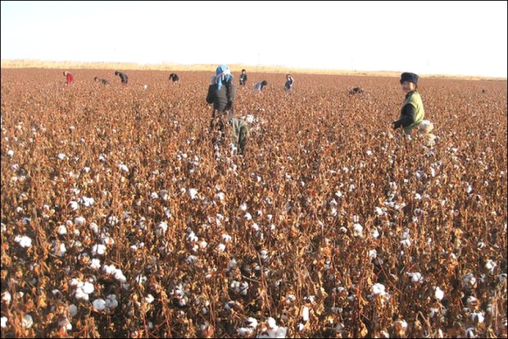
Agricultural Land (Mis)Management
Aral sea eco-disaster
Watch this video and:
Identify the cause(s) of the disaster – both direct (“downstream”) and indirect (“upstream”)
List 4 major impacts of the disaster

Slide 14
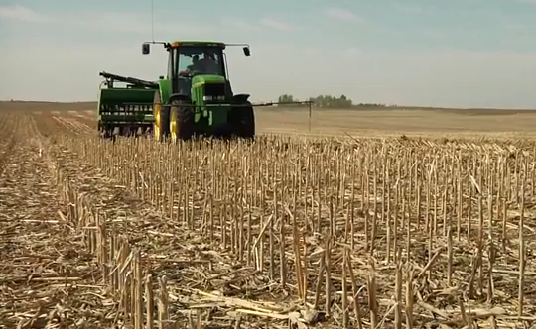
Changes in Land Management
No-till or zero-till
Organic matter including stocks with roots, left on top of the soil rather than tilled under
Meant to retain soil moisture and reduce wind and water erosion
Video: harrow (discs) still used to break up and smooth field for planting

Slide 15
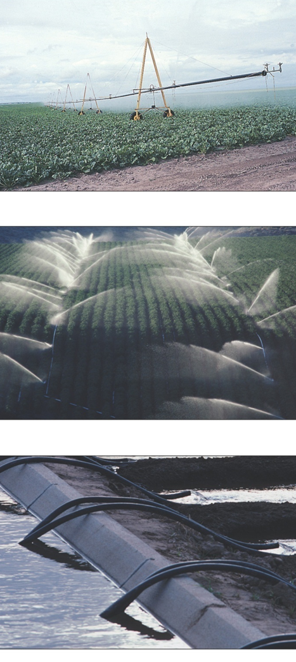
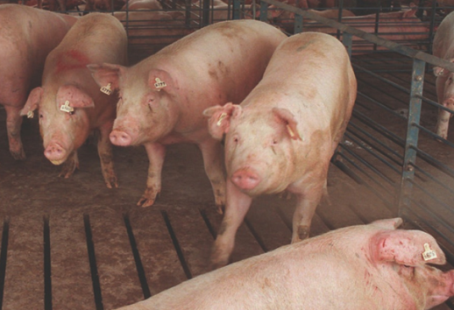
Human Activities on Agricultural Lands
Effects on water resources
Contamination from crop production activities
surface runoff
aquifers showing significant amounts of agrochemicals
Irrigation effects
3,991 million m³ of water used for agriculture in 1991
85% used for irrigation
Prairie provinces apply irrigation to > 635,000 ha
Contamination from livestock production
ILOs; E. coli and the Walkerton tragedy
Notes:
ILO – intensive livestock operations

Slide 16
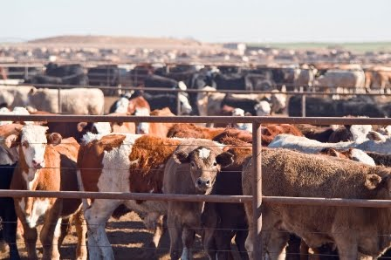
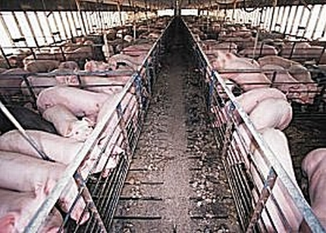
Exercise: ILOs and Balancing economic benefits with socio-environmental costs
Break into groups of 4
Discuss the merits of intensive livestock operations for providing food for Ontarians.
After 10 minutes be prepared to share key points of your discussion
Intensive livestock operations (ILO) have environmental and social consequences

Slide 17
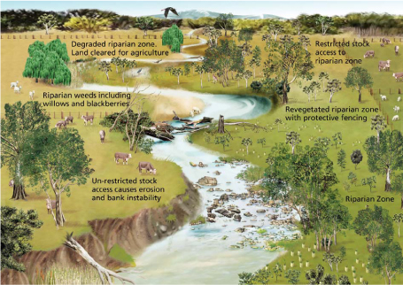
Human Activities on Agricultural Lands
Effects on biodiversity
Wetland loss and conversion
Great Lakes basin: loss of 8,100 ha per year to agriculture and residential development
Rangeland grazing
40% of worlds land surface used for grazing
major cause of “riparian” habitat disturbance
Riparian zone is the area at the interface of land and a freshwater river, stream, lake, pond or wetland

Slide 18
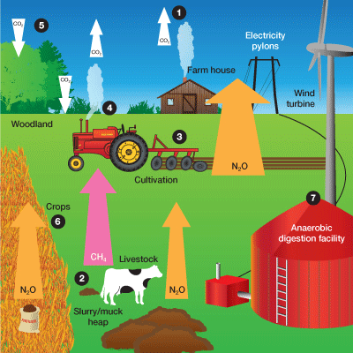
Human Activities on Agricultural Lands
Greenhouse gases
Relation of agricultural activities to GHG concentrations:
soils are a natural source of and reservoirs for carbon
methane is emitted from livestock and liquid manure
nitrous oxides are released from nitrogen fertilizers
Nitrogen in fertilizer increased 10% to 30% to grow higher yield crops
carbon dioxide released from burning of fossil fuels
Notes:
For #3 see law conservation of matter – if a plant is larger it simply requires more inputs.

Slide 19
Sustainable Agricultural Practices
Tillage practices
conservation tillage; zero tillage
less summerfallow (land left idle during growing season)
Protecting riparian habitat
“cows and fish ‘experiment’ ” (Box 6-7)
Rangeland stewardship
stocking rates
Integrated Pest Management (IPM)
Notes:
Summerfallow often requires tilling or spraying to control weeds which is counterproductive
Other soil degradation issues associated with summerfallow are soil erosion, soil organic matter depletion, and soil salinity. Since the soil on fallow land is left bare for long periods of time, the exposed soil is vulnerable to wind and/or water erosion.

Slide 20
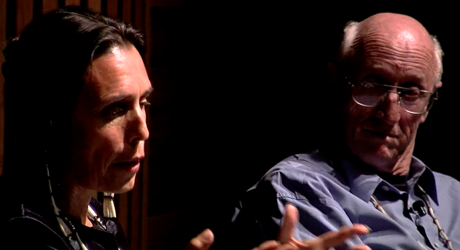
Challenges to Sustainable Agriculture
What is sustainable agriculture?
Land management issues; stewardship
Global markets and competition
Agroecosystem health and productivity
Genetically modified foods: aka “Frankenfoods”?
video
Video: Where do you stand on the GMO debate (because much of your diet likely includes GMOS) ?

Slide 21
International and Federal Initiatives
International
Agenda 21
International Development Research Center (IDRC)
UN’s Food and Agriculture Organization (FAO)
World Trade Organization (WTO)
Convention to Combat Desertification
Canadian International Development Agency (CIDA)
Federal
Environmental Farm Planning (EFP)
National Farm Stewardship Program (NFSP)
Greencover Canada Program (GCP)
Young Environmental Professionals (YEP)
Notes:
Battle against protectionism in the more developed countries is a substantial hurdle.

Slide 22
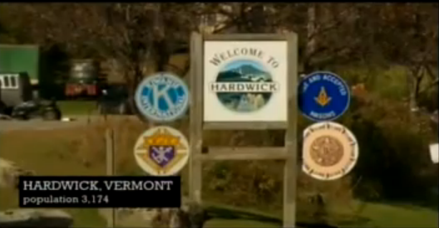
Local Initiatives
Why are local food systems considered more sustainable?
What do you think about this idea?
Returning to localized food systems (videos)

Slide 23
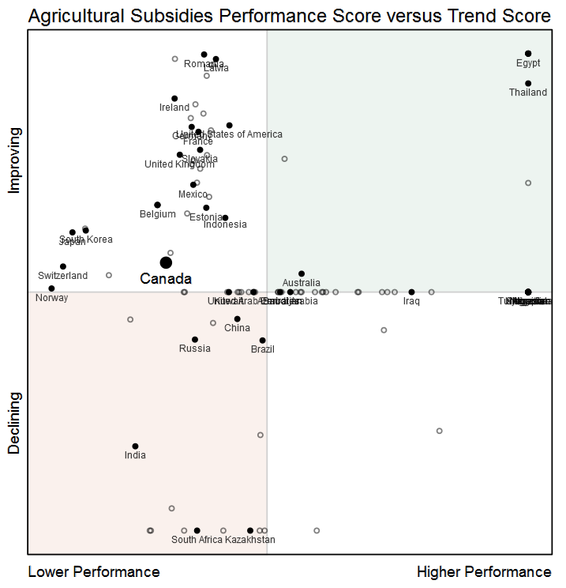
Canada and the World: Agricultural Subsidies
Subsidies
Generally considered counterproductive re: sustainability since they tend to promotes chemical use and expansion of land into sensitive areas
Though we have relatively tight pesticide regulation earning us #1 ranking, Canada’s 2012 EPI agricultural subsidies ranking = #109 (heavily subsidized);while our overall agricultural ranking is #79!

Slide 24
Review
Most desertification is caused by natural processes rather than human-induced processes.
Text a code to 37607 (text Geog2153 to initiate session if needed)
True
False
Or
Respond at this link
No peeking back up the notes…
poll results here

Slide 25
Review
Which of the following substances is generally NOT implicated as a serious greenhouse gas emission from agricultural practices?
Text a code to 37607
O₃
N₂O
CH₄
CO₂
Or
Respond at this link
No peeking back up the notes…
poll results here

