Slide 1
Geography 2153 – Fall 2013
Environment, Economy and Society
Midterm Full-Mark Answer Examples
Jamie Baxter

Slide 2
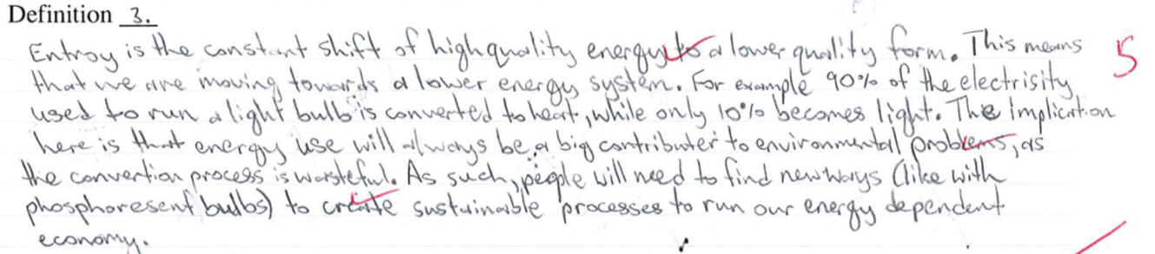
Definitions

Slide 3
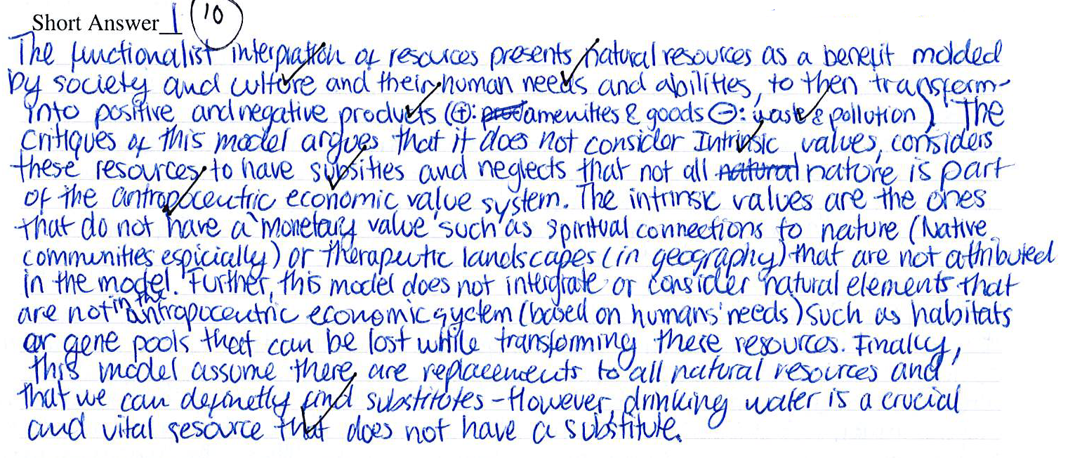
Short Answer

Slide 4
Short Answer

