Slide 1
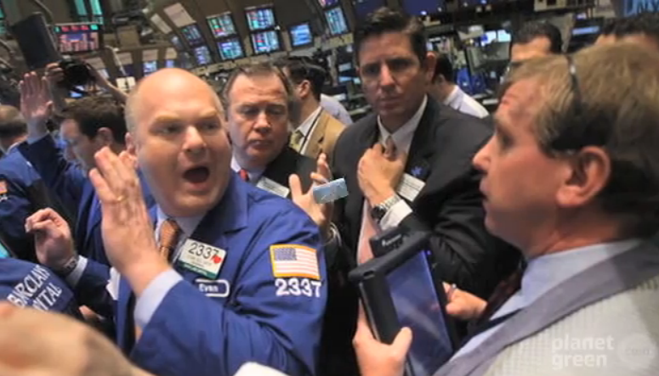
Cap and Trade
A policy that is meant to reduce CO₂ and other greenhouse gas emissions by fixing emissions through permits (emission allowances) – which can be traded (price set by the market)
Used in the European Union, but similar bill defeated in the U.S. in 2009
Video: Cap and trade explained
Notes:
Cap-and-trade environmental advantage over a carbon tax- more certainty re: emissions reductions but little certainty about the price of emissions (which is set by the emissions trading market).
Carbon tax provides certainty about the price but little certainty about the amount of emissions reductions.

Slide 2
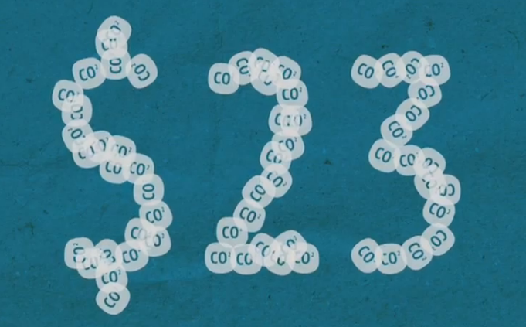
Carbon Tax
A policy that is meant to reduce CO₂ and other greenhouse gas emissions by fixing its price
Video: Carbon tax explained
(effective 2012 in Australia)

