Slide 1
Research Designs
Chapter 2

Slide 2
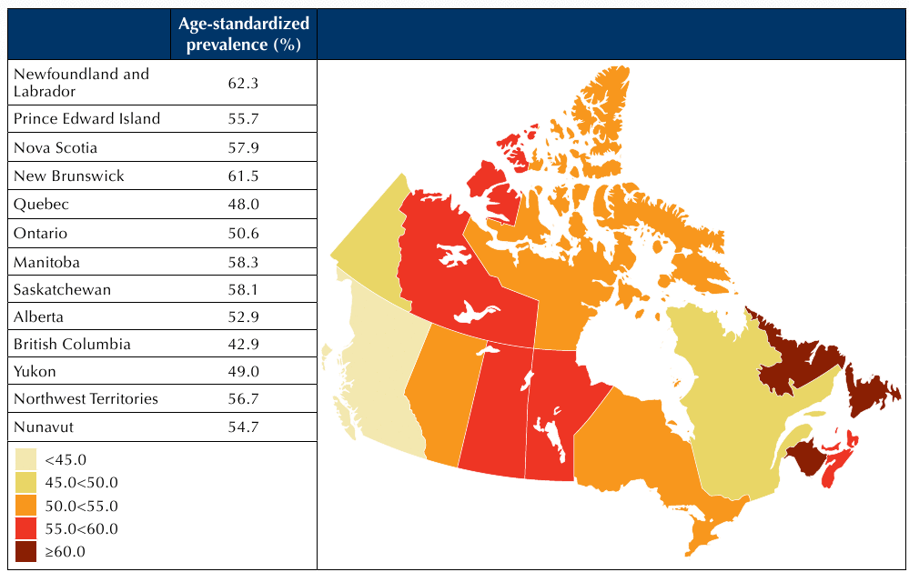
What is a Research Design?
framework for collection and analysis of data
criteria for producing useful results
consider ethics
What sorts of study designs might this map of “obesity” prevalence inspire?

Slide 3
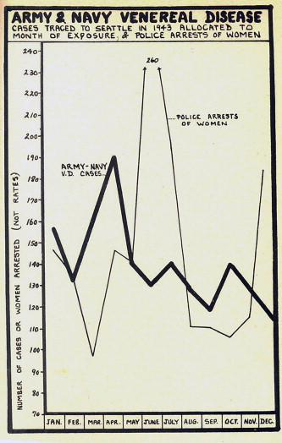
Choice of Design
Types of Explanation
Nomothetic
  attributions of cause and effect, expressed in terms of general laws and principles.
  sample of research subjects extrapolated to larger population
  e.g., ‘The prevalence of obesity in London is a function of the neighbourhood design.’
Brown and Knopp (2010) “Geographies of
sexual health in wartime Seattle”
Notes:
Not just prostitutes…women of all “sorts” including married women…the study reveals how men’s bodies were not nearly as “problematized” – graphs like this, if considered alone, as the main data, hide such interpretations.

Slide 4
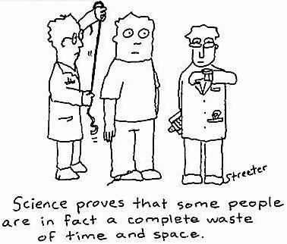
Choice of Design, cont’d.
Ideographic
  rich description of a phenomenon, person or group.
  focus on depth of understanding rather than breadth (degree to which applies to other groups?)
  e.g., ‘Jade became obese because she never got over her parents’ divorce, she felt she was never really accepted by her friends, (plus many more details of how Jade interpreted her life)’.
…but none of them attend Western…

Slide 5
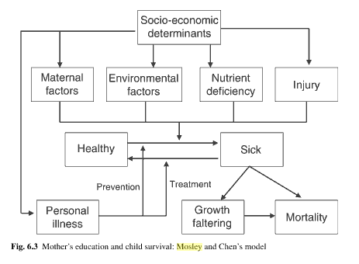
Criteria for Evaluating (Quantitative) Social Research
Causality
correlation between variables
temporal precedence
non-spuriousness (no confounders)
Detecting Spurious Relationships Statistically: If the relationship between maternal education (ME) and child survival (CS) disappears when environmental factors (EF) are added, then the relationship between ME and CS is said to be spurious

Slide 6
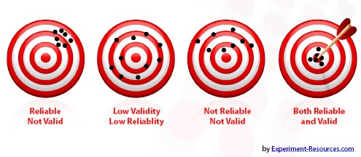
Criteria for Evaluating (Quantitative) Social Research, cont’d.
Reliability – same results from same measurement used on the same subject
  results aren’t influenced by the researchers, setting, timing, etc.
Replicability – results remain the same when others repeat a study.
  i.e., procedures are sound.
Assume that what you intended to measure is in the center, each dot is a repeated measure

Slide 7


Criteria for Evaluating (Quantitative) Social Research, cont’d.
Validity - integrity of conclusions
Measurement/construct validity
  measuring what you want to measure
  e.g., is the number of sexually transmitted infections recorded at military infirmary adequate for the STI rate?
Internal validity
  degree to which causation has been established (see spuriousness in particular)
  e.g., did the study establish that STIs in wartime Seattle really are influenced by arrests of women alone? Could STIs be influenced by something else?

Slide 8


Criteria for Evaluating Social Research, cont’d.
Key terms used when discussing causation:
  Independent variable: the proposed cause, e.g., ‘level of education’
    Occurs first
  Dependent variable: the proposed effect, e.g., ‘recycling behaviour’
    Occurs second as a result of the specified independent variable

Slide 9


Criteria for Evaluating Social Research, cont’d.
Simple model of recycling behaviour
+
+
education
gender
toured a landfill
level of recycling
Independent Variables
Dependant Variable
Notes:
How are we going to measure these things?
What are the possibilities for reverse causation in this model?

Slide 10

Criteria for Evaluating Social Research, cont’d.
External validity: two primary concerns:
  findings applicable to situations outside the research environment?
    e.g., Naturalistic (non laboratory) studies
  findings generalized beyond the people or cases studied?
    E.g., using representative samples.
Would we act the same
outside a laboratory?
Notes:
2. Also known as “generalizability”

Slide 11
Criteria for Evaluating (Qualitative) Social Research, cont’d.
trustworthiness – findings which are worth paying attention to, worth taking account of
  Credibility (in preference to internal validity)
  Transferability (in preference to external validity)
  Dependability (in preference to reliability)
  Confirmability (in preference to replicability)

Slide 12


Criteria for Evaluating (Qualitative) Social Research, cont’d.
Credibility
degree to which findings “make sense” to a wide variety of audiences – e.g., researchers, lay audiences, those studied
  E.g., through close interaction with those studied
Transferability
degree to which findings fit within contexts outside the study
  E.g., through comparison of cases
Living and working with
Small farmers in Jamaica
Notes:
Credibility is the main advantage of qual methods over quant – being there with respondents matters – i.e., who knows what a person is thinking when they fill out a survey?
Transferability of a study may not be known until further case studies are conducted – researcher’s job is to choose concepts that are not so context-specific that they might be conceivably be transferable

Slide 13
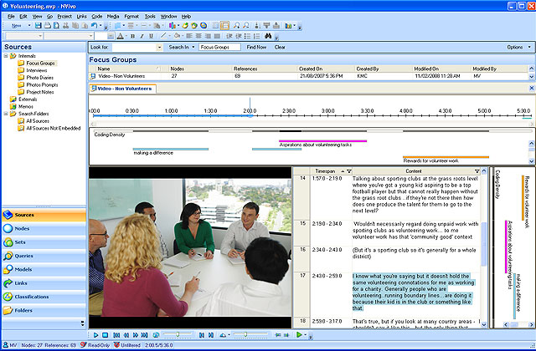
Criteria for Evaluating (Qualitative) Social Research, cont’d.
Dependability
consistency with which the same constructs may be matched with the same phenomena over space and time
Confirmability
the degree to which findings are determined by the respondents and context and not (solely?) by the biases, motivations, interests or perspectives of the inquirer
Software now helps keep track of data-to-concept linkages
Notes:
Autobiography is one way to address confirmability…and keep in mind all research is biased in one way or another – confirmability addresses how we deal with that bias

Slide 14
Research Designs: Experiments
Two kinds of experiments:
  Field experiments are conducted in real-life surroundings
  Laboratory experiments take place in artificial environments/
    Controls research environment.
    Easier to randomly assign research subjects.
    Therefore enhanced internal validity.
    Easier to replicate.

Slide 15
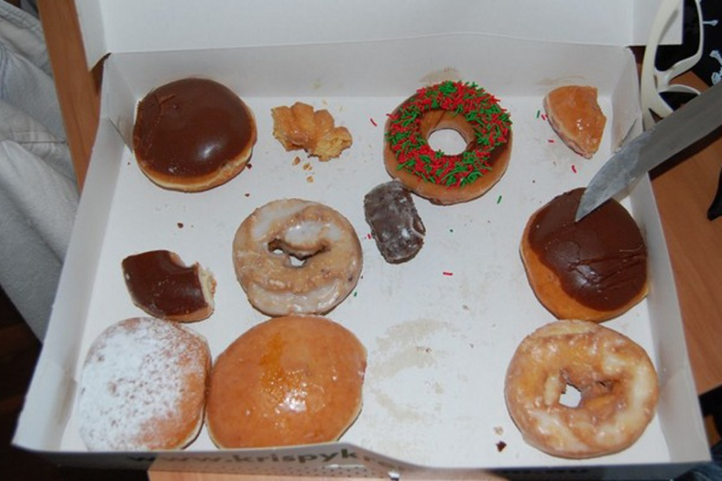
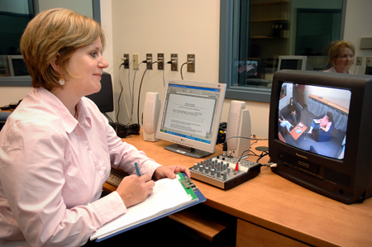
Research Designs: Experiments, Key Concepts
  Experimental or treatment group
  Control group
  Random assignment
  Pre-test
  Post-test
Are people experiencing personal and professional
instability more likely to discount long term rewards?
(Will they eat a stale donut in favour of waiting for fresh donuts?)

Slide 16
Research Designs: Experiments
Rare in social geography because:
  Many variables of interest are not subject to experimental manipulation.
  Ethical concerns preclude performing experiments.
  Many phenomena of interest have long-term, complex causes that cannot be simulated in experiments.
  Even where applicable, experimental models do not get at the perceptions and feelings of research subjects.

Slide 17
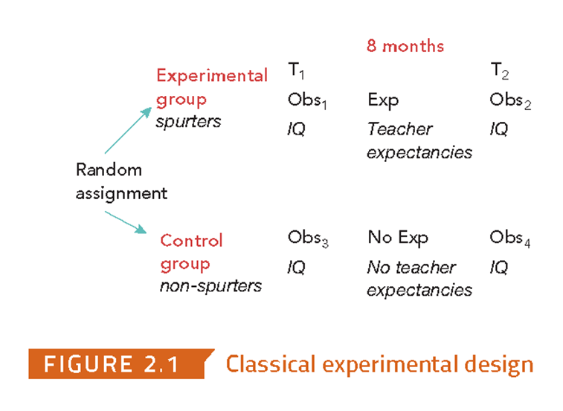
Classic Experiment
Rosenthal and Jacobson (1968) “teachers expectations” experiment – “Pygmalion effect”
Click image for video

Slide 18
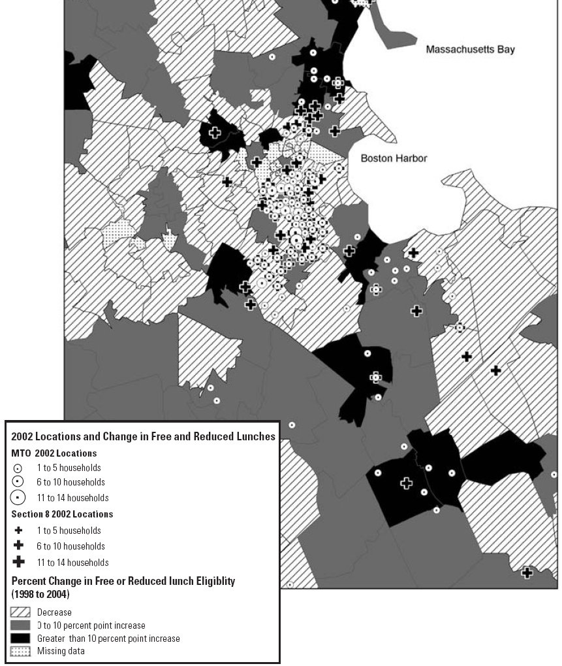
Natural experiments
“Why did the moving to opportunity experiment not get young people into better schools?”
study (“treatment”)
group
control group
Notes:
Xavier de Souza Briggs; Kadija S. Ferryman; Susan J. Popkin; María Rendón, Why did the moving to opportunity experiment not get young people into better schools? Housing Policy Debate (January 2008), 19 (1), pg. 53-91

Slide 19
Review
Which of the following is not a main weaknesses of controlled experiments in social research?
  Many variables of interest are not subject to experimental manipulation. 545901
  Ethical concerns preclude performing experiments. 545902
  Experiments focus too much on perception and feeling. 545904
  The complex multiple causes of real-world behaviour cannot be simulated in experiments. 545966
Phone # is: 37607
Web link is here.
See results here.

Slide 20
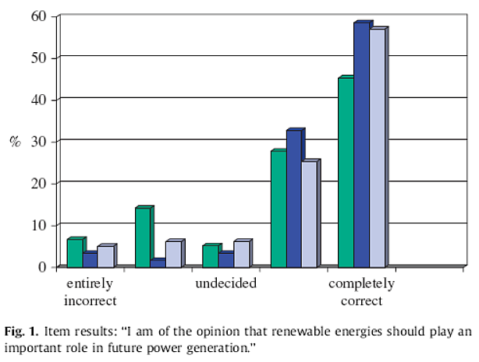
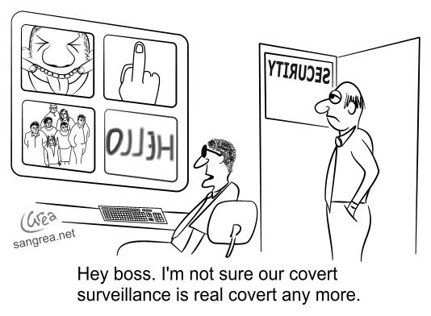
Research Designs: Experiments, cont’d.
Green – solar (2006)
Light blue – wind power (Jan 2007)
Threats to internal validity in experiments that lack random assignment and/or the presence of a control group.
  History: some event occurring after the treatment was given may have influenced the dependent variable.
  Testing: the pre-test may have influenced how same people respond in post-test
  Instrumentation: changes in the way a test is administered may account for pre-test and post-test differences
Dark blue – biomass (Jul 2007)
History – major report about climate change crisis released in 2007
Testing – if they know, behaviour may change
Notes:
Zoellener, Schweizer-Ries, and Wemheurer (2008) Public acceptance of renewable energies: Results from case studies in Germany, Energy Policy ,36: 4136-4141

Slide 21
Research Designs: Experiments, cont’d.
Threats to internal validity (continued):
  Mortality: participants leave the experiment before it is over.
  Maturation: participants change over time, e.g., get older, develop mentally and emotionally, etc.
  Selection: pre-existing differences in control and experimental group – e.g., non-random assignment

Slide 22
Research Designs: Experiments, cont’d.
Threats to external validity:
  Interaction of selection and treatment: findings not generalizable beyond group studied in the experiment
  Interaction of setting and treatment: findings may not apply to settings that differ from those of the experiment
  Interaction of history and treatment: findings may not apply to other time periods
  Interaction effect of pretesting: findings may not apply to people who were not pretested
  Reactive effects of experimental arrangements: the findings may be invalid because they were caused by subjects behaving atypically due to the fact that they were in an experimental situation

Slide 23
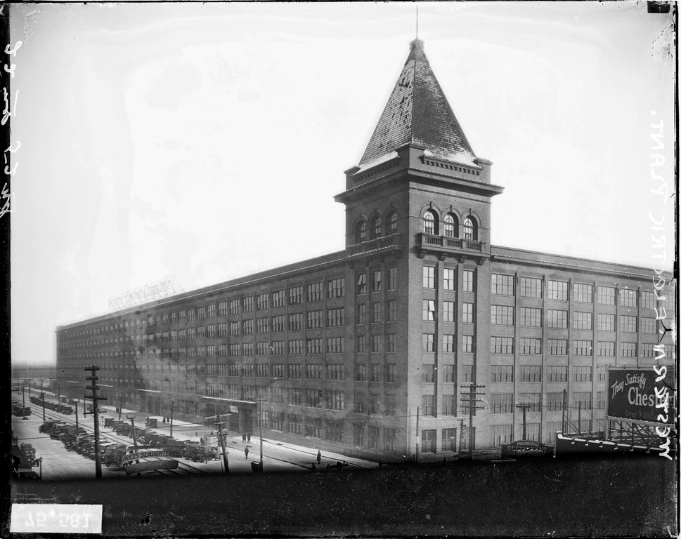
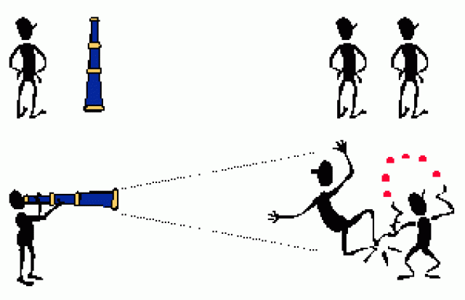
Confounder: Hawthorne Effect - Reactivity
People change behaviour because know being studied
  (video: start at 4:54)
Hawthorne Illinois Western Electric Factory
Playing to the camera?

Slide 24
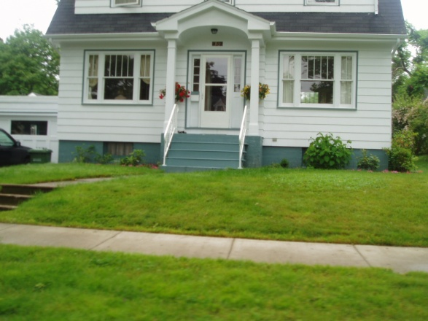
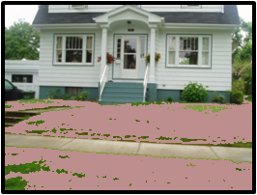
Research Designs: Natural-Experiments
naturally occurring phenomena or changes introduced by people who are not researchers result in experiment-like conditions.
Avoids ethical problems of assigning “treatment” – but not random
  E.g. does a municipal pesticide ban result in landscape degradation that in turn leads to weakened civic pride?
Time to put the lawn mower on Kijiji
What is the effect of a pesticide ban on civic pride?

Slide 25

Research Designs: Cross-sectional design
Cross-sectional designs involve taking observations at one point in time (“snapshot” - no before and after comparisons).
  They do not include a manipulation of the independent variable (no ‘treatment’ is given).
  E.g.: questionnaires, structured interviews, structured observation
  Two or more variables are measured in order to detect patterns of association.
Notes:
This is the type of research most of us do.

Slide 26
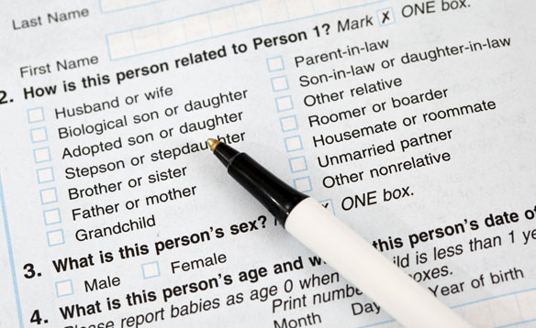
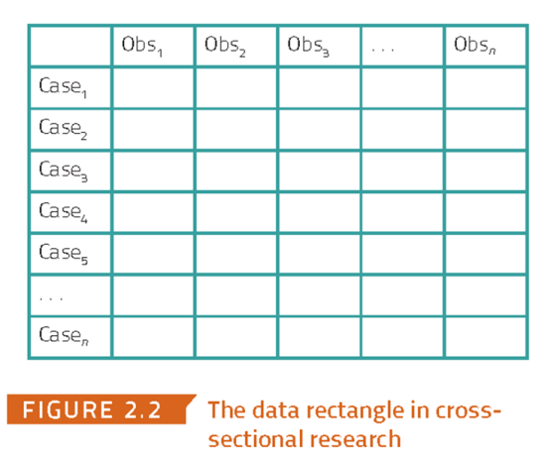
Research Designs: Cross-sectional design Advantages
Examine the effect of variables that cannot be manipulated in experiments.
  E.g., age, gender, ethnicity, culture, social class, etc.
Relatively inexpensive
Fast
Many data sets readily available
  E.g., Canadian census
There are several cross-sectional
data sets freely available

Slide 27
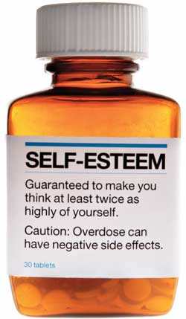

Research Designs: Cross-sectional design, cont’d.
Internal validity problem: reciprocal causation
  e.g., a researcher may find a positive association between self-esteem and income.
  But does self-esteem influence the level of income, or is it the other way around?
or
or

Slide 28
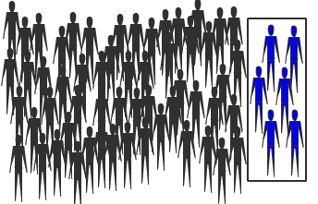
Research Designs: Cross-sectional design, cont’d.
external validity problem: generalizability and random selection
For cross-sectional studies to have external validity, it helps if some random method is used to select participants for the study.
See lecture on sampling!
Sample should have same
characteristics as the population.
Random sampling usually accomplishes this.
Notes:
Random assignment in experiments handles confounders, random selection handles generalizability

Slide 29
Research Designs: Longitudinal Design
Cases are examined at a particular time (T1), and again at a later time or times (T2, T3, etc.)
These designs provide information about the time-order of changes in certain variables.
This helps establish the direction of causation.
  For example, if an increase in income is observed at T1, and an increase in self-assessed health occurs at T2, that is evidence that the increase in life satisfaction was preceded by the increase in income, rather than the other way around.

Slide 30
Research Designs: Longitudinal design, cont’d.
Two basic types:
  Panel study: the same people, households, organizations, etc. are studied at different times.
  Cohort study: people sharing the same experience are studied at different times, but different people may be studied at each time.
    e.g.: a researcher may study people born in 1990 at three different times (say in 1995, 2000, and 2005), but may use different subjects each time.

Slide 31
Research Designs: Longitudinal design
Drawbacks:
  Attrition over time
  It may be difficult to determine when subsequent waves of the study should be conducted.
  Panel conditioning: people’s attitudes and behaviours may change as a result of participating in a panel.

Slide 32

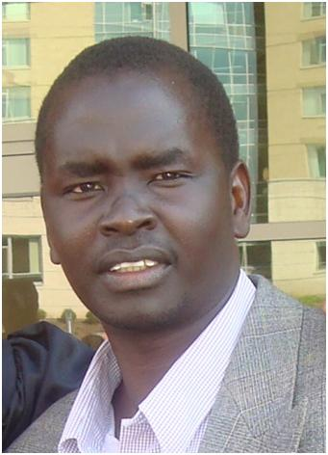
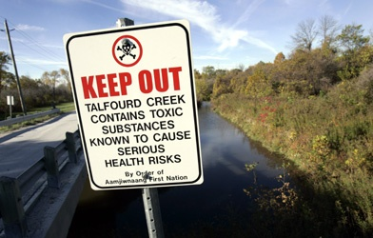

Research Designs: Case Studies
A basic case study involves an in-depth study of a single case.
A single case can be a community, person, family, organization, event, etc.
Can involve qualitative and/or quantitative research methods.
Luginaah
Atari
Experiences living in “Chemical Valley”

Slide 33
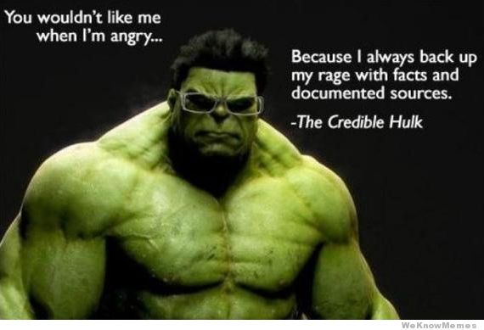
Research Designs: Case Studies - Strength
Credibility - in particular they provide in-depth descriptions of the characteristics of a particular case that cannot be achieved using other methods.

Slide 34
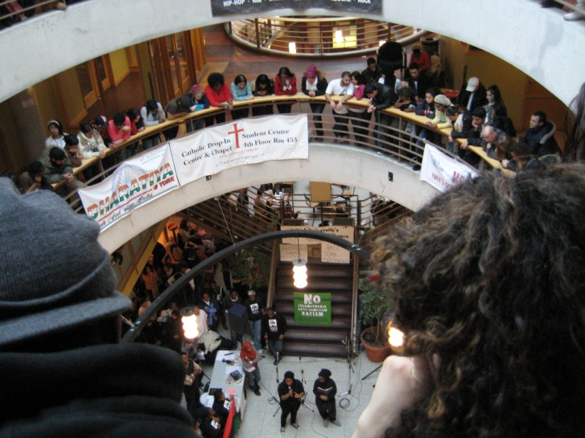

Research Designs: Case Studies, cont’d.
Case studies problem: external validity
Specifically, the findings for a particular case may not be applicable to other cases.
  e.g., a study of student activism at York university may not be applicable to students at Western.
Student protests at York a way of life?

Slide 35
Research Designs: Case studies, cont’d.
Types of case:
  Critical: illustrates the conditions under which a certain hypothesis holds or does not hold.
    e.g., household or neighbourhood in Sarnia with high stress and weak coping strategies
  Extreme (or unique): illustrates unusual cases, which help in understanding the more common ones.
    e.g., household or neighbourhood in Sarnia that stands out with low income but strong coping strategies
Notes:
Often it is difficult to distinguish a critical from extreme cases

Slide 36
Research Designs: Case studies, cont’d.
Revelatory: examines a case or context never before studied.
  e.g., the study of a particular historical figure may be enhanced when documents are ‘de-classified’ or enter the public domain, such as the diaries of former Prime Minister McKenzie-King.

Slide 37
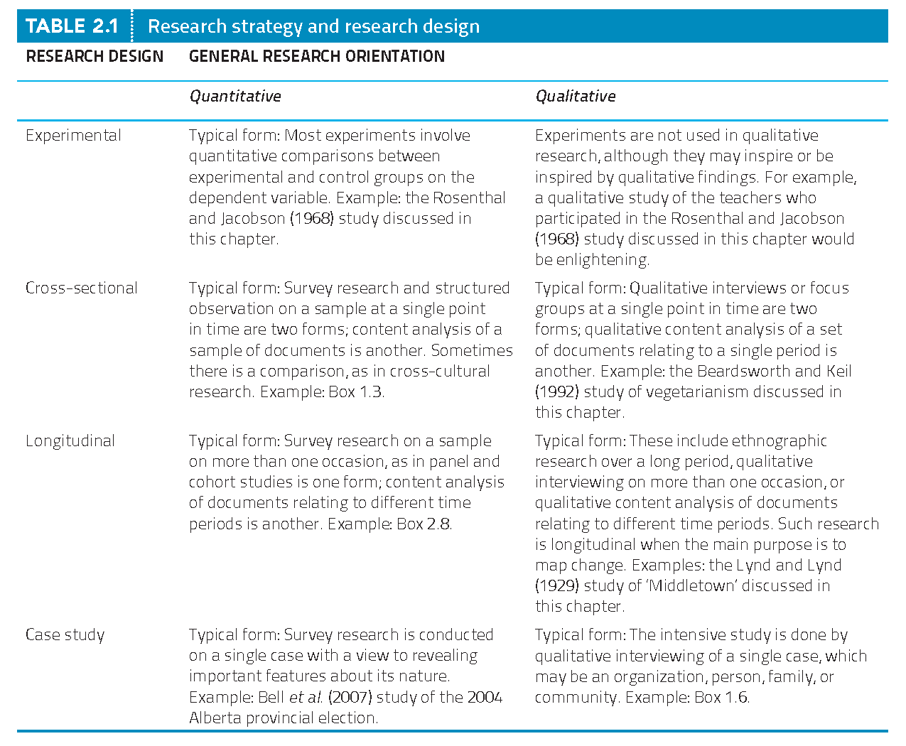
Summary

Slide 38
Review
Which of the following is not a characteristic of a causal relationship between A (cause) and B (outcome)?
  Variable A must be correlated with B. 556537
  Variable A must be reciprocally correlated to B 556538
  Variable C must not cause A and B (non-spuriousness). 556591
  Variable A must precede B in time. 556594
Phone # is: 37607
Web link is here.
See results here.

