Slide 1
Geography 2153 – Fall 2013
Environment, Economy and Society
Key Concepts
Jamie Baxter

Slide 2
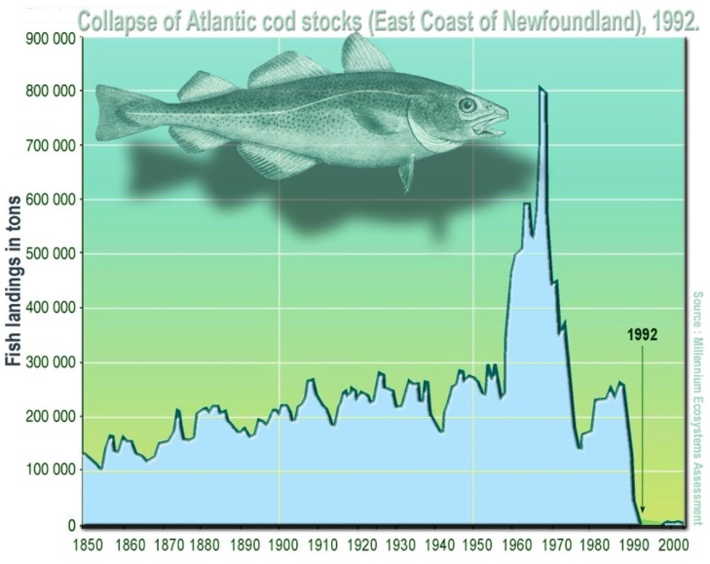
Outline
Defining sustainability
Defining resources
Ecosystem approach
Tragedy of the commons
Key moments in sustainability
Measuring sustainability
  Ecological footprint
  Critique of EF
Assignment #1
The concepts in this lecture help to explain the collapse of the Altantic cod fishery 1992

Slide 3
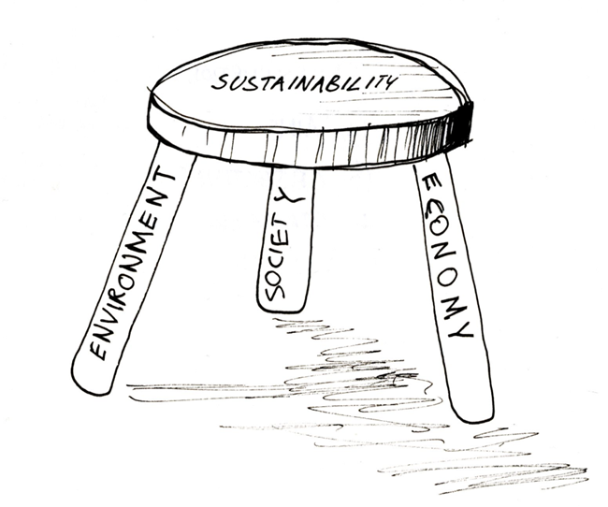
Definitions
Environment
surroundings in which an organism lives
affected by physical characteristics
  abiotic – e.g., temperature, moisture, light, ph, soil, wind
  biotic – other living organisms (i.e. for food, symbiosis etc.)
Image source

Slide 4
Definitions
Economy
system that generates the wealth
production and consumption of goods and services
distribution or exchange of goods
Image source
Notes:
…and we will be reminded again and again throughout the term that that distribution is uneven

Slide 5
Definitions
Society
group of humans who co-exist
relates to each other through politics and culture, institutions (e.g., school, religion) all of which govern behaviour
systems of dominance/oppression
Image source

Slide 6



Definitions
Sustainability
What are key elements?
(post discussion slide – password provided after discussion)
Text GEOG2153 to 37607 engage polleverywhere then text your response
Image source
OR
Instructor:
activate the poll now
Respond at this link
OR
Respond at PollEv.com/geog2153
Poll results

Slide 7
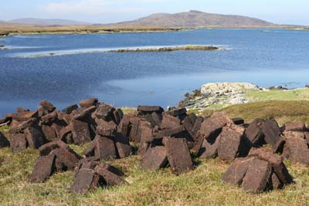
Definitions
Resource
Something from which benefit is produced
socially defined
historically and place specific
  Name a resource that is much more important now than 100 years ago
Is this a resource?

Slide 8
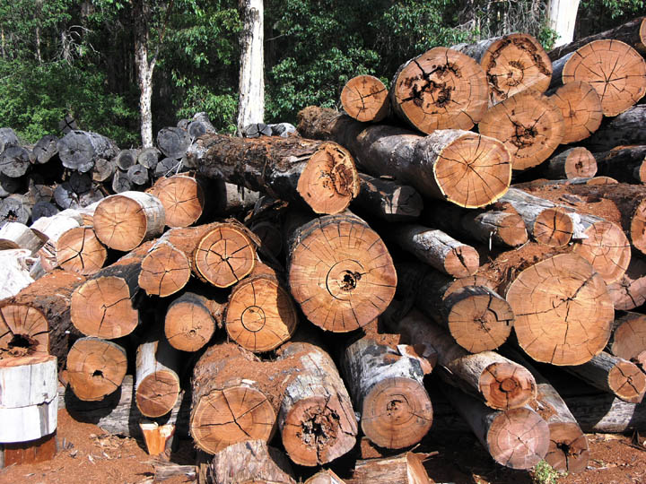

Definitions
Natural Resource
Components of nature that are useful to humans at a price we are willing to pay
What resources are not “natural”?
Trees are natural resources, so are forests, source.
Notes:
So maybe not(non)-natural resource as a concept is not as useful as these next two…

Slide 9
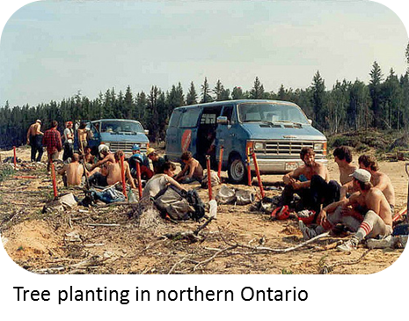
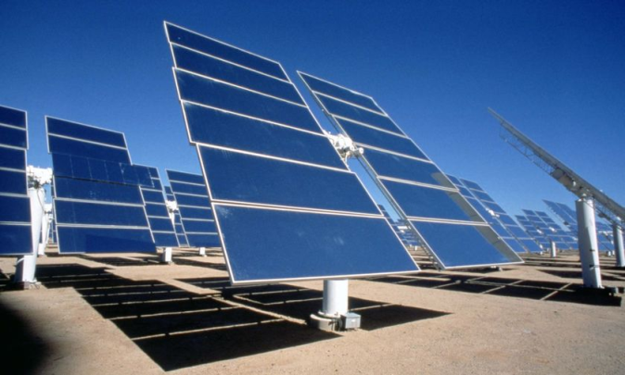
Definitions
Renewable Resource
Resources that can be replaced by ecosystem processes
Replacement must be in timeframe meaningful to humans (i.e. not geologic time…)
a.k.a.: renewable natural capital
Solar energy for heat or electricity

Slide 10
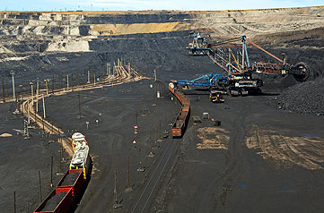
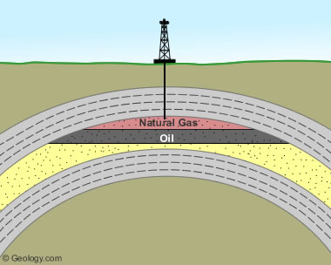
Definitions
Non-Renewable Resource
Resources that are in finite supply on timescale meaningful to humans
a.k.a non-renewable natural capital
Open pit coal mine
This type of natural gas is non-renewable

Slide 11
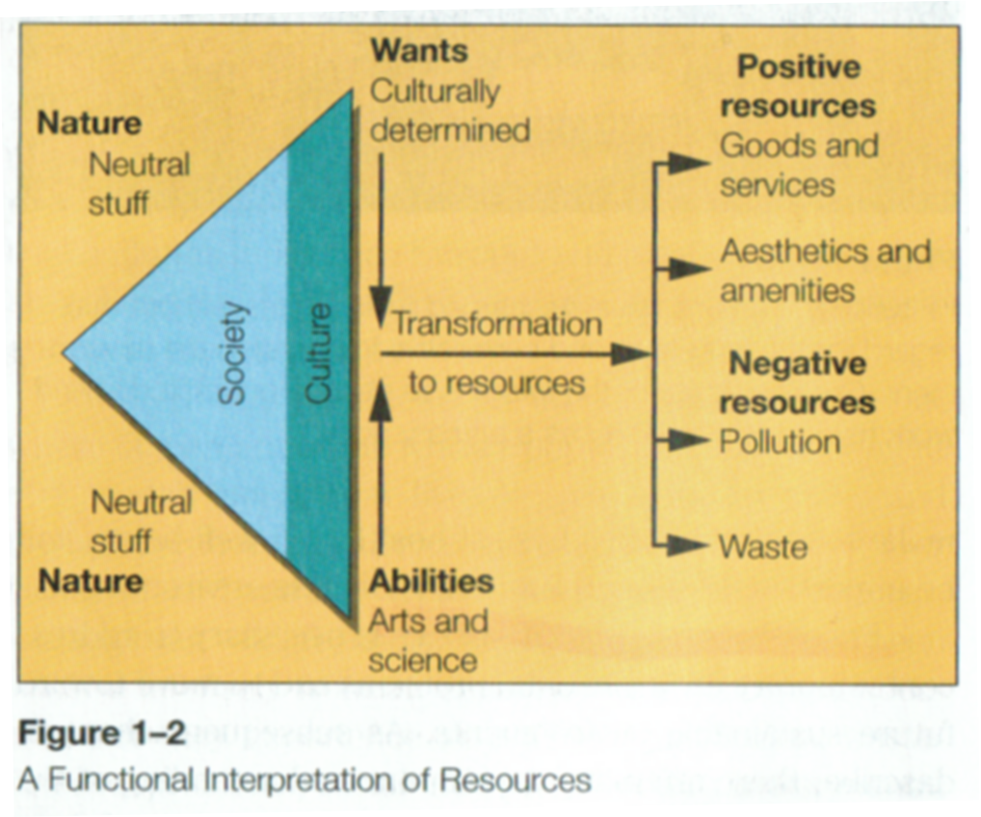
Functionalist Perspective on Natural Resources
Resource use is determined by culture (e.g., capitalism)
Limited largely by wants and abilities
As pollution and waste accumulate, less harmful substitutes are used
Market helps create harmony with natural resource use
Notes:
3 critiques from the text

Slide 12
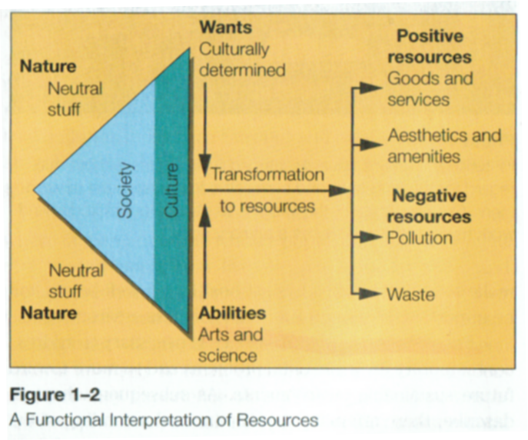

Limitations…
What are some problems with the functionalist model of resources (post discussion slide password in class)?
Notes:
3 critiques from the text

Slide 13
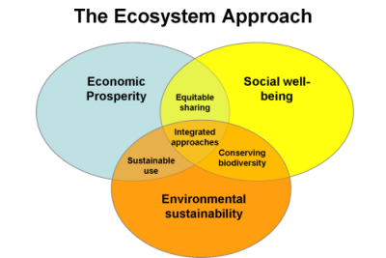
Ecosystem Approach
Ecosystem Approach
Approach to resource management that integrates rather than isolates
Set of principles to guide decision-making
Holistic
Equity
Shared governance
Commensurate with sustainability

Slide 14
Conflict Over Resources
Four Types of Resource Conflict
Cognitive | Different understandings of a situation. Different technical knowledge
Value | Different judgements about ends to be achieved
Interests | Different judgements about who should pay and who should benefit
Behavioural | How stakeholders act towards each other based on historical attitudes and relationships (which may have included the other three types of resource conflict)
Source: Mitchell (2010) Resource and Environmental Management in Canada, New York: Oxford

Slide 15
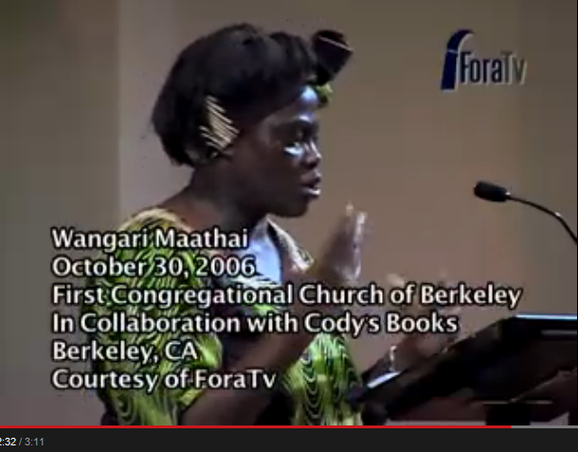
So What?
Click to view video

Slide 16
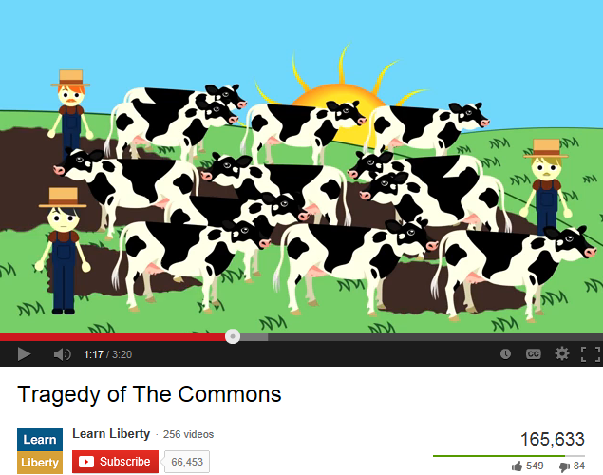
Tragedy of the Commons
What do you think of the private ownership solution to the tragedy of the commons?
Notes:
Think critically!

Slide 17
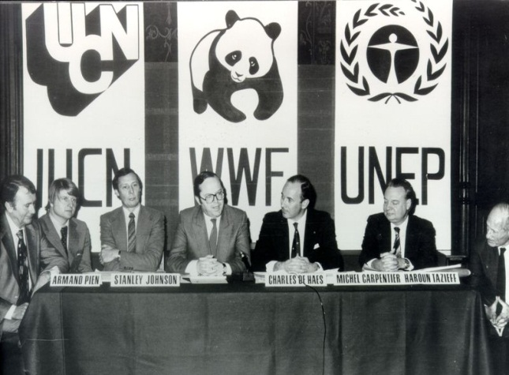
Key Moments in Sustainability
World Conservation Strategy – 1980
Introduced “sustainability” into common public discourse
Focused on conservation (humans more indirectly)
Meeting that spawned the World Conservation Strategy document
Notes:
International events!

Slide 18
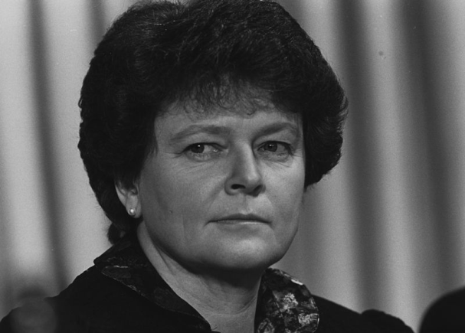
Key Moments in Sustainability
Our Common Future – 1987
a.k.a. the “Bruntland Report”
World Commission on Environment and Development
Focus on equity
“Development that meets the needs of the present generation without compromising the ability of future generations to meet their own needs”
Norwegian Gro Harlem Bruntland 1989
Notes:
International events!

Slide 19
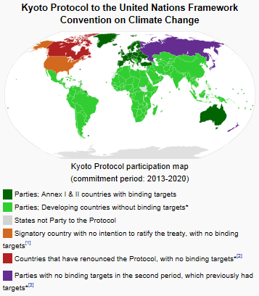
Key Moments in Sustainability
UNCED “Earth Summit”– 1992
International agreements signed – e.g., Climate Change charter; Agenda 21 plan for sustainable development
Kyoto Protocol– 2005 (date in force)
International treaty under United Nations Framework Convention on Climate Change (from 1992)
Greenhouse gas emissions reductions
Canada dropped out of “Kyoto” in 2011
Notes:
Kyoto Protocol adopted in 1997 – 8 years to put into effect (13 years after initiated in Rio)!

Slide 20
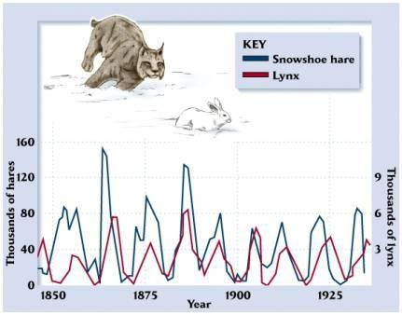

Measuring Sustainability: Carrying Capacity
Carrying Capacity – capability of an ecosystem to support healthy organisms while maintaining its productivity, adaptability and capability for renewal
(World Conservation Union et al., 1991)
Biological/ecological term – usually refers to a number of organisms a defined space on earth can support
Carrying capacity for Canadian lynx regulated by availability of snowshoe hares
Notes:
Population goes up and down according to ecosystem fluctuation – sobering thought, but is that happening with humans?

Slide 21
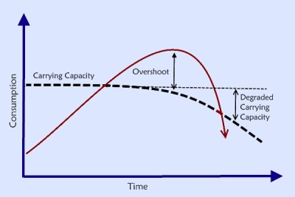
Carrying Capacity
Overshoot - a population's consumption exceeds the carrying capacity of its environment
  Consequence – death rates increase and population declines
  Resources degraded – degraded carrying capacity
  Median of estimates for humans on earth…approx. 10 billion
+ natural increase
- natural increase

Slide 22
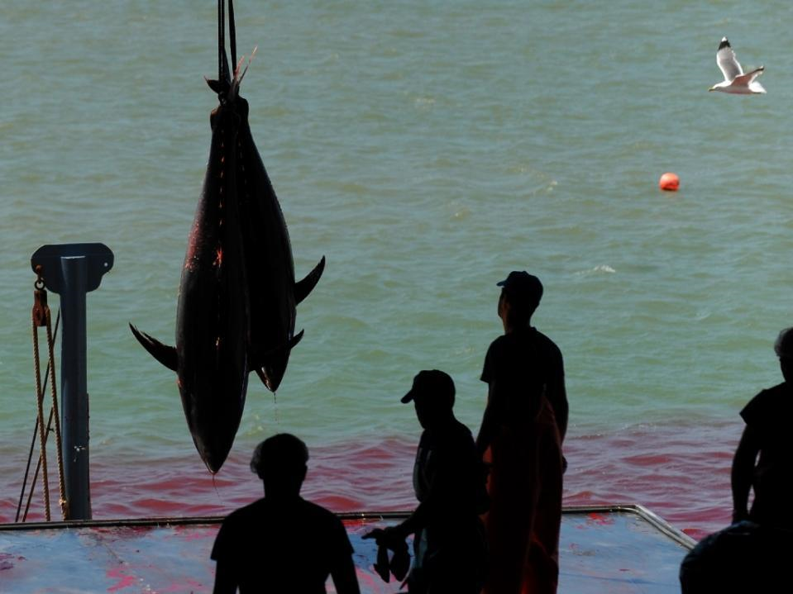
Overshoot in Oceans
WWF report that between 1970 and 2012 marine life cut in half (source)
Overfishing, global climate change, and pollution among culprits
Global climate change one several causes of marine life loss

Slide 23

Limitations (critique) of Carry Capacity
Why is determining the population an ecosystem (piece of land) will support limited for humans?

Slide 24
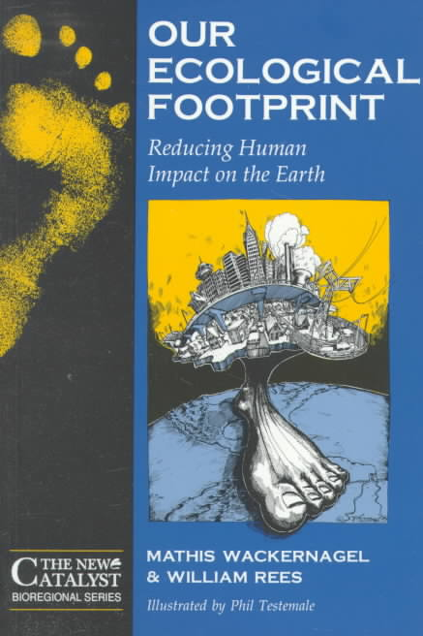
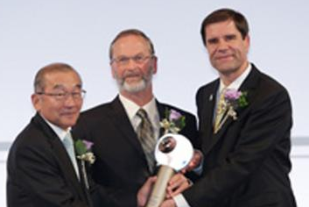
Ecological Footprint
Wackernagel and Rees (1996)
accounting tool to invoke positive change
convert consumption into land
used to compare across space and time
turns carrying capacity concept on its head
Award winning-idea!

Slide 25
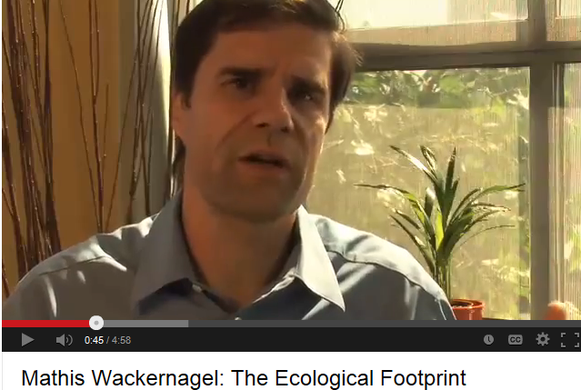
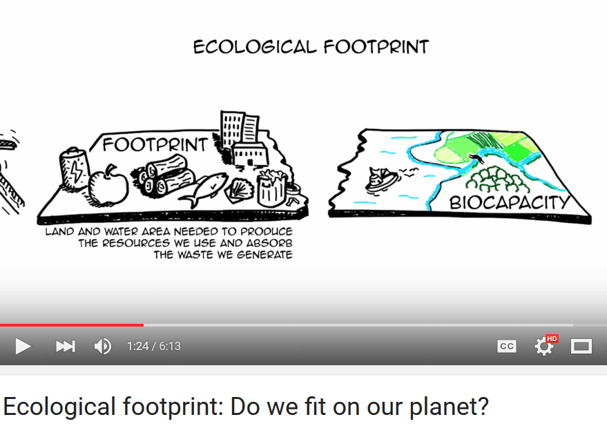
Ecological Footprint

Slide 26
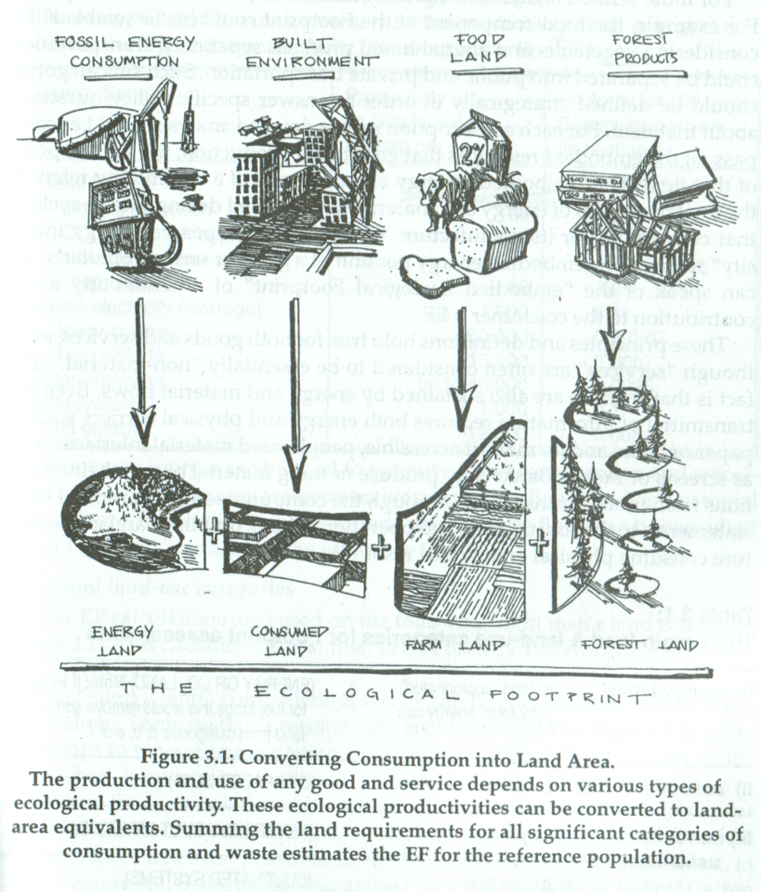
Ecological Footprint
Simple and elegant
Forces us to (at least) think about our connection to nature for everyday needs

Slide 27
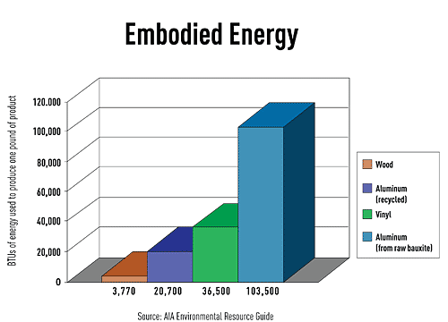
Ecological Footprint
Embodied energy
  energy from processes associated with the production of a product/material, from the mining and processing of natural resources to manufacturing, transport and product delivery
EF analysis builds on this idea
Products requiring mining and petrochemicals have high embodied energy, source

Slide 28
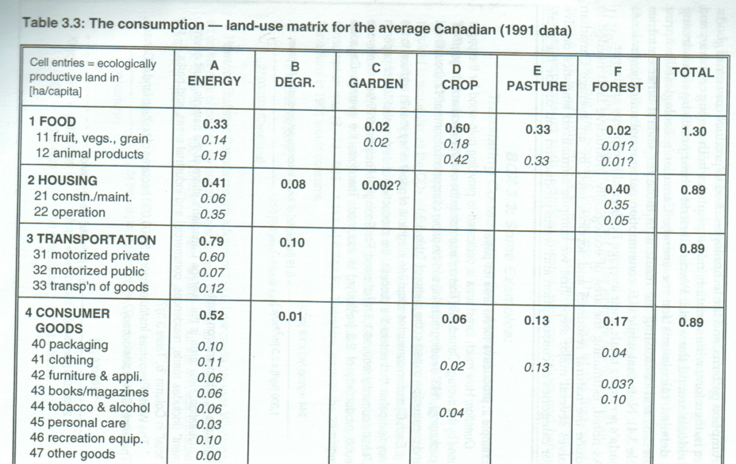
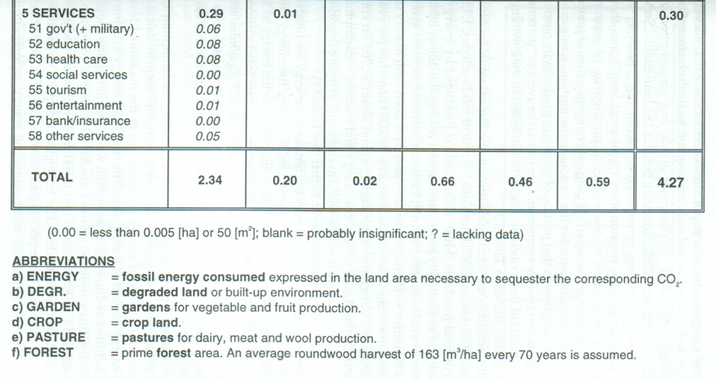
Ecological Footprint
Each good or service is converted to hectares of land needed to produce that good or service
E.g. energy is measured in arable land needed to sequester the CO₂ from the fossil fuel inputs
Implications from this table?
Notes:
Hint: look at column and row totals

Slide 29
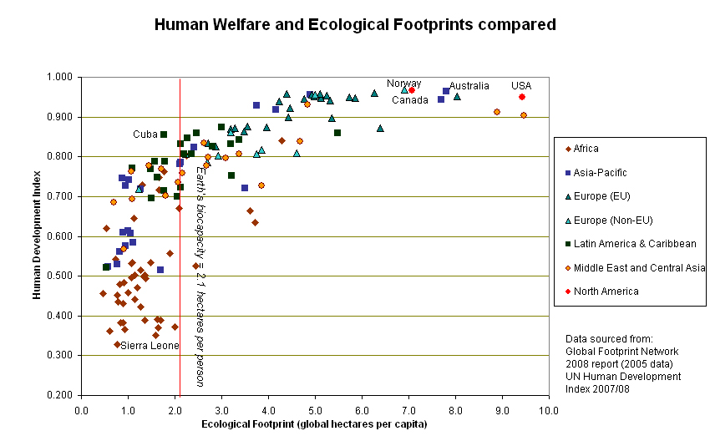
Ecological Footprint
Characterize the following relationship
Notes:
Pay particular attention to countries to the left and right of the coloured line…

Slide 30


Ecological Footprint
calculate your footprint
for a more detailed accounting and if you are familiar with xls spreadsheets…
myfootprint.org NO LONGER free
footprintnetwork.org version is free

Slide 31
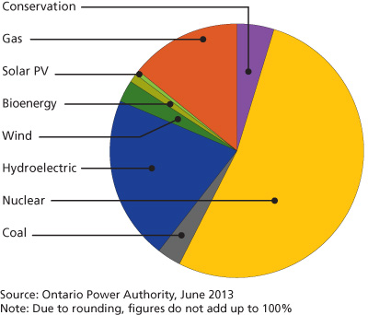
Ecological Footprint to think about…
What assumptions might these footprint calculators be making about energy?
E.g., what about renewables energy?
Notes:
Original EF calculations – i.e. the book Our Ecological Footprint – used a CO₂ sequester method – the amount of land needed to grow trees to result in net 0 carbon release
i.e. nuclear energy is CO₂ friendly, but does EF analysis fully account for this technology? What about other technologies?

Slide 32
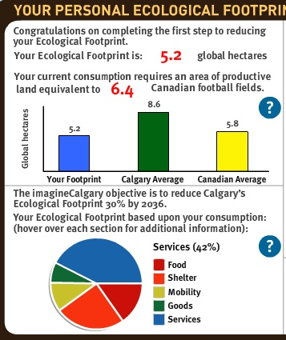
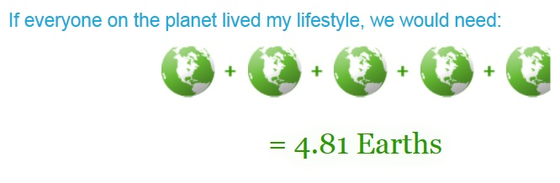
Do as I say not as I do…
My footprint
Globally we currently need about 1.5* earths to sustain us
Suggests we are in overshoot
Myfootprint.org
footprintnetwork.org
* This figure varies widely depending on the assumptions built into EF

Slide 33


Ecological Footprint:
Review Poll
Where does your footprint fall (as converted to “earth” equivalents)?
Text a, b, c, d or e to 37607
Less than 1 “earth”
1.0-1.9 “earths”
2.0-2.9 “earths”
3.0-3.9 “earths”
4.0 “earths” or greater
Instructor:
activate the poll now
OR
Respond at this link
OR
Respond at PollEv.com/geog2153
poll results here

Slide 34
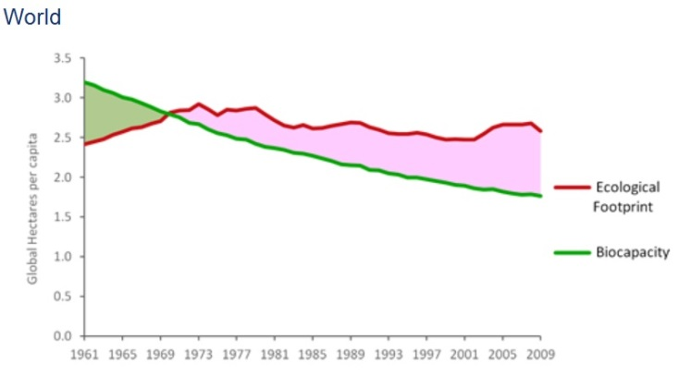
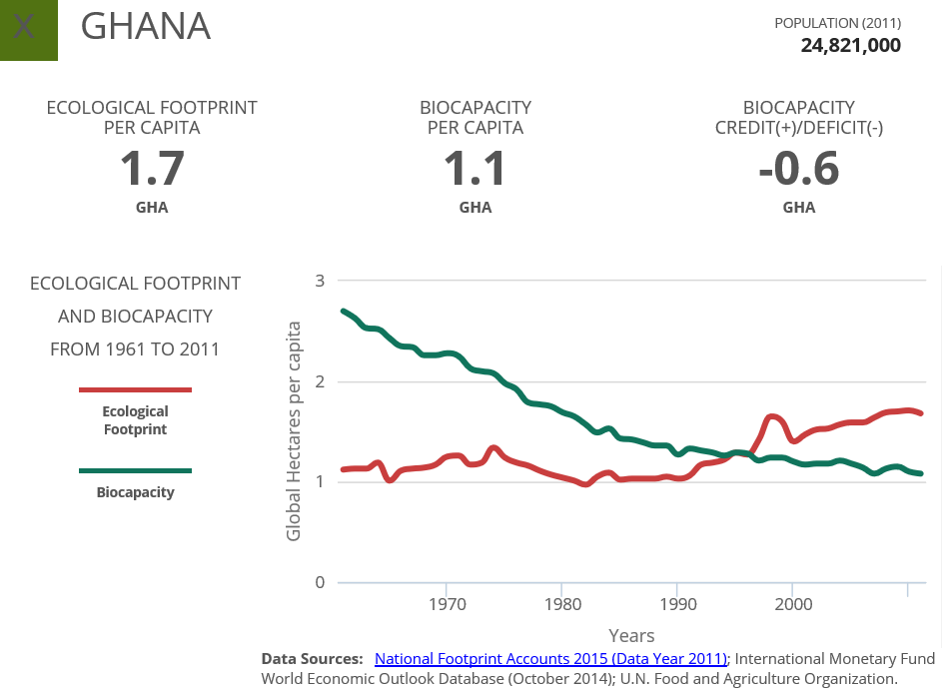
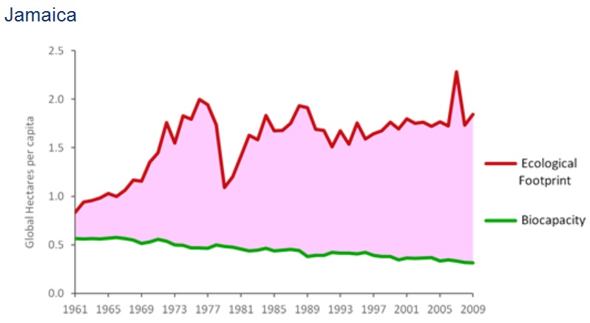
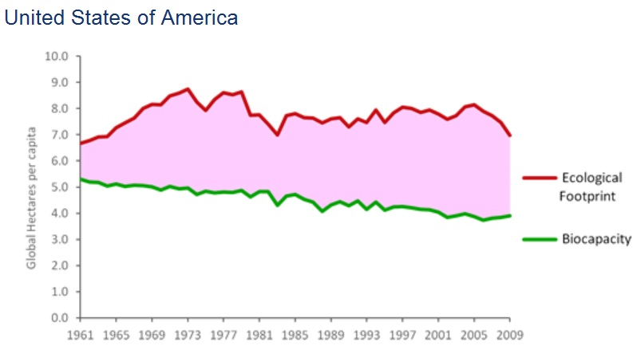
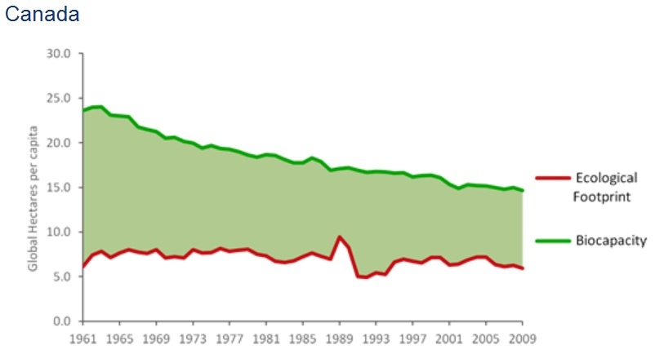
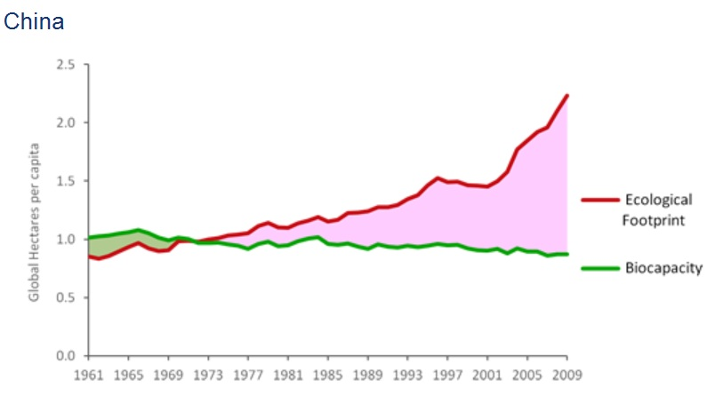
Footprint Examples
Why such wide discrepancies?

Slide 35
Ecological Footprint:
Review Poll
What is the most important factor to account for global differences in the ratio of ecological footprints to bio-capacity?
Text a, b, c or d to 37607
Over consumption
Population size
Sequestration of carbon from energy use
Overuse of arable land
OR
Instructor:
activate the poll now
Respond at this link
OR
Respond at PollEv.com/geog2153
poll results here

Slide 36
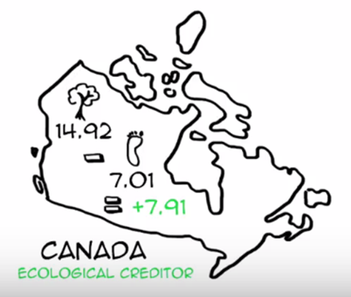
Critiques of Footprint Analysis
Identify some limitations/problems with ecological footprint analysis.
  see slide (password provided after discussion)
Notes:
Places with small land mass are depicted as parasitic – whereas dense can be environmentally sustainable if hinterlands are resource rich and close-by (e.g., Toronto)

Slide 37
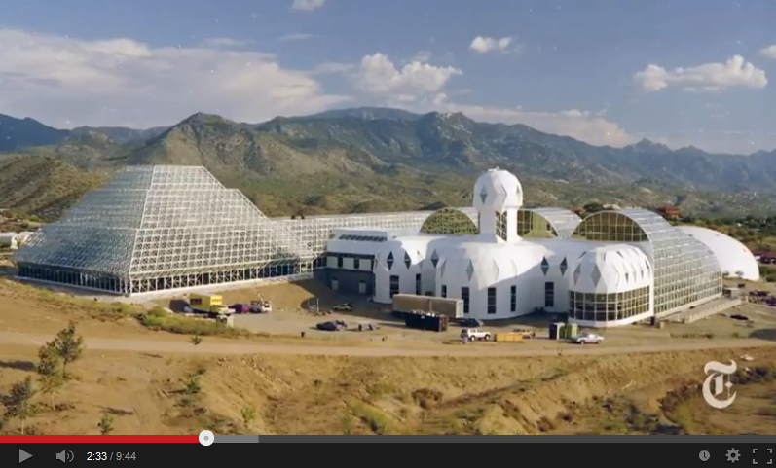
Thinking about Sustainability
Another way to measure sustainability?
Biosphere 2
Notes:
We currently live in biosphere 1.
rio, zimmermann, rees

