Slide 1
Geography 2153 – Fall 2015
Environment, Economy and Society
Introductory Lecture
Jamie Baxter

Slide 2
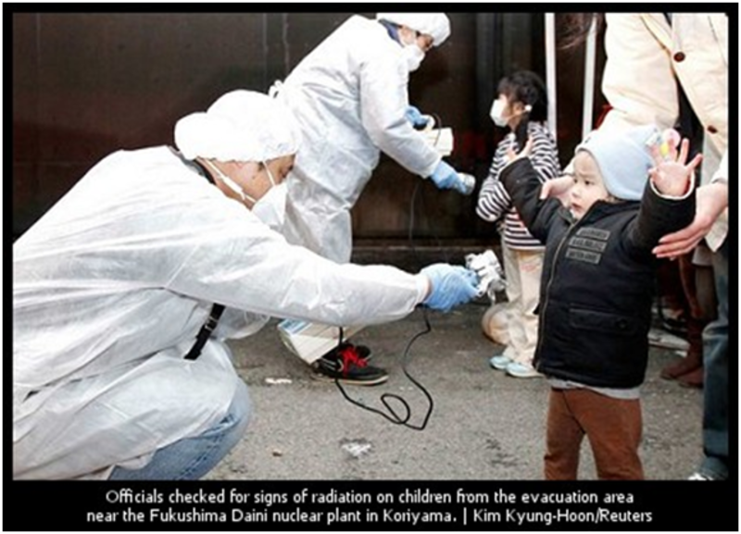
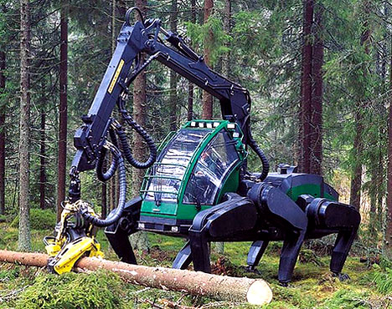
Outline
Introduction
Discussion
Syllabus
My research
Why are we here?
Fukushima Daiiachi post-tsunami radiation
“Walking” tree harvester

Slide 3


Top of Mind Environmental Issues:
Poll and Discussion
What do you feel is the most pressing issue that bridges environment, economy and society?
OPTIONS for responding:
1) Text GEOG2153 to 37607 to connect
i.e., on your phone create a new contact “polleverywhere 2153” phone number = “37607” (you will use it throughout the term)
Once connected in a conversation – type your response(s)
e.g. “my response”
OR
2) Respond at this link
Live poll results or click here.

Slide 4
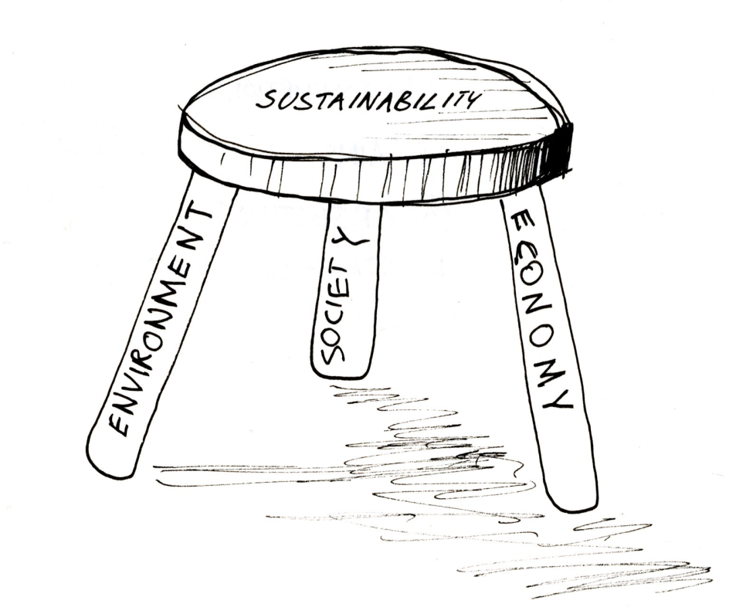
Top of Mind Environmental Issues:
The Discussion…
Let’s pick three from our list above 1)________ 2)________3)_______
Now YOU pick one of those, what are the key issues relating to the three core elements of the course – be as specific as you like – jot down your ideas to discuss with the group in about 5 minutes
Image source

Slide 5
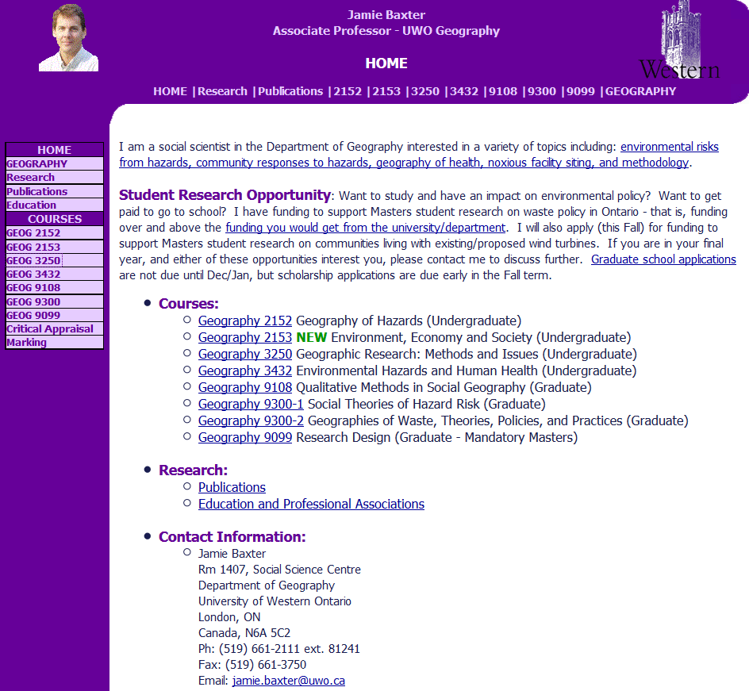
Syllabus is on the web

Slide 6
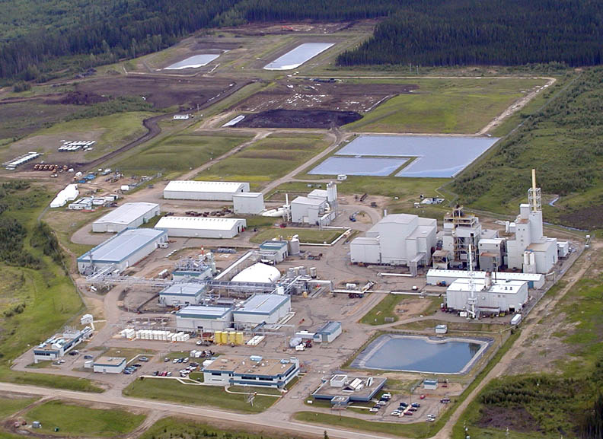
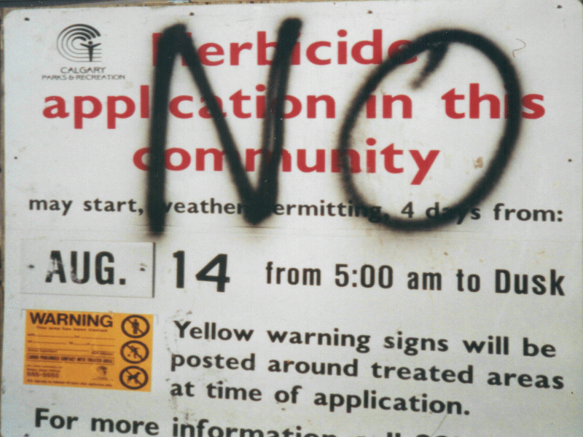
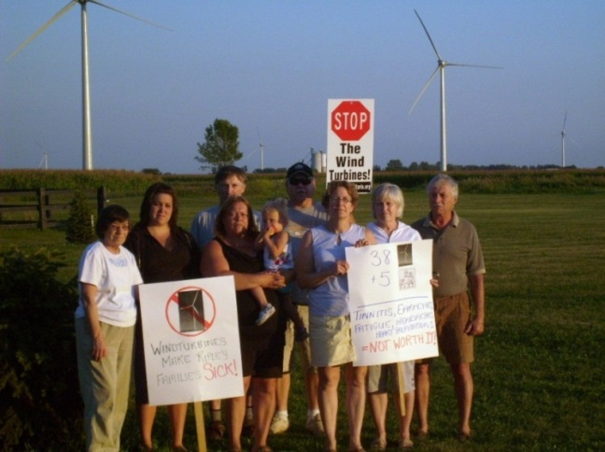
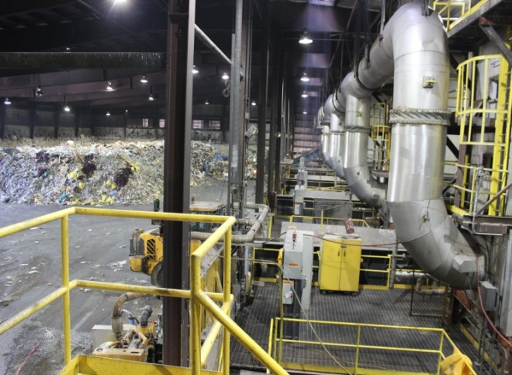
My Research
Community perception of environmental risk:
Hazardous waste incinerator
Urban pesticide use
Wind turbines
Waste-to-energy incinerator

Slide 7
What are you here?:
Poll and Discussion
Why are you taking this course?
OPTIONS for responding:
1) Text GEOG2153 to 37607 to connect
i.e., on your phone create a new contact “polleverywhere 2153” phone number = “37607”
Once connected in a conversation – type your response(s):
e.g. “my response”
OR
Respond at this link
(note to self: activate poll now)
Advance slide for live poll results or click here.

Slide 8
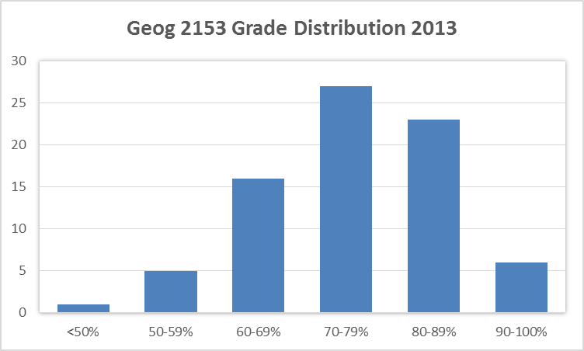
Grade Distribution
I do not grade to a distribution, this is just what happened in 2013

