Slide 1
Power, Conflict and Politics
Ashley Crnic
Steffany Flook
Roxanne Tian

Slide 2
Discussion
What types of conflicts have you witnessed in the workplace? Why do you think they occurred?

Slide 3
Intergroup Conflict in Organizations
Three ingredients:
1) Group Identification
2) Observable Group Differences
3) Frustration

Slide 4
Sources of Conflict
Goal Incompatibility
Differentiation
Task Interdependence
Limited Resources
The sources of conflict are related to EGSS. How?

Slide 5
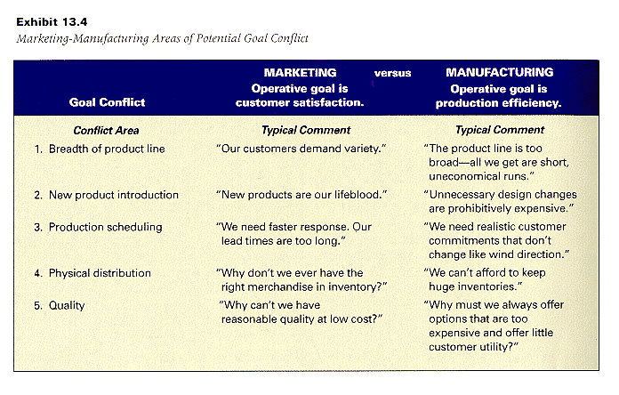

Slide 6
Rational vs.
Political Model of Behaviour
Rational
Decisions made in a logical way
Used when goals are in alignment, pooled interdependence and abundant resources
Like rational decision making, the choice with the highest probability of success is selected
Little to no conflict involved

Slide 7
Rational vs.
Political Model of Behaviour
Political
Used when differences are great, groups have different interests, goals and values
Disagreement and conflict are high
Used commonly in learning environments where employee participation is encouraged

Slide 8
Internal Influences
When
Conflict Is Low
Rational Model
describes the
organization
Organization
Variables
When
Conflict Is High
Political Model
describes the
organization
Sources of
Potential
Inter-group
Conflict
Consistent across
participants
Centralized
Orderly, logical,
rational
Norm of efficiency
Extensive,
systematic, accurate
Goals
Inconsistent & numerous
within the organization
Decentralized, shifting
coalitions and interest groups
Disorderly, result of bargaining
and interplay among interests
Conflict is legitimate and
expected.
Ambiguous, information used
and withheld strategically
Goal
Incompatibility
Differentiation
Task
Interdependence
Limited
Resources
Power and
Control
Decision
Process
Rules and
Norms
Information

Slide 9
External Influences
Simple Environment
Stable Environment
RATIONAL (Management Science)
Reliable Information
Routine Technology
Complex Environment
Unstable Environment
POLITICAL (Carnegie Model)
Disagreement
Non-routine Technology

Slide 10
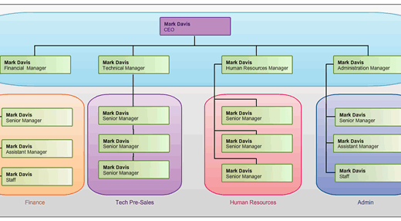
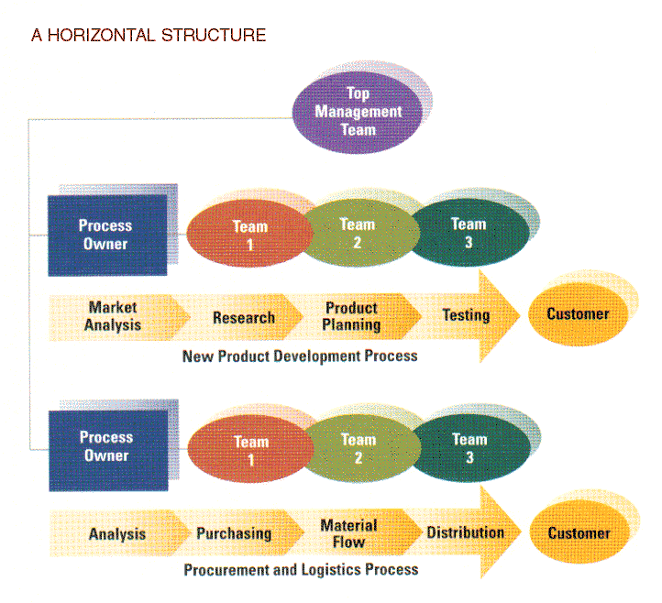
Power and Organizations
Structure
Framework
Interactions

Slide 11
What is Power?
Intangible force
Felt internally
Power can result from structural characteristics
Structural characteristics= influences strategy and goals
Horizontal structures or vertical structures

Slide 12

Power and EGSS
Definition
“Ability to achieve goals or outcomes that power holders desire”
“Influence other people to bring about desired outcomes”
Is power in the hands of the director or the directee?

Slide 13
Power derives from…
An exchange relationship in which one position or department provides scarce or valued resources to other departments
Dependency= power relationship
How does power affect organic and mechanistic structures?
Is power more dominant in vertical or horizontal structures?

Slide 14
Individual vs. Organizational Power
5 sources of personal power
1) Legitimate Power (granted)
2) Expert Power (greater skill/ knowledge)
3) Referent Power (personal characteristics)
4) Reward Power (bestow rewards)
5) Coercive Power (punishment)

Slide 15

Question
Which comes first… power or structure?

Slide 16
Authority
force prescribed by formal hierarchy
3 properties:
1.Authority vested in organizational position
2.Authority accepted by subordinates
3.Authority flows down from vertical structure
What is the difference between power and authority regarding EGSS?
Can you have authority but not power?

Slide 17
Vertical Sources of Power
Access to power in a functional structure & allocation
1.Formal Position (Accrued)
2. Resources (Downward) “Building are constructed, salaries are paid, and equipment & supplies are purchased”
3. Control of Decision Premises and Information (primary business source)
4. Network Centrality (Access)
5. People (Coalitions)

Slide 18
Horizontal Sources of Power
  Level of power defined by role of department when corporation dealing with key resources issue
Deals with the relationships across departments
Those departments (or individuals) able to successfully deal with activities essential to the organization will be the most powerful
  “Strategic Contingencies”

Slide 19
Strategic Contingencies Approach
Events and activities that are essential for attaining organizational goals
Influence horizontal sources of power among departments
  Departmental activities are important when they provide strategic value by holding important information, resources or ability to solve a problem

Slide 20
Power Sources
Dependency on the department by others for information, resources and/or assistance
Proximity to the organization’s critical activity (Centrality)
Ability to bring in money (Financial resources)
Ability to reduce, prevent or absorb uncertainty for others (Includes forecasting events and trends)
Degree to which a department or person is irreplaceable (Nonsubstitutability)

Slide 21
Politics
A way of using power to achieve ones goals
Appropriate use of politics can achieve organizations goals (negative and positive)
Politics help reach agreements when decisions are unprogrammed and uncertainty is high (Carnegie model)

Slide 22
Domains of Political Activity
Areas in which politics play a role :
Structural reorganization
Resource allocation

Slide 23
Collaboration
Create integration devices (teams, task forces, integrators, labour- management teams)
Rotation of workers (promote compatible subcultures)
Create shared mission and superordinate goals
How do these relate to EGSS?

Slide 24
Questions?

