Slide 1

Chapter 4
The External Environment

Slide 2
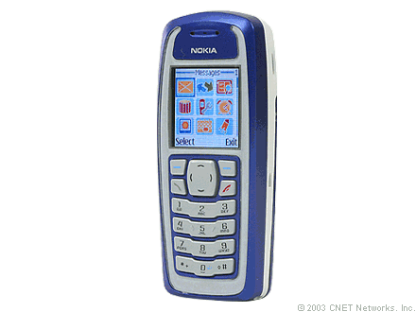
Nokia
1998: World leading handset manufacturer
2004: Products no longer matched consumer needs , loss of 7% of it’s market share
What went wrong?
Notes:
In 1998 Nokia was the world’s leading maker of cellphone handsets- they were thought to be in the midst of taking over the handset market!
By 2004 products no longer matched consumers needs, they lost 7% of their market share and strained relationships with its major customers

Slide 3

Problems
New phones too bulky and expensive
Candy bar style
Slow to respond to changing customer preferences
In the end…..
Had to change their target market –waiting to see if their strategy will work..
Notes:
The problems Nokia experienced that
-Didn’t change into the flip phone
-in developing countries- reduced costs of their phone to meet those customers preferences/ needs
-promised mobile operators to tailor phones to meet there needs

Slide 4
Organizational Environment- All elements that exist outside the boundary of the organization that have potential to affect all or part of the organization
Green Environment- Nature centered organization. Common amongst organizations that are responsible for much of the damage to the natural environment
Notes:
A “green” business strives to have a positive impact on the environment and community. It develops and practices business strategies that go beyond regulation and demonstrate commitment to a healthy and sustainable future. A green business adopts principles, policies, and practices that improve the quality of life for its customers and employees. http://www.earthshare.org/greening-business.html
Demand for environmentally-friendly services and products continues to grow. According to a survey conducted by Cohn & Wolfe, a majority of consumers in all countries say that it is very or somewhat important that companies are environmentally-friendly and 35% are willing to spend more for green products.
Coca-Cola's efforts to cut down on packaging saved it $100 million.
After Marks & Spencer adopted environmental and ethical business guidelines, the company earned an extra £50 million in revenue.
Green efforts can be done by businesses of any size!
A small business owner in the UK replaced 62 tube lights to more energy efficient lighting throughout his shop, saving him £2,282 in annual energy costs.
Do you guys have any ideas of other companies which are partaking in green enviornment efforts?

Slide 5
Domain: The companies niche
Who they serve and how they serve them
External sectors with which the organization will interact with
Notes:
Companies choose what their target market will be and then they are to look at the external environement and what affects their niche

Slide 6
Sectors
Subdivisions of the external environment
10 sectors for each organization:
Can be divided into:
Task Environment
General Environment
Industry | Technology
Raw Materials | Economic Conditions
Human Resources | Government
Financial Resources | Socio Cultural
Markets | International
Notes:
Task Environment - Sectors with which organization interacts directly and that have a direct impact on the organizations ability to achieve its goals:
General Environment -Sectors that might not have a direct impact on daily operations of a firm but will indirectly influence it
Does any one have an idea which sectors fit into task environment and general environment?

Slide 7
Task Environment
Sectors with which organization interacts directly and that have a direct impact on the organizations ability to achieve its goals:
Industry
Raw Materials
Market Sectors
Human Resources
International Sectors
Notes:
Industry- what is going on around changes how you can do business-competitors, industry size and competitiveness, related industries
Raw Materials- Can change prices through increases and decreases-
Market Sectors- What society wants
Human resources- right person, right time, right job-labour market, employment agencies, universities
International Sectors- Global marketplace- - competition from foreign firms, entry into oversea markets, foreign customs

Slide 8
General Environment
Sectors that might not have a direct impact on daily operations of a firm but will indirectly influence it
Government
Socio Cultural
Economic Conditions
Technology
Financial Resources
Notes:
Government- rules and regulations imposed by government wherever located- if global organization we have to deal with several governments and their regulations
Sociocultural- Shifting demographics and preferences (birth rates, immigration, education, religion, green movements)
Economic conditions- Affect business and having to cut jobs- the value of the dollar etc- recession, unemployment rate, inflation rate
Technology- online software and blogs- consumers can bad mouth us if they want on these blogs- e-commerce
Financial resources- stock market, banks, credit unions

Slide 9
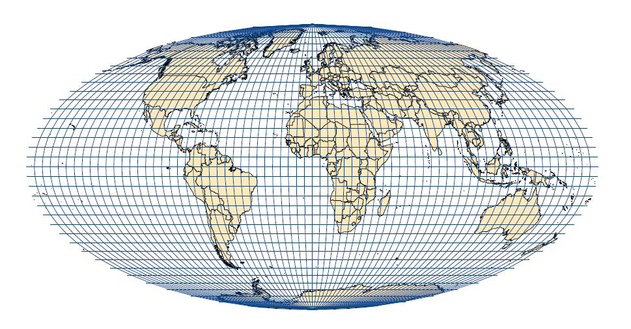
International Context
Domestic sectors can be affected by international events!
How?
Notes:
The international context is extremely influential in a firm and how they do bussiness even domestic sectors can be affected by international events.
How?
-company can be bought out by international companies
-international partnerships
-global competitors- extremely complex + extremely competitive

Slide 10
The environment's influence on organizations:
1) The need for information about the environment
2) The need for resources from the environment
Scarce material and financial resources- need to ensure their availability !
Notes:
The environment influences organizaitons through :
1) The need for information about the environment
2) The need for resources from the environment
Scarce material and financial resources are a problem for organizations need to ensure their availability !
Focus: Task environment= what we deal with regularly and it is extremely important because of how rapidly it is changing

Slide 11

Uncertainty- Not having sufficient information about environmental factors which results in a difficult time predicting changes
* What does this cause? *
Notes:
-increased risk of failure
-difficulty in computing the costs of various alternatives

Slide 12
Simple-Complex Dimension
Concern’s with environmental complexity
Heterogeneity or number and dissimilarities of external elements relevant to the organization’s operations.
The more external factors that regularly influence the organization + increased number of competitors = Greater Complexity
Notes:
A complex environment is one in which the organization interacts with and is influenced by numerous diverse and different external elements
What are some examples of these?
Ex. Aerospace firms and universities- large number of technologies, social, cultural and value changes – government regulations, competition of quality of students, quality of staff-> creates a complex environment
A simple environment is one that the organization interacts with and is influence by only a few similar external elements
What are some examples of these?
Ex. Mom and Pop hardware store- don’t deal with complex technologies, gov’t regulations, cultural and social changes + H/r b/c run by family members
-only external elements are few competitors, suppliers and customers

Slide 13
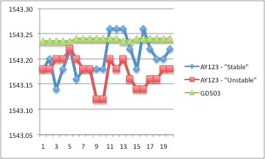
Stable-Unstable Dimension
Does the environmental domain remain the same over a period of months/years
Are changes predictable?
Stable Vs Unstable
Notes:
Stable- if environment remains the same over a period of months/years or experiences predictable change
Any examples?
Ex. Public utility- stable environment- a gradual increase in demand may occur which is easily to predict over time
-Unstable- environment shifts abruptly/unexpectedly
-occurs when competitors react with aggressive moves and countermoves regarding advertising and new products
Examples?
Ex. Toy companies- - children losing interest in toys at a younger age, capitvated by TV, video games and internet – big competition with low cost producers in china

Slide 14
Framework for assessing environmental uncertainty
Simple + Stable= Low Uncertainty
Complex + Stable= Low-Moderate Uncertainty
Simple+Unstable= High-Moderate Uncertainty
Complex + Unstable= High Uncertainty
Notes:
Simple + Stable- there is a small number of similar external elements. Elements remain the same or change gradually and slowly over time
Ex. Soft drink bottlers, beer distributors, container manufacturers, food processors
Complex + Stable- Large number of external elements that are dissimilar, and elements remain the same or change slowly
Ex. Universitites, appliance manufacturers, chemical companies, insurance companies
Simple + Unstable- small number of external elements which are similar, and change frequently and unpredictably
Ex. E-commerce, fashion clothing, music industry, toy manufacturers
Complex + Unstable- large number of external elements that change simultaneously and are dissimilar
Ex. Computer firms, aerospace firms, telecommunications firms, airlines

Slide 15
Positions and Departments
^ in complexity and uncertainty in external environment increases means a ^ in # of positions and departments
^ internal complexity
Each sector in external environment requires an employee/department to deal with it

Slide 16

Buffering roles
Absorb uncertainty from environment
Surround technical core
Exchange resources/materials between environment and org.
New approach!

Slide 17
Boundary Spanning
Detect changes in environment and bring info to org.
Send info. into environment that presents org. in favourable light
New Approach = Business Intelligence
High-tech analysis of data to spot patterns and relationships

Slide 18

Business Intelligence
Competitive intelligence: systematic way to collect/analyze info about rivals and use it to make better decisions

Slide 19

Differentiation and Integration
Differences in cognitive and emotional orientations.
Results in difference in formal structure among these departments.

Slide 20
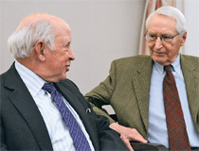
Differentiation and Integration
Paul Lawrence, Jay Lorsch
Each dept evolved towards different orientation.
Structured to deal with specialized parts of external environment.
R&D → informal structure, long-term orientation, task-oriented employees and marketing was at opposite end of spectrum .

Slide 21
Differentiation and Integration
Outcome of high differentiation:
Coordination among departments becomes more difficult.
Integration:
Collaboration among departments.
Who :
Project managers, liaison personnel etc.

Slide 22
Differentiation and Integration
When environment is highly uncertain:
Frequent changes
Require more information
Processing to achieve coordination
Integrators become more necessary
When environment is simple and stable:
Few managers assigned to integration roles
Lawrence/Lorsch concluded:
Organizations perform better when differentiation/integration matches level of uncertainty in environment

Slide 23
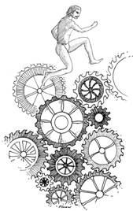
Organic/Mechanistic Management
Burns/Stalker:
Observed 20 industrial firms in England
External environment is related to internal management structure
Mechanistic management structure:
Stable external environment
Rules, procedures, clear hierarchy of authority
Communication is vertical

Slide 24

Organic/Mechanistic Management
Organic Management :
Rapidly changing environment
Free flowing and adaptive
Hierarchy of authority not clear
Communication is horizontal
Organic process → Enhances organizations ability to quickly respond to changes

Slide 25

Planning, Forecasting and Responsiveness
Uncertain environment:
Planning/forecasting become more important
Planning softens impact of external shifts

Slide 26
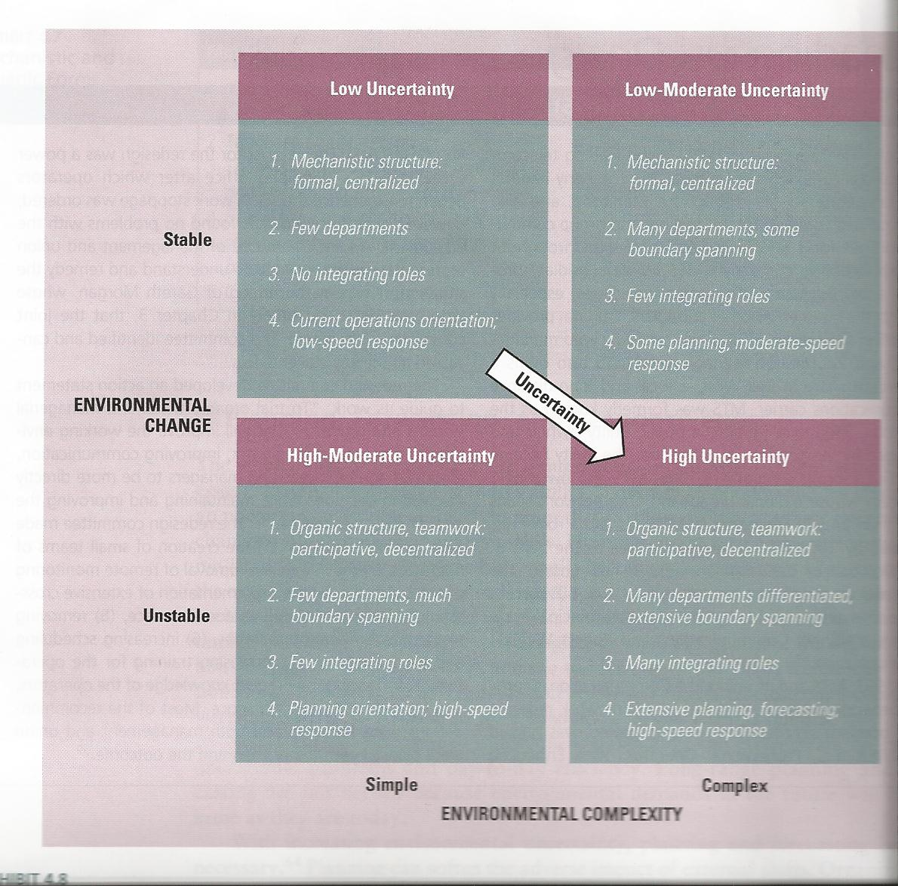
Framework for Organizational Responses to Uncertainty

Slide 27
Resource Dependence
Organizations depend on the environment
Strive to acquire control over resources
Costs+ risk = high
Team up to share scarce resources
Relationships create dilemma:
Trade-off: resources ←→ autonomy
Organizations with abundant resources avoid relationships

Slide 28
Controlling Environmental Resources
Organizations balance relationships/autonomy, by controlling other organizations
Two strategies to manage resources in external environment :
Create linkages with key organizations in environment
Shape environment to suit focal organization

Slide 29
Establishing Inter-Organizational Linkages
Aquisition: purchasing of one organization over another-buyer assumes control
Merger: Unification of two or more organization’s into a single unit
Strategic Alliances: High level of complementarity- skills, geographic positions
License Agreements
Supplier Arrangements
Joint Venture: creation of a new organization formally independent from its parents (parents have little control)

Slide 30
Establishing Inter-Organizational
Linkages
Cooptation: leader from important external sector made part of an organization
Interlocking directorate: Member of the board of directors of one company sits on the board of directors of another company.
Direct Interlock
Indirect Interlock
Executive Recruitment: transferring/exchanging executives

Slide 31
Advertising and Public Relations
Advertising: Traditional way of establishing relationships
Large amounts of time and money
Influence taste of consumers
Very important in highly competitive industries
Public relations: Stories aimed at public opinion

Slide 32
Controlling Environmental Domain
Four traditional techniques:
1) Change of domain - Acquisition and divestment
2) Political Activity, Regulation - Influence legislation and regulation
3) Trade Associations - Organizations influence environment jointly
4) Illegitimate Activities - Conditions cause managers to take part in unlawful/unethical activities

Slide 33
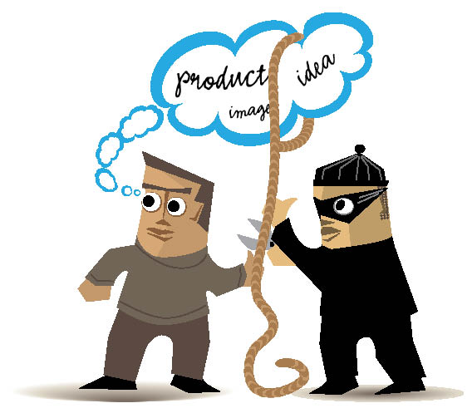
Controlling Environmental Domain
Companies experiencing low demand, shortages, strikes:
More likely to take part in illegal activities
Attempt to deal with resource scarcity

Slide 34

Knowledge to take home:
Complexity in the environment has a big impact on organizations
Decisions are made based on the external environment
Stable-unstable and simple-complex dimensions
Resource dependence
Notes:
Change and complexity in the environment has major implications on organizational design and action
Organizational decisions, activities and outcomes can be traced to stimuli in external environment
Organizational uncertainty is a result of stable-unstable and simple-complex dimensions
Resource dependence is a result of scarcity of resources needed

Slide 35

An organizations departments are created to deal with uncertainties.
Departments buffer uncertainty.
When resources are scarce, organizations can establish linkages.

Slide 36

Organization’s Vs Environment
Cross functional communication
Find the Right Fit between Internal Structure and the External Environment
As complexity ^ more positions have ^ complexity!
Avoid selective hearing/wishful thinking
Notes:
So how does an organization combat the environment and all of the uncertainty that it brings?!

Slide 37


