Slide 1
Chapter 11
Innovation and Change
Yolanda, Scott, Sara

Slide 2

Did You Know?

Slide 3
Relationship to EGSS
External Environment
  Forces driving the NEED for change
Goals
  Addresses both effectiveness and efficiency
  Strategy
  Miles and Snow/Porter
  Structure
  Learning and Organic

Slide 4
Incremental vs. Radical Change
Incremental Change
  Technology and product improvements etc.
Radical Change
  Breakthrough, new markets etc.

Slide 5
Strategic Types of Change
Technology Change
New Products and Services
Strategy and Structure Change
Culture Change
All four are Interdependent – a change in one often means a change in another

Slide 6
Technology Change
  The Ambidextrous Approach
  Organic (Bottom up, creative)
    Expand capabilities
    Explore and develop new ideas
  Mechanistic (Top down, implementing)
    Exploit capabilities
    Routine application of new ideas

Slide 7
Technology Change
Techniques for Encouraging Technology Change
  Switching Structures
  Separate Creative Departments
    Idea incubator
  Venture Teams
    Skunkworks
    New-venture fund
  Corporate Entrepreneurship
    Idea, technical and management champion

Slide 8
New Products and Services
Success Factors
  External Environment (Need)
  Internal Environment (Can)
  Support (Want)

Slide 9
New Products and Services
Horizontal Coordination Model
  Departmental specialization
  Boundary Spanning
  Horizontal Coordination
  The Need for Speed - Time based competition

Slide 10
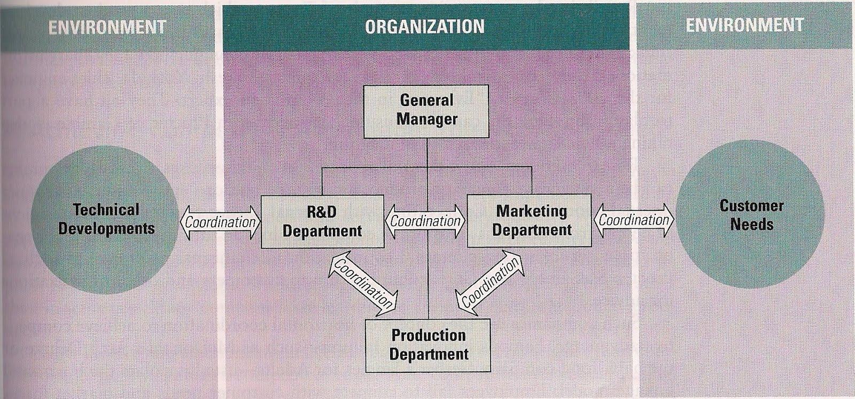
Horizontal Coordination Model for New Product Innovations
Notes:
P.407

Slide 11
Strategy and Structure Change
The Dual-Core Approach
  Technical Core
  Administrative Core

Slide 12
Culture Change
Forces for Culture Change
  Re-engineering and Horizontal Organizing
  Diversity
  The Learning Organization

Slide 13
Culture Change
Organization Development (OD) Interventions
  Large Group Intervention
  Team Building
  Interdepartmental Activities

Slide 14
Elements For Successful Change
Ideas
Needs
Adoption
Implementation
Resources
Note: NOT necessarily sequential

Slide 15
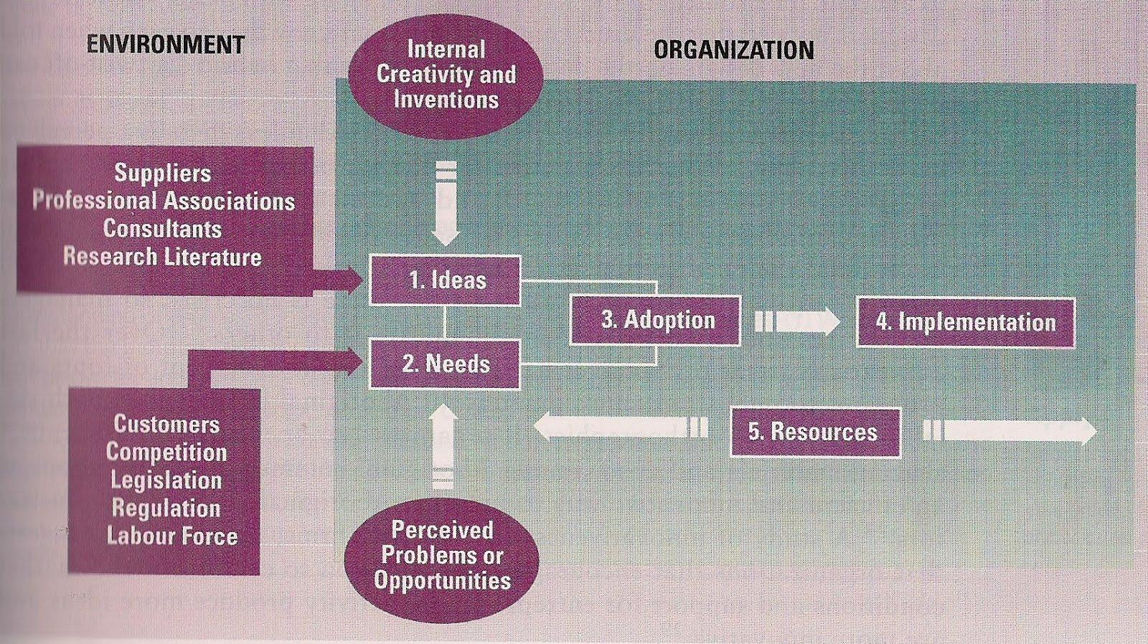
Sequence of Elements for Successful Change
Notes:
P309

Slide 16
Stages of Commitment to Change
Preparation
Acceptance
Commitment
Institutionalization

Slide 17
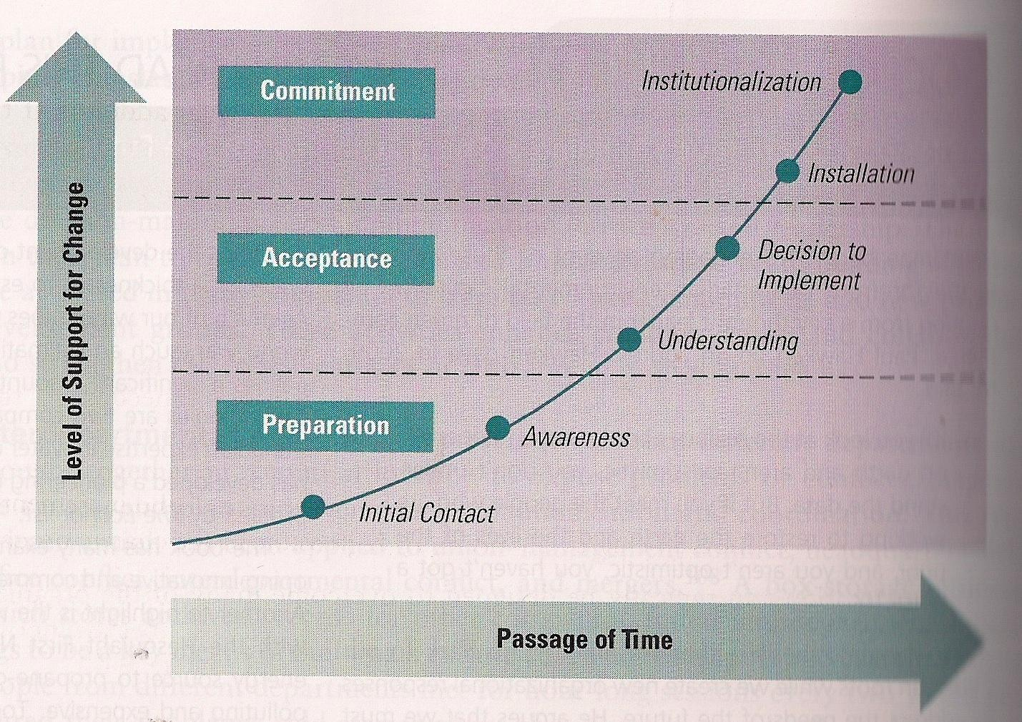
Stages of Commitment to Change
Notes:
P.418

Slide 18
Barriers to Change
Excessive Focus on Costs
Failure to Perceive Benefits
Lack of Coordination and Cooperation
Uncertainty Avoidance
Fear of Loss

Slide 19
Techniques for Implementation
Establishing a sense of urgency for change
Establish a coalition to guide the change
Create a vision and strategy for change
Find an idea that fits the need
Notes:
How at a structural level? Checklist

Slide 20
Techniques for Implementation
5. Develop plans to overcome resistance to change
  Alignment with needs and goals of users
  Communication and training
  An environment that affords psychological safety
  Participation and involvement
  Forcing and coercion
6. Create change teams
7. Foster idea champions

