Slide 1
Chapter 3: Fundamentals of Organizational Structure
Basic concepts of organizational structure:
Structural design
Vertical/horizontal linkages
Grouping strategies
Application
misalignments

Slide 2
Organizational Structure
Three components of the org. structure:
  Designates formal reporting relationships
  Identifies grouping of departments into whole organization
  Designs of systems to ensure effectiveness across departments

Slide 3
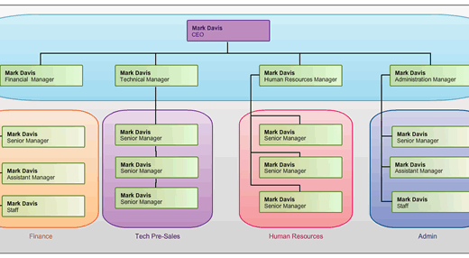
Organizational Chart

Slide 4
Information – Processing Perspective on Structure
Organizations can choose to structure for either efficiency or learning.
Efficiency = Vertical structure
  Specialized tasks
  Strict hierarchy, many rules
  Vertical communication and reporting systems
  Few teams, task forces, or integrators
  Centralized decision making

Slide 5
Learning =Horizontal
  Shared tasks, empowerment
  Relaxed hierarchy, few rules
  Horizontal communication, face to face
  Many teams and task forces
  Decentralized decision making

Slide 6
Vertical linkages
Linkage : the extent of communication and coordination among organizational elements
Vertical linkages: communication and coordination activities connecting the top and bottom of an organization
Structural devices to achieve vertical linkage:
  Hierarchical referral
  Rules and plans
  Vertical information systems

Slide 7
Hierarchical Referral:
Chain of command: formal line of authority in a hierarchy
  The lines of the organizational chart act as communication channels
  When there is a problem, it can be referred up
Rules and plans.
  To the extent that problems and decisions are repetitious, a rule or procedure can be established so employees know how to respond without communication directly with their managers
  Provides a standard info source, enables employees to be coordinated without communicating about every task
  Provides standing info for employees
  Most widely used plan is a budget

Slide 8
Vertical info systems.
  Vertical information systems: the periodic reports, written info, and computer based communications distributed to managers
  Makes communication up and down organization more efficient

Slide 9
Horizontal Linkage
The amount of horizontal communication and coordination across departments
Devices to improve horizontal coordination and flow:
  Information Systems
  Direct Contact
  Task Forces
  Full-time Integrator
  Teams

Slide 10
Organizational design alternatives
Required work activities
  Organizations typically define new departments or divisions as a way to accomplish tasks deemed valuable by the company
Reporting relationships
  Once required work activities and departments are defined, the next question is how these activities and departments should fit together in the organizational hierarchy
  Departmental grouping options:

Slide 11
Functional grouping:
  the placing together of employees who perform similar functions or work processes or who bring similar knowledge and skills to bear on a task
Divisional grouping:
  a grouping in which people are organized according to what the organization produces
Multi-focused grouping:
  a structure in which an organization embraces structural grouping alternatives simultaneously
Horizontal grouping:
  organizing of employees around core work processes rather than by function, product or geography
Virtual network grouping:
  organization that is a loosely connected cluster of separate components
  In essence departments are separate organizations that are electronically connected for the sharing of info and completion of tasks

Slide 12
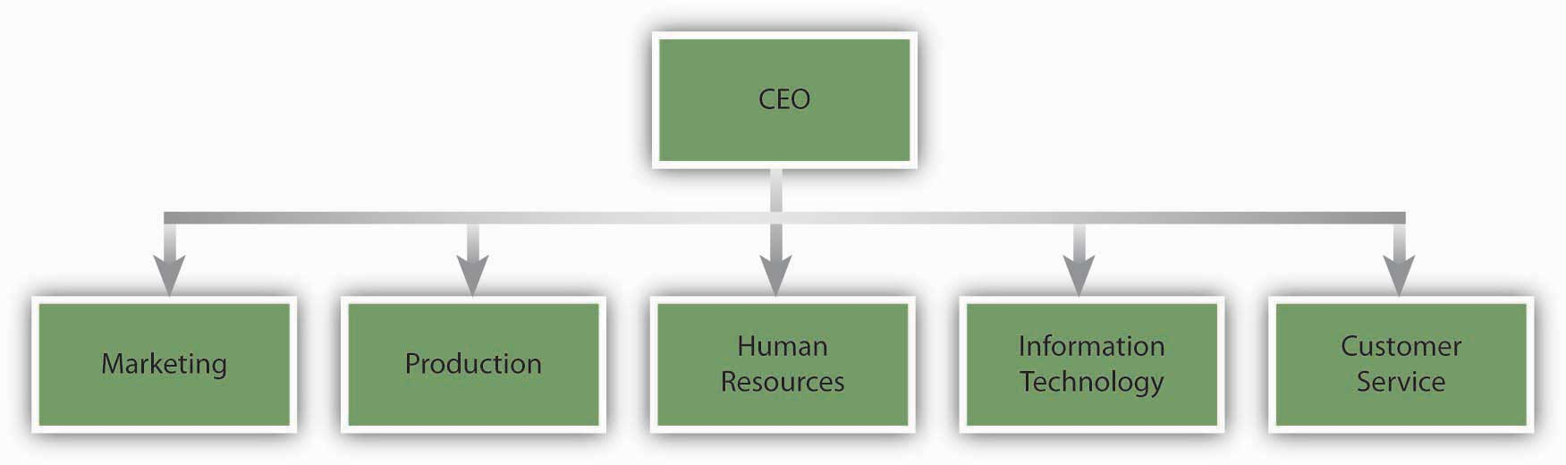
Functional Structure
Activities are grouped together by common function from the bottom to the top of the org

Slide 13
Functional Structure
Strengths
Weaknesses
  Economies of scale
  Enables in-depth knowledge and skill development
  Able to accomplish functional goals
  Works best with one or a few products
  Slow response to environmental changes
  Decisions pile up
  Poor horizontal coordination
  Less innovation
  Restricted view of organizational goals

Slide 14
Divisional structure
Divisional structure: the structuring of the organization according to individual products, services, product groups, major projects, or profit centers also called product structure or strategic business units

Slide 15
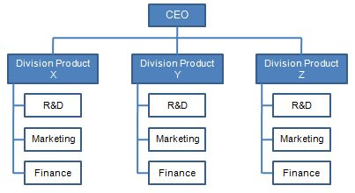
Divisional chart

Slide 16
Divisional structure
strengths
weaknesses
Suited to fast change in unstable environment
Leads to customer satisfaction because product responsibility and contact points are clear
Involves high coordination across functions
Allows units to adapt to differences in products, regions, customers
Best in large organizations with several products
Decentralizes decision making
Eliminates economies of scale in functional departments
Leads to poor coordination across product lines
Eliminates in-depth competence and technical specialization
Makes integration and standardization across product lines difficult

Slide 17
Geographical structure
Each geographic unit includes all functions required to produce and market products or services in that region
Strengths and weaknesses are similar to divisional organization characteristics

Slide 18
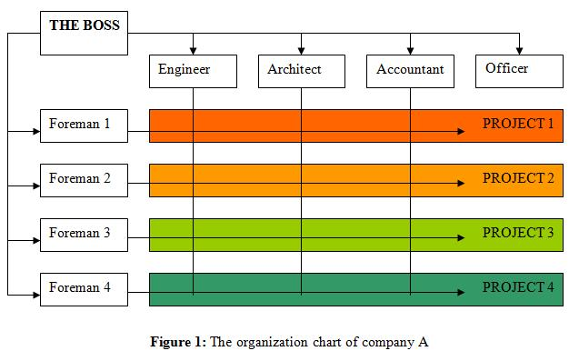
Matrix Structure
A strong form of horizontal linkage in which both product and functional structures are implemented simultaneously

Slide 19
Matrix Structure
Three conditions for Matrix structure:
1.
  Pressure exists to share scarce resources across product lines.
  The organization is typically medium sized and has a moderate number of product lines.
  It feels pressure for the shared and flexible use of people and equipment across those products

Slide 20
Matrix Structure
2.
  Environmental pressure exists for two or more critical outputs, such as for indepth technical knowledge ( functional structure) and frequent new products (divisional structure).
  This dual pressure means a balance of power is needed between functional and product sides of the organization and a dual authority structure is needed to maintain that balance

Slide 21
Matrix Structure
3.
  The environmental domain of the organization is both complex and unstable.
  Frequent external changes and high interdependence between departments require a large amount of coordination and information processing in both vertical and horizontal directions

Slide 22
Matrix Structure
Strengths
Weaknesses
  Can meet dual demands of customers
  Flexible sharing of human resources across departments
  Adapt to frequent changes in unstable environment
  Opportunity for functional and product skill development
  Best in medium organizations with multiple products
  Dual authority can be frustrating and confusing
  Participants need good interpersonal skills and extensive training
  Very time-consuming
  Requires a lot of effort to maintain power balance

Slide 23
Horizontal structure
Horizontal structure: a structure that virtually eliminates both the vertical hierarchy and departmental boundaries by organizing terms of employees around core work processes; the end to end work, info, and material flows that provide value directly to customers

Slide 24
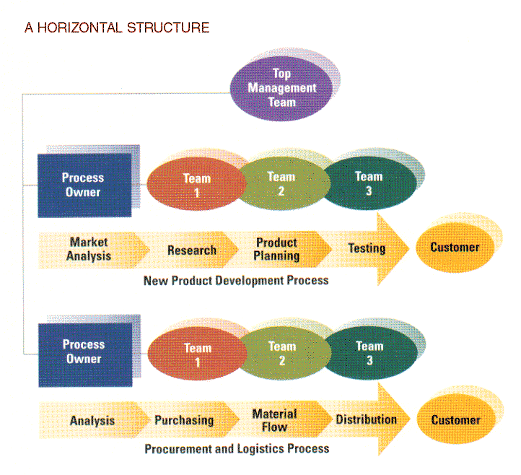
Horizontal structure chart

Slide 25
Characteristics:
  Structure is created around cross functional core processes rather than tasks, functions or geography. Thus boundaries between departments are obliterated
  Self directed teams, not individuals, are the basis of organizational design and performance
  Process owners have responsibility for each core process in its entirety
  People on the team are given the skills, tools, motivation, and authority to make decisions central to the team’s performance. Team members are cross trained to perform one another’s jobs, and the combined skills are sufficient to complete a major organizational task
  Teams have the freedom to think creatively and respond flexibly to new challenges that arise
  Customers drive the horizontal corporation. Effectiveness is measured by end of process performance objectives ( based on the goal of bringing value to the customer), as well as customer satisfaction, employee satisfaction, and financial contribution
  Culture is one of openness, trust, and collaboration, focused on continuous improvement. The culture values employee empowerment, responsibility, and well being

Slide 26
Horizontal structure
strengths
weaknesses
Promotes flexibility and rapid response to changes in customer needs
Directs the attention of everyone toward the production and delivery of value to the customer
Each employee has a broader view of organizational goals
Promotes a focus on teamwork and collaboration
Improves quality of life for employees by offering them the opportunity to share responsibility, make decisions, and be accountable for outcomes
Determining core processes is difficult and time consuming
Requires changes in culture, job design, management philosophy and info and reward systems
Traditional managers may balk when they have to give up power and authority
Requires significant training of employees to work effectively in a horizontal team environment
Can limit in-depth skill development

Slide 27
Virtual network structure
Virtual network structure: the firm subcontracts many or most of its major processes to separate companies and coordinates their activities from a small headquarters organization

Slide 28
Virtual network structure
strengths
weaknesses
Enables even small organizations to obtain talent and resources world wide
Gives a company immediate scale and reach without huge investments in factories, equipment, or distribution facilities
Enables the organization to be highly flexible and responsive to changing needs
Reduces administrative overhead costs
Managers do not have hands on control over many activities and employees
Requires a great deal of time to manage relationships and potential conflicts with contract partners
There’s a risk of organizational failure if a partner fails to deliver or goes out of business
Employee loyalty and organizational culture might be weak because employees feel they can be replaced by contract services

Slide 29
Hybrid Structure
Combines the characteristics of functional, divisional, geographical, horizontal and/or network structures into a hybrid structure that is tailored to specific needs
Tend to be used in rapidly changing environments
Popular hybrid model combines characteristics of functional and divisional structures

Slide 30
Symptoms of Structural Deficiency
Signs of the organization structure being out of alignment, including:
  Delayed/poor decision-making
  Organization does not respond innovatively to a changing environment
  Employee performance declines when goals are not being met
  Too much conflict is evident

