Slide 1

Decision-Making Processes
Lina Hourani
Neeraja Ganeshalingam
Riley Truswell

Slide 2
Examples?
Can anyone provide an example of an organization that has made a decision that was either successful or failed?

Slide 3
Key Terms
Organizational Decision Making:
“The process of identifying and solving problems.”
Problem Identification
Information about environmental and organizational conditions is monitored to determine if performance is satisfactory and to diagnose the cause of shortcomings.
Problem Solution
When alternative courses of action are considered and one alternative is selected and implemented.

Slide 4
Types of Decisions
Organizational decisions can be categorized based on their complexity…
Programmed Decisions
Repetitive and well defined, and procedures exist for resolving the problem.
Non-Programmed Decisions
Novel, ill structured, and poorly defined, and no procedure exists for solving the problem.

Slide 5
Individual Decision Making
Described in two ways…
First: Rational Decision Making
Systematic analysis of a problem
Suggests how managers should try to make decisions in order to reach the optimal solution

Slide 6
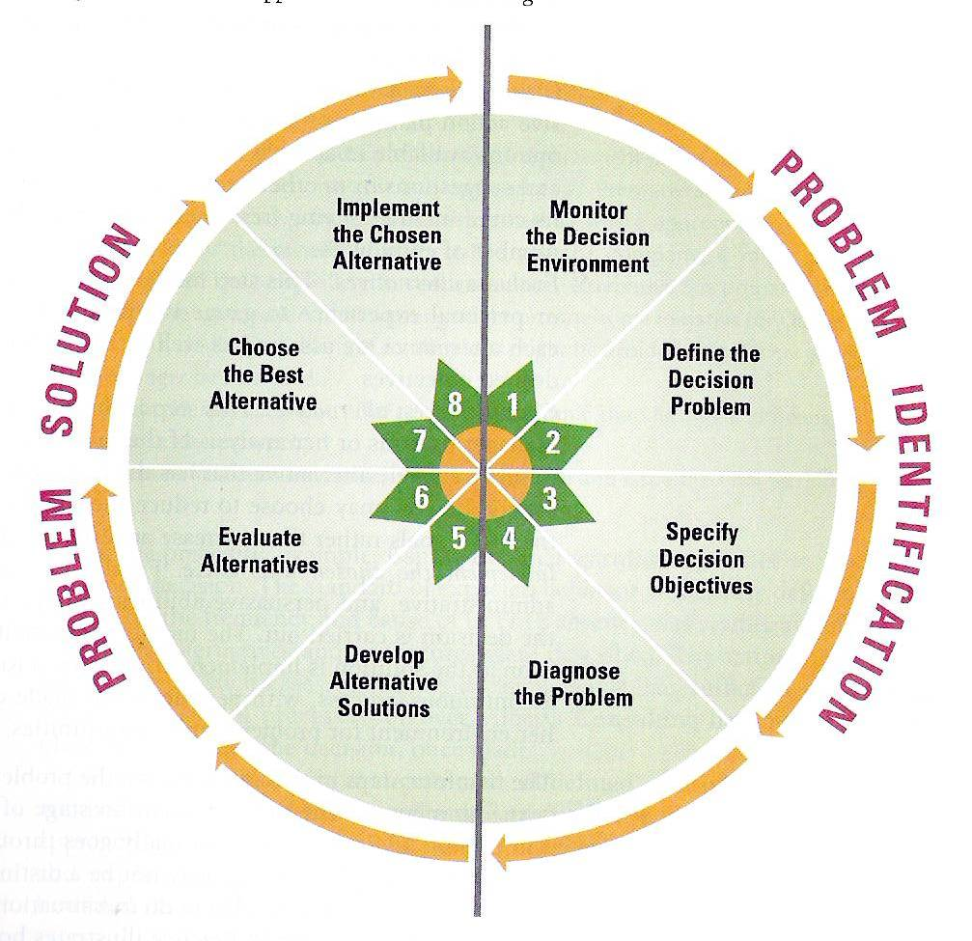
Individual Decision Making
Rational Approach
Consists of 8 steps:

Slide 7
Individual Decision Making
Rational Approach
When is it used?
Sufficient time
Sufficient information
Dealing with well-understood issues
Facing little competition
Is this approach realistic?

Slide 8
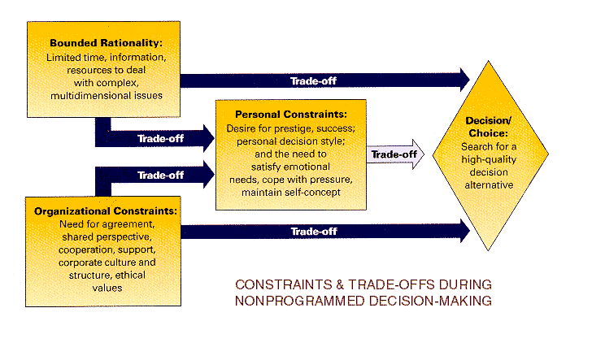
Individual Decision Making
Second: Bounded Rationality Perspective
Recognizes the limitations of our decision-making ability
  Limited time, information, uncertainty
We are bounded by the enormous complexity of many problems:

Slide 9
Individual Decision Making
Bounded Rationality Perspective
When is it used?
Applies mostly to non-programmed decisions
Limited time, resources to deal with complex, multidimensional issues
The Role of Intuition
Making decisions on the basis of experience, feelings, and accumulated judgment rather than sequential logic

Slide 10
Organizational Decision Making
Organizations are influenced by a number of factors, particularly the organizations own internal structures and the degree of stability or instability of the external environment.
Four primary decision- making processes:
Management Science Approach
The Carnegie Model
Incremental Decision Process
The Garbage Can Model

Slide 11
Management Science Approach
Similar to the rational approach at the individual level
  Based on the use of statistical and mathematical models to find optimal solutions to a problem
  Developed during WWII
When do we use it?
  Problems that are analyzable
  When variables can be identified & measured
  When there are too many variables for human processing

Slide 12
The Carnegie Model
Coalitions
Why are they needed?
Implications for organizational decision making:
  Satisficing – accepts satisfactory rather than optimal
  Short-term outlook - “Problemistic Search”
  Discussion and bargaining
Useful at problem identification stage and for smooth implementation

Slide 13
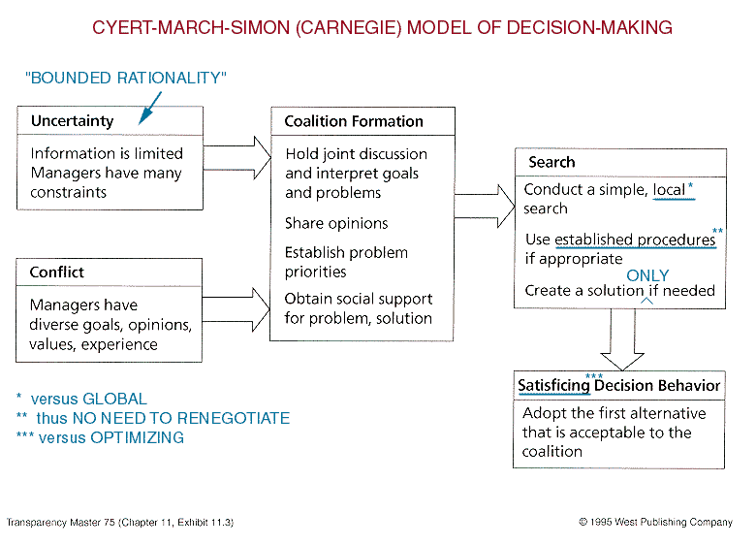
The Carnegie Model

Slide 14
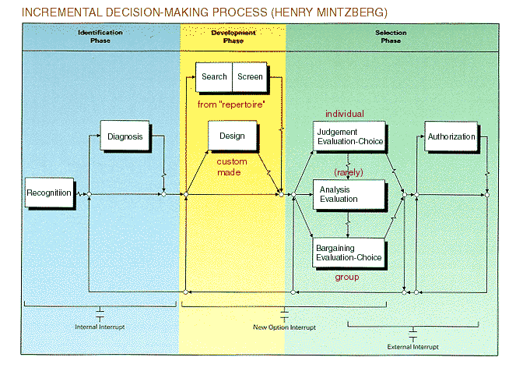
Incremental Decision Making
Focuses on sequence of events from problem discovery to solution

Slide 15
The Learning Organization
Organizations functioning in a rapidly changing external business environment
  Marked by a lot of uncertainty at both the problem identification and problem solution stage
Two Approaches to cope with the uncertainty and complexity:
  Combined Incremental Process & Carnegie Model
  Garbage Can Model

Slide 16
The Garbage Can Model
Deals with the pattern or flow of multiple decisions within organizations vs. single decisions
Pattern of decision making in organizations characterized by organized anarchy
Three Causes of organized anarchy:
Problematic preferences
Unclear, poorly understood technology
Turnover

Slide 17
Streams of Events
Solutions
Not a sequence of steps that begins with a problem and ends with a solution
Problems randomly attach to solutions in the “Garbage Can”
Choice
opportunities
Problems
Participants
Organization

Slide 18
The Red Cross: Garbage Can Model
The Red Cross uses the donations to assist all of the people affected by hurricane Sandy
Volunteers, fundraisers, employees
Donations are collected over the year for the 2012 Red Cross Hurricane Fund.
Hurricane Sandy hits the Eastern seaboard and millions of individuals are in need of aid.
Consequences?

Slide 19
Contingency Decision Making
Decision-making approach is contingent on the organization setting.
Two characteristics of organizations that determine the use of decision approaches:
1. Problem Consensus
  Agreement among managers about the nature of a problem or opportunity and about which goals and outcomes to pursue.
2. Technical Knowledge about Solutions
  Understanding and agreement about how to solve problems and reach organizational goals.

Slide 20
Contingency Framework
Problem
Consensus
Certain
Uncertain
Certain
1
2
Individual:
Rational Approach
Computation
Organization:
Management Science
Individual:
Bargaining, Coalition
Formation
Organization:
Carnegie Model
Solution
Knowledge
3
Individual:
Judgment, Trial-and-error
Organization:
Incremental Decision
Process Model
4
Individual:
Bargaining and Judgment
Inspiration and Imitation
Learning Organization:
Carnegie and Incremental
Decision Process Models,
Evolving to Garbage Can
Uncertain

Slide 21
Special Decision Circumstances
High Velocity Environments
Characteristics
How to overcome them
“A slow decision is as ineffective as the wrong decision”
Decision Mistakes & Learning
Escalating Commitment
Why does it happen?

