Slide 1


Organizational Culture and Ethics
Pilar Santiago
Justin Kuiper
Tao Wang

Slide 2

Opening Case: Birks & Mayors Inc.
Implemented measures to comply with Kimberley Process Certification Scheme
Sources diamonds only from cutters who declare that the diamonds have been obtained in compliance with the Kimberley Process
Birks has gone above and beyond this process
Birks created a line of jewelry with diamonds from Botswana, where they are cut and polished
Directly gives back to people of Botswana

Slide 3

Purpose of This Chapter
Explores ideas about organizational culture and ethical values, and how these are influenced by organizations
Nature of organizational culture
How culture reinforces strategy and structural design
Ethical values and social values
How leaders shape culture and ethical values
Cultural and ethical issues in a global environment

Slide 4

Organizational Culture
Every organization has a set of values that characterize how people behave and how the organization carries out everyday business
Culture can have a positive or negative effect on a company
Social capital – quality of interactions among people, whether they share a common perspective; relates to both organizational culture and ethics

Slide 5
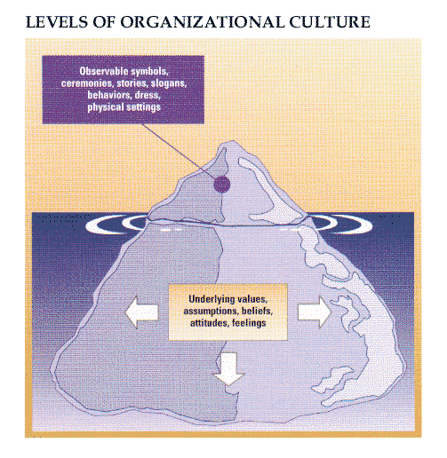
What Is Culture?
Set of values, norms, guiding beliefs, and understanding that is shared by members of an organization and is taught to new members…represents the unwritten, feeling part of an organization…
The Learning Culture Iceberg – represents two levels of culture

Slide 6
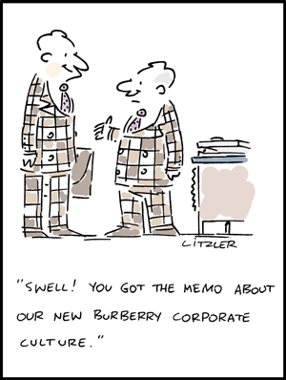
Emergence and Purpose of Culture
Provides members with a sense of organizational identity
Generates a commitment to beliefs and values that are larger than themselves
Generally begins with a founder or early leader who articulates and implements particular ideas and values as a vision, philosophy, or business strategy
Guides employee decision making in the absence of written rules or policies

Slide 7
Two Critical Functions of Culture
To integrate members so that they know how to relate to one another
To help the organization adapt to the external environment
Internal integration – members develop a collective identity and know how to work together effectively; guides daily working relationships
External integration – how the organization meets goals and deals with outsiders; help guide daily activity to meet goals

Slide 8

Interpreting Culture
Rites and Ceremonies
Type of Rite | Example | Social Consequences
Passage | Induction and basic training, Canadian military | Facilitate transition of persons into social roles and statuses that are new for them
Enhancement | Annual awards night | Enhance social identities and increase status of employees
Renewal | Organization development activities | Refurbish social structures and improve organization functioning
Integration | Office holiday party | Encourage and revive common feelings that bind members together and commit them to the organization

Slide 9
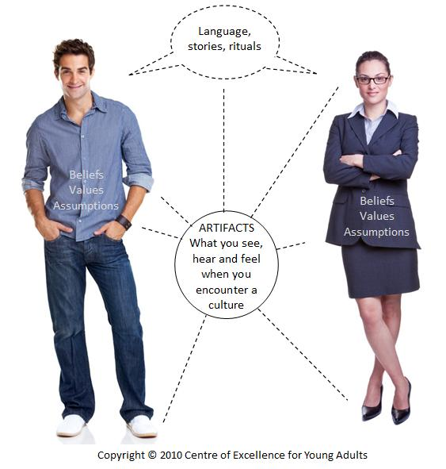
Stories
  Narratives based on true events that are frequently shared among employees and told to new employees to inform them about an organization; involves heroes, legends and myths
Symbols
  Ceremonies, stories, slogans, and rites are all symbols; they symbolize the deeper value of an organization
Language
  Companies use a specific saying, slogan, metaphor, or other form or language to convey special meaning to employees

Slide 10
Organizational Design and Culture
Adaptability Culture
  Strategic focus on the external environment through flexibility and change to meet customer needs
Mission Culture
  Suited for organizations concerned with serving specific customers in the external environment, but without the need for rapid change
Clan Culture
  Primary focus is on the involvement and participation of the organization’s members and on rapidly changing expectations from the external environment
Bureaucratic Culture
  Has an internal focus and a consistency orientation for a stable environment; supports a methodological approach to doing business

Slide 11
 |  | NEEDS OF THE ENVIRONMENT
STRATEGIC FOCUS |  | Flexibility | Stability
 | External | Adaptability Culture | Mission Culture
 | Internal | Clan Culture | Bureaucratic Culture

Slide 12
A Culture of Discipline
Level 5 leadership
  Leaders who have a complete lack of ego, coupled with a strong will and ambition for organizational success
The right values
  Leaders build a culture based on values of individual freedom and responsibility, but within a framework of organizational purpose, goals, and systems
The right people in the right jobs
  Self-disciplined employees who embody values that fit the culture
Knowing where to go
  Base their success on a deep understanding of 3 ideas: what they can be best in the world at, what are they deeply passionate about, what makes economic sense for the organization

Slide 13

Culture Strength and Organizational Subcultures
Culture strength
  Degree of agreement among members of an organization about the importance of specific values.
    Subculture – developed to reflect the common problems, goals, experiences, that members of a team, department, or other unit, share.

Slide 14
Organizational Culture, Learning, and Performance
A strong organizational culture is one that encourages adaptation and changes in organizational performance
  Strong positive relationship between culture and performance; companies that intentionally managed cultural values outperformed similar companies that did not
However, strong cultures that do not encourage adaptation can hurt the organization
  Culture becomes set and fails to adapt as the environment changes

Slide 15
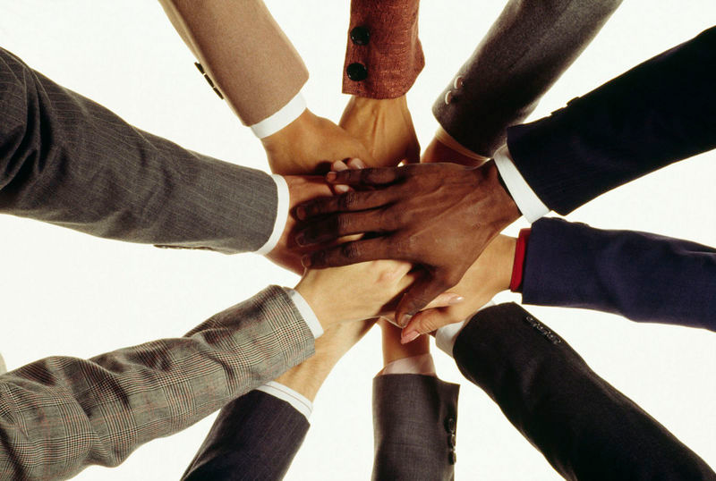
Strong, Adaptive Cultures
Often incorporate the following values:
  The whole is more important than the parts, and boundaries between parts are minimized.
  Equality and trust are primary values.
  The culture encourages risk taking, change, and improvement.

Slide 16
Adaptive VS. Maladaptive Cultures
 | Adaptive Cultures | Maladaptive Cultures
Core Values | Managers care deeply about customers, stockholders, and employees. They value processes that can create useful change. | Managers care about themselves and their immediate work group, and value orderly and risk-reducing processes. They value short-term gains.
Common Behaviours | Managers pay attention to their stakeholders and initiate change to serve their interests. They create an organizational climate that is supportive of employee participation, development, and creativity. | Managers tend to be somewhat isolated, political, and bureaucratic. They tend to resist change and when they must change, they tend to push ideas down the hierarchy and resist employee creativity.

Slide 17
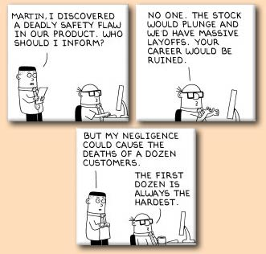
Ethical Values and Social Responsibility
Ethical issues:
  Accounting scandals, personal use of company money, insider trading, etc.
Ethics and economics become reacquainted

Slide 18

Sources of Individual Ethical Principles
Ethics:
  the code of moral principles
  values that governs the behaviours of a person or group with respect to what is right or wrong?
Factors affect individual’s ethical stance:
  Peers, subordinates and supervisors
  Organizational culture

Slide 19
Sources of Individual Ethical Principles
History
Society
Local Environment
Individual

Slide 20
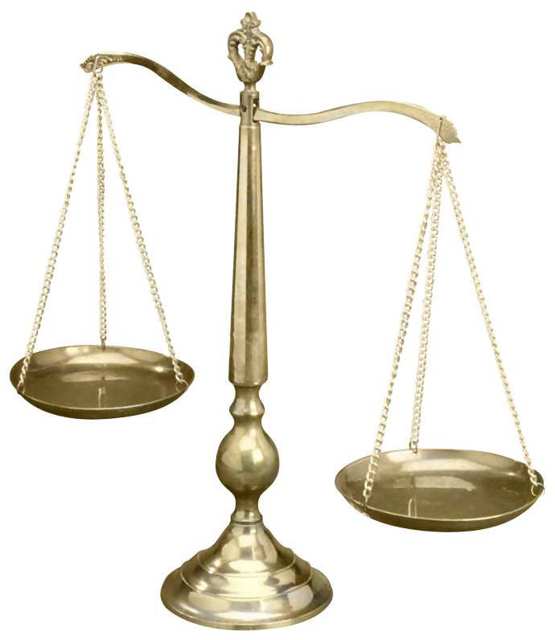
Managerial Ethics and Social Responsibility
Rule of law:
  Codified principles and regulations
  General accepted in society, enforceable in courts
Ethical standard:
  Apply to behaviours not covered by law by moral judgment.
Widespread for unethical conduct

Slide 21

Managerial ethics
  Principles guides managers with respect to which is right or wrong
Social Responsibility
  Managers’ obligation to contribute to stakeholders’ welfare and interest
Ethical dilemma:
  Situations concerning right and wrong in which values are in conflict

Slide 22
Does It Pay to Be Good?
Small positive relationship between ethical behaviors and financial results
  Employees: long term success relies largely on social capital
  Customers: prefer to companies with high commitment to ethics

Slide 23
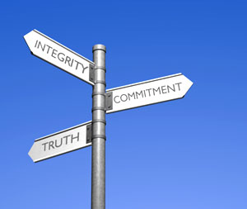
Sources of Ethical Values in Organizations
Ethics is both an individual and an organizational matter
Immediate forces
  Personal Ethics
  Organizational Culture
  Organizational System
  External Stakeholder

Slide 24
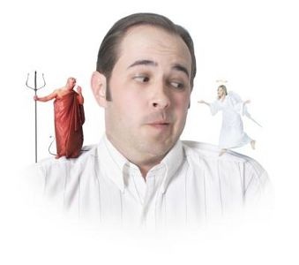
Personal Ethics
Moral development
Ethical framework
  Utilitarian theory:
  generate greatest benefits for most people
  Personal liberty:
  ensure greatest individual freedom
  Distributive justice:
  promote equity, fairness and impartiality

Slide 25
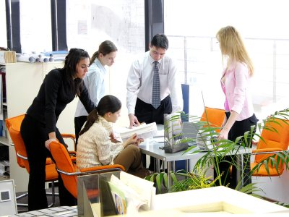
Organizational Culture
Business practices
  Reflect the values, attitudes and behaviour pattern
  Company should make ethics an integral part of organizational culture
Powerful impact on individual ethics

Slide 26
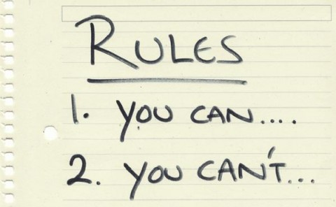
Organizational Systems
Basic architecture of the organization
  Policies and rules
  Code of ethics
  Rewards
  Consideration of selection and training
Formal ethics programs

Slide 27
External Stakeholders
Important external stakeholders
  Government agencies:
    Laws and regulations
  Customers:
    Quality, safety, availability of good and services
  Special-interest groups:
    Environmentalism: sustainable development

Slide 28
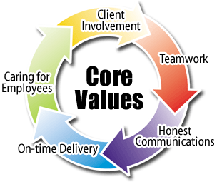
How Leaders Shape Culture and Ethics
Signal and apply values
Culture consistent with strategy and the environment

Slide 29
Strong culture that is adaptable and encourages change
   Improves the performance of the organization by motivating employee
   Forms a cohesive group built around shared goals
Everyone’s actions are aligned with the strategic priorities of the organization

Slide 30
Values and Culture
The CEO and other top managers must be committed to specific values and provide constant leadership in tending and renewing the values.
Values can be communicated in a number of ways - speeches, company publications, policy statements, ACTIONS SPEAK LOUDER THAN WORDS
Organizational effectiveness improved if leaders communicate important values to their employees

Slide 31

Values Based Leadership
“ Relationship between a leader and followers that is based on shared, strongly internalized values that are advocated and acted upon by the leader.”
Culture can be consciously managed in order to shift values and achieve high performance and accomplish goals

Slide 32
Adaptability
  Care deeply about customers, employees and shareholders
  Value process and people, especially customers and create change when needed--even if risk involved
Non-adaptable
  Care mainly about themselves, a work group tied to a product or technology
  Value order and reduced risk more than leadership initiatives
  Do not change strategies quickly or take advantage of changes in business environment

Slide 33

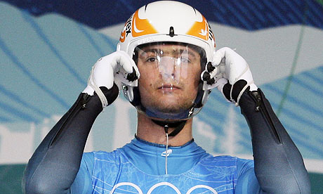
Examples
The Vancouver 2010 Olympic games

Slide 34
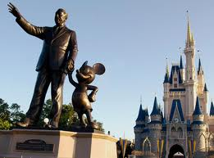
Every statement or action has an impact on culture and values
Executives often use symbols, ceremonies, speeches, and slogans that match the values- employees socialized
“Do what you do so well that they will want to see it again and bring their friends.”
- Walt Disney

Slide 35
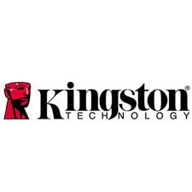
“Business is not about money”
“It’s about relationships”
“They are part of the team”
“They are not owners; they are employees. And that.. Value system is passed on.”

Slide 36
Formal Structure and Systems
Structure - Managers can assign responsibility for ethical values to a specific position
Ethics committee - cross-functional group of executives who oversee company ethics
Chief ethics officer - a high level company executive who oversees all aspects of ethics

Slide 37
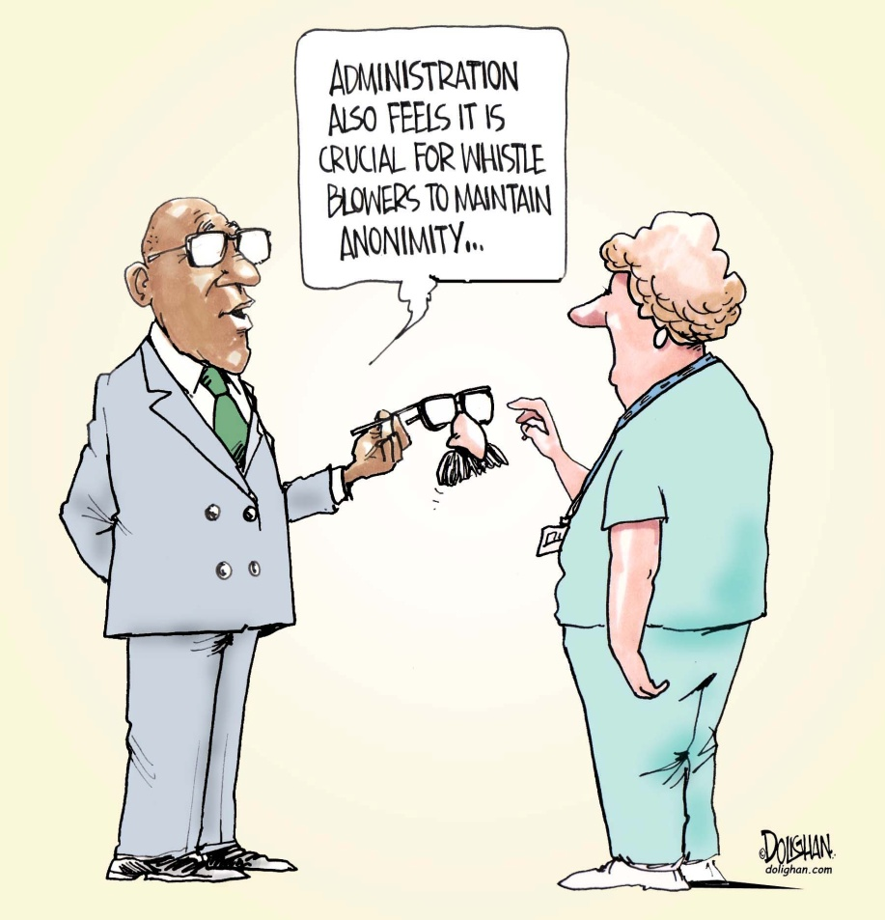
Formal Structure and Systems
Disclosure Mechanisms - purpose to help and protect whistle-blowers
Whistle-blowing – employee discloses practice of an organization that is illegal, immoral, or illegitimate

Slide 38
Code of Ethics
Code of Ethics - a formal statement of the company’s values concerning ethics and social responsibility
Ethical values set standards as to what is good or bad in behaviour and decision making
Ethical decisions are influenced by
  Management’s personal background
  Organizational culture
  Organizational systems

Slide 39
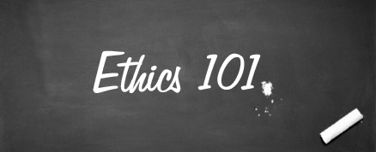
Training Programs
To ensure that ethical issues are considered in daily decision making, companies can supplement a written code of ethics with employee training programs.

Slide 40

Organizational Culture and Ethics in a Global Environment
“ The rest of the world matters to a degree that it never did in the past”.
Employees from different countries
  different attitudes and beliefs
  difficult to establish a sense of community and cohesiveness based on organizational culture

Slide 41
Global Culture
Emphasis on multicultural rather than national values
Status on merit and not nationality
Open to ideas from other cultures
Sensitive to cultural differences but not limited to them

Slide 42

Organizational Culture and Ethics in a Global Environment
Social audit, which measures and reports the ethical, social, and environmental impact of a company’s operations.
Social Accountability 8000

Slide 43

Thank you for listening!

